Slide 1
SDOH of Food Security & Health
Social Determinants of Health
Notes:
For this module we’re going to focus on a particular SDOH: food security. With awareness of the many, and overlapping, social determinants the hope is that by going a little more in depth on one particular SDOH we might see threads the resonate in other areas.

Slide 2
Discussion question
How can an increased awareness of the connection among SDOH-Health Disparities-Health Outcomes influence your interactions with patients?

Slide 3
Objectives
By the end of this track, participants will be able to:
Informally define food insecurity
Discuss how food insecurity is linked to health outcomes

Slide 4
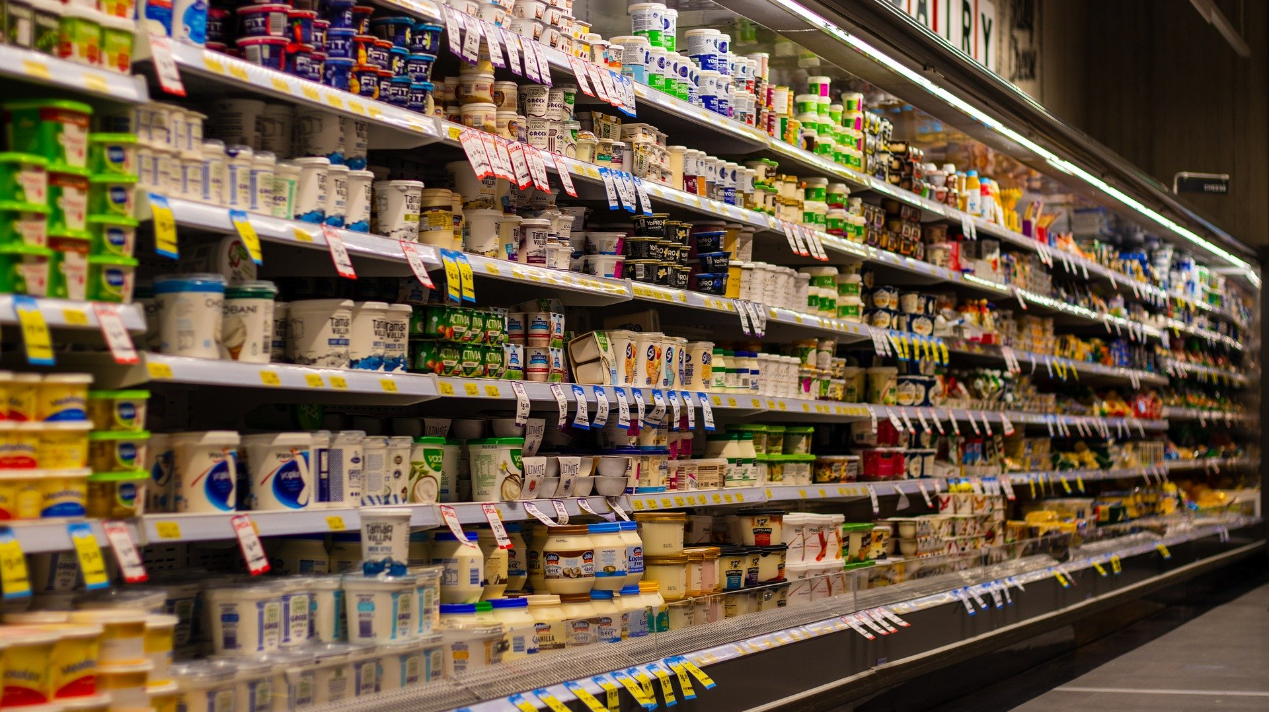
True or False?
Food insecurity is the number one leading cause of obesity, diabetes, and heart disease.
Notes:
We’ll start today’s conversation with a question: true or false, food insecurity is the number one leading cause of obesity, diabetes, and heart disease? [NOTE to FACILITATOR: give the audience as much time as you’d like- this will probably be a quicker answer since they are just choosing true or false]

Slide 5
False.
Notes:
The answer is false. Obesity is multifactorial. The leading cause of obesity lies at the intersection of social and personal treads of overeating, dietary awareness, genetics, inactivity, and education. And choice.¹ One of the other conditions mentioned in the first question was diabetes. In 2015, 30.3 million Americans, or 9.4% of the population, had diabetes². Of the 30.3 million adults with diabetes, 23.1 million were diagnosed, and 7.2 million were undiagnosed². It is the seventh leading cause of death.² The most common cause of cardiovascular disease is atherosclerosis (i.e., a disease of the arteries characterized by the deposition of plaques of fatty material on their inner walls). It can be caused by correctable problems, such as an unhealthy diet, lack of exercise, being overweight and smoking.^{3,4}
A running question for you to consider throughout this module is what connection do these health indicators have with food insecurity? [Note to Facilitator: let the audience know that they do not have to answer now, but just keep this in mind.]

Slide 6
Food Insecurity Defined
“Food insecurity refers to USDA’s measure of lack of access, at times, to enough food for an active, healthy life for all household members and limited or uncertain availability of nutritionally adequate foods. Food-insecure households are not necessarily food insecure all the time. Food insecurity may reflect a household’s need to make trade-offs between important basic needs, such as housing or medical bills, and purchasing nutritionally adequate foods.”⁹
Notes:
As we consider that question, let’s start with a definition of food insecurity from Feeding America South Dakota. You can see here that food insecurity is a term that refers to the USDA’s measure of lack of access at some times to enough food to be healthy and active⁹. An important point of this definition is that food insecure households might not be consistently food-insecure⁹. Instead, there could be a back and forth with paying for all the household needs, including food⁹.

Slide 7
USDA Ranges of Food Security
High food security (old label=Food security): no reported indications of food-access problems or limitations.⁵
Marginal food security (old label=Food security): one or two reported indications—typically of anxiety over food sufficiency or shortage of food in the house. Little or no indication of changes in diets or food intake. ⁵
Low food security (old label=Food insecurity without hunger): reports of reduced quality, variety, or desirability of diet. Little or no indication of reduced food intake. ⁵
Very low food security (old label=Food insecurity with hunger): Reports of multiple indications of disrupted eating patterns and reduced food intake. ⁵
Food insecure
Notes:
Moving from the Feeding America definition, outlined here are the four USDA measures that categorize lack of access from high food security to very low food security. Those with high security do not have any reported problems accessing food⁵. Those with very low food security are people who reported multiple times where they couldn’t eat as much or as frequently⁵. Food insecure households include those with low or very low food security. The experience of food insecurity falls along a spectrum, and as noted previously, can fluctuate based on competing financial needs from month-to-month or week-to-week.

Slide 8
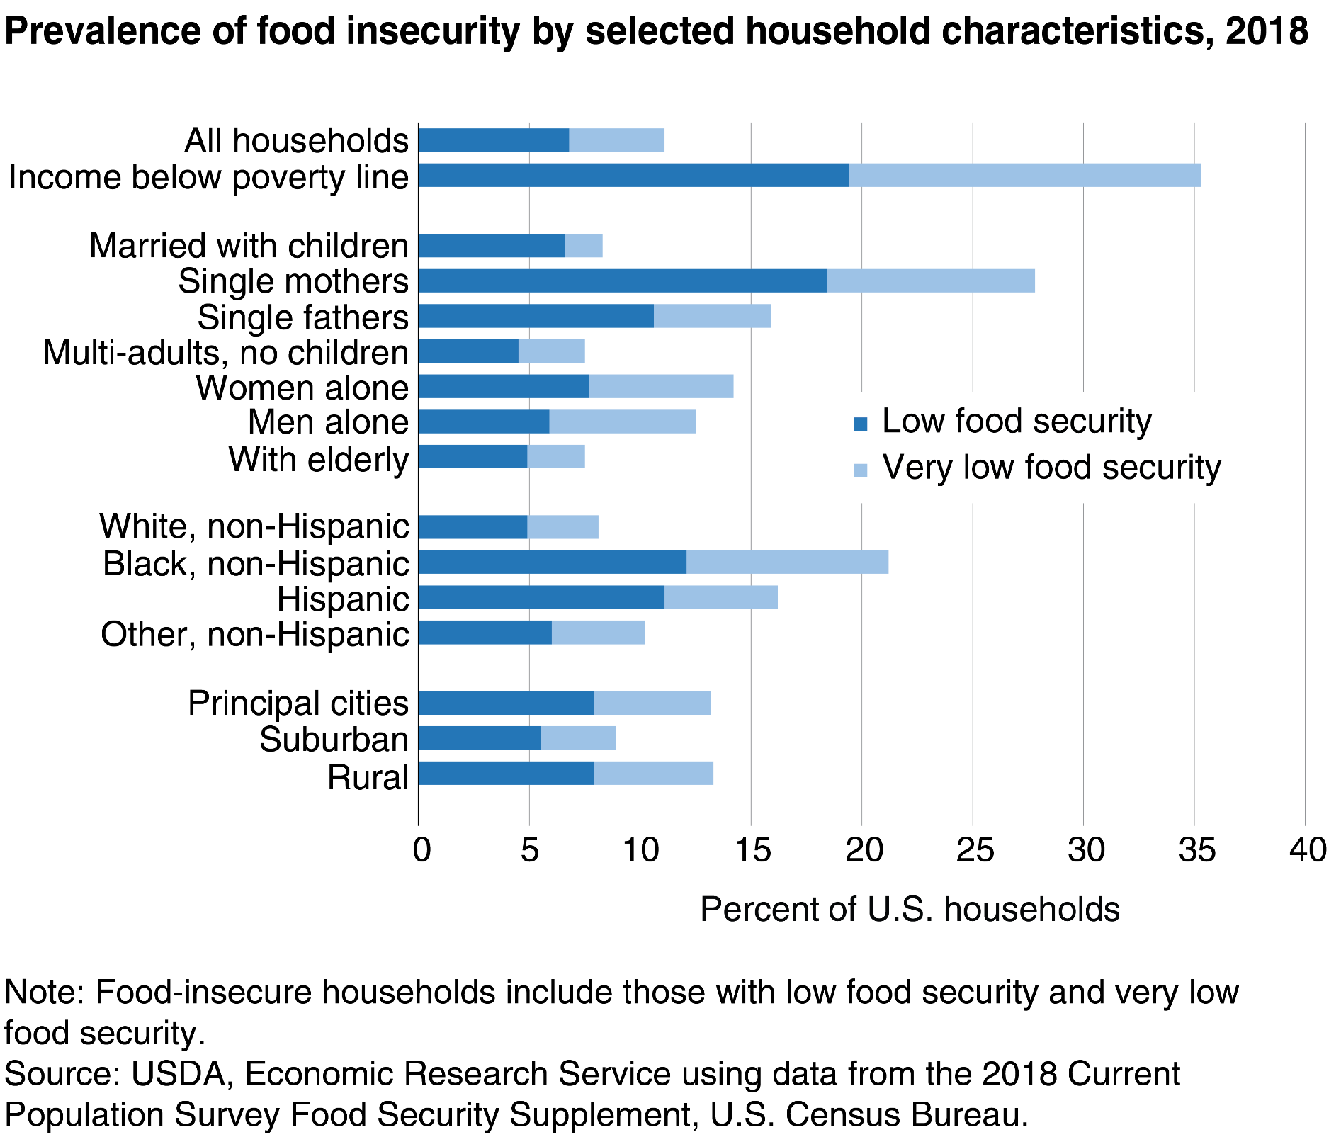
Prevalence of Food Insecurity
Fig. 1 United States Food and Drug Administration (2019). Food insecurity rates are highest for single mother households and households with incomes below poverty line. Retrieved from: URL to Source
Notes:
The prevalence of food insecurity varies widely across subgroups of the U.S. population. Some groups experience disparities, whereby they are more likely to be food insecure than others. For example, food insecurity tends to be more prevalent in for those living below the poverty line, in households with children and in single-parent households, in particular. In 2018, 35.3% of households with incomes below the Federal poverty line were food insecure and13.9% of households with children were food insecure, which equates to 1 in 7 households with children.⁶ In 2017, children accounted for 43.4 percent of all SNAP participants and in 2016, 31.6 percent of single-mother households and 21.7 percent of single-father households were food insecure.
While we are discussing the link between food insecurity and poverty, it is important to note that although food insecurity is closely related to poverty, not all people living below the poverty line experience food insecurity and people living above the poverty line can experience food insecurity¹¹.

Slide 9
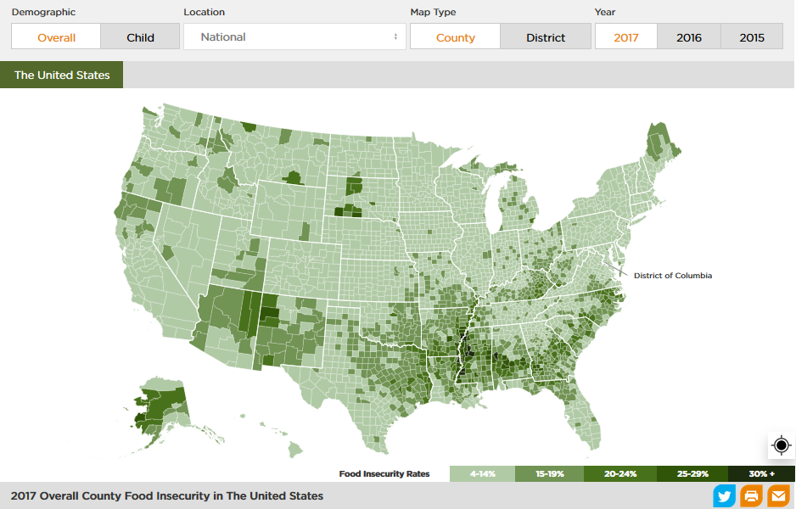
Food Insecurity in Your Community
Notes:
If you are interested in local statistics about food insecurity, Feeding America’s Map the Meal Gap highlights food insecurity rates, estimated public benefit program eligibility, average meal cost, and the money required to meet food needs.
[Note to Facilitator: visit map at https://map.feedingamerica.org/, look up your community to see details at your local level. See how this compares with what others understand or are experiencing, anecdotally or otherwise.]

Slide 10
Food Insecurity & Health
“The leading cause of obesity lies at the intersection of social and personal treads of overeating, dietary awareness, genetics, inactivity, and education.”¹
“You are more likely to develop type 2 diabetes if you are not physically active and are overweight or obese… certain genes also may make you more likely to develop type 2 diabetes.”¹²
The most common cause of cardiovascular disease is plaques of fatty material on arterial inner walls. It can be caused by issues such as an unhealthy diet, lack of exercise, being overweight and smoking. ^{3,4}
Notes:
So let’s return to our true/false question. While the answer is false because causation is difficult to determine because of multiple and overlapping factors for each of those health indicators, like the ones that you see highlighted on the slide. often there is a paradox at play that perhaps seems counterintuitive. Let’s think about just obesity. Research indicates that higher rates of obesity are linked to increased food insecurity⁷. This has been shown to be more true to women than men⁷.

Slide 11
Obesity and Food Insecurity
Children who grow up in poverty are more likely to become obese adults⁷
People who must limit food costs will select lower-quality diets⁸
Notes:
A couple of considerations of why this is:
First, it has been suggested that children who grow up in poverty are more likely to become obese adults and, thus, childhood food insecurity as a result of poverty may amplify the effect of poverty on adult obesity⁷.
Second, the low cost of energy-dense foods (high calories, think ice cream, potato chips, fried foods) may promote overconsumption of energy, leading to weight gain. To maintain adequate energy intake, people who must limit food costs will select lower-quality diets, consisting of high-energy, inexpensive foods. Often this is what’s available at the local corner store⁸.
Given that being overweight can be causes of both type 2 diabetes and cardiovascular disease, we can begin to see a thread that runs from food insecurity to each of these health indicators.

Slide 12
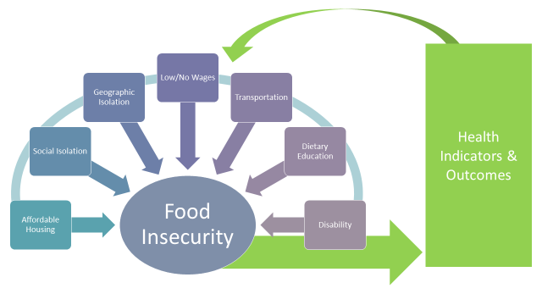
Interconnected Cycle of Food Insecurity, SDOH Factors & Health
Notes:
SDOH factors are often interconnected. Geographic isolation or living in poverty influences food insecurity, therein impacting health. One’s health, depending on nature and severity, can then impact a person’s capacity to find gainful work or access healthful, nutritious foods. And the cycle continues. ​
​
While poverty is not synonymous with food insecurity, social, economic, and educational disparities increase the likelihood they experience more of these overlapping issues more frequently. Transportation is also a large governing factor to accessing healthful, nutritious foods​
​
“Food insecurity does not exist in isolation, as low-income families are affected by multiple, overlapping issues like lack of affordable housing, social isolation, chronic or acute health problems, high medical costs, and low wages.”¹¹

Slide 13
Ask One More Question
In the past 12 months, have you worried if food would run out before you had money to buy more?*
Do you know where to access/find vegetables and fruits (local produce programs)?**
Do you have a way to get to and from the produce program?
Notes:
So, what do we do as providers? Asking one more question presents to opportunity to address food insecurity in the moment.
Please do not shy away from asking one more question for which you may not have an immediate answer. Far too often the people we care for become stuck in the same unhealthy rut/routine because we do not ask these things.
*There’s an ICD-10 z-code for this: Z59.4
**Do you, as a provider, know where these are? Or who to connect with who does?

Slide 14
Take home message
Consider:
What assumptions have you made about patients and their diet?
What are the barriers to accessing healthful food for people in your community?
Remember:
Where someone lives often determines their access to nutritious foods.
Developed resources reported in this presentation are supported by the National Library of Medicine (NLM), National Institutes of Health (NIH) under cooperative agreement number UG4LM012342 with the University of Pittsburgh, Health Sciences Library System. The content is solely the responsibility of the authors and does not necessarily represent the official views of the National Institutes of Health.
Notes:
As you move forward in the coming (week/month/etc.) I ask you to consider how more intentionally attending to SDOH might change how you care for your patients – or, if you already do so, think about what might happen if more of your colleagues did as well. What challenges might or currently do hinder your ability to attend to SDOH issues?
NOTE TO FACILITATOR: If combining modules or using them out of suggested sequence, delete this slide or rearrange for your needs. This is Module 1 of the Social Determinants of Health (SDOH) Track.

Slide 15
References
Lee A, Cardel M, Donahoo WT. Social and Environmental Factors Influencing Obesity. 2019 Oct 12. In: Feingold KR, Anawalt B, Boyce A, et al., editors. Endotext [Internet]. South Dartmouth (MA): MDText.com, Inc.; 2000-. Available from: URL to Source
American Diabetes Association (n.d). Statistics About Diabetes. Available at: URL to Source
U.S. National Library of Medicine. MedlinePlus. Heart Diseases. Available at: URL to Source
Frostegård J. Immunity, atherosclerosis and cardiovascular disease. BMC Med. (2013) 11:117. 10.1186/1741-7015-11-117. Available at: URL to Source
United States Department of Agriculture. Definitions of Food Insecurity. Available at: URL to Source
Rabbitt, M., Coleman-Jensen, A. and Gregory, C. USDA ERS - Understanding the Prevalence, Severity, and Distribution of Food Insecurity in the United States. USDA.gov, 2019. Available at: URL to Source
Dinour LM, Bergen D, Yeh MC. The food insecurity-obesity paradox: a review of the literature and the role food stamps may play. Journal of the American Dietetic Association. 2007;107(11):1952–61. doiI: URL to Source
Dhurandhar EJ. The food-insecurity obesity paradox: A resource scarcity hypothesis. Physiol Behav. 2016;162:88–92. doi:10.1016/j.physbeh.2016.04.025
Feeding South Dakota (2019). What is “Food Insecurity?”. Retrieved from: URL to Source
United States Food and Drug Administration (2019). Food insecurity rates are highest for single mother households and households with incomes below poverty line. Retrieved from: URL to Source
Hunger + Health (2019). What is Food Insecurity? Retrieved from: URL to Source
National Institute of Diabetes and Digestive Kidney Diseases [NIDDK] (2016). Symptoms & Causes of Diabetes. Retrieved from: URL to Source

