Slide 1
Course Approval 101- Consumer Health for Library Students
Notes:
Hello! Welcome to today’s session, Course Approval 101- Consumer Health for Library Students

Slide 2
Agenda
Introductions
The Medical Library Association(MLA)
Consumer Health Information Specialization(CHIS)
Consumer Health for Library Students
Universities Approved to Offer CHIS
Requirements & Steps for Class Approval
Faculty Spotlight: Brenda Linares,MLIS, MBA, AHIP
Student Spotlight: Maggie Hairabedian
Q & A
Notes:
Today’s session agenda is as follows
Introductions
The Medical Library Association(MLA)
Consumer Health Information Specialization(CHIS)
Consumer Health for Library Students
Universities Approved to Offer CHIS
Requirements & Steps for Class Approval
Faculty Spotlight: Brenda Linares,MLIS, MBA, AHIP
Student Spotlight: Maggie Hairabedian
Q & A

Slide 3
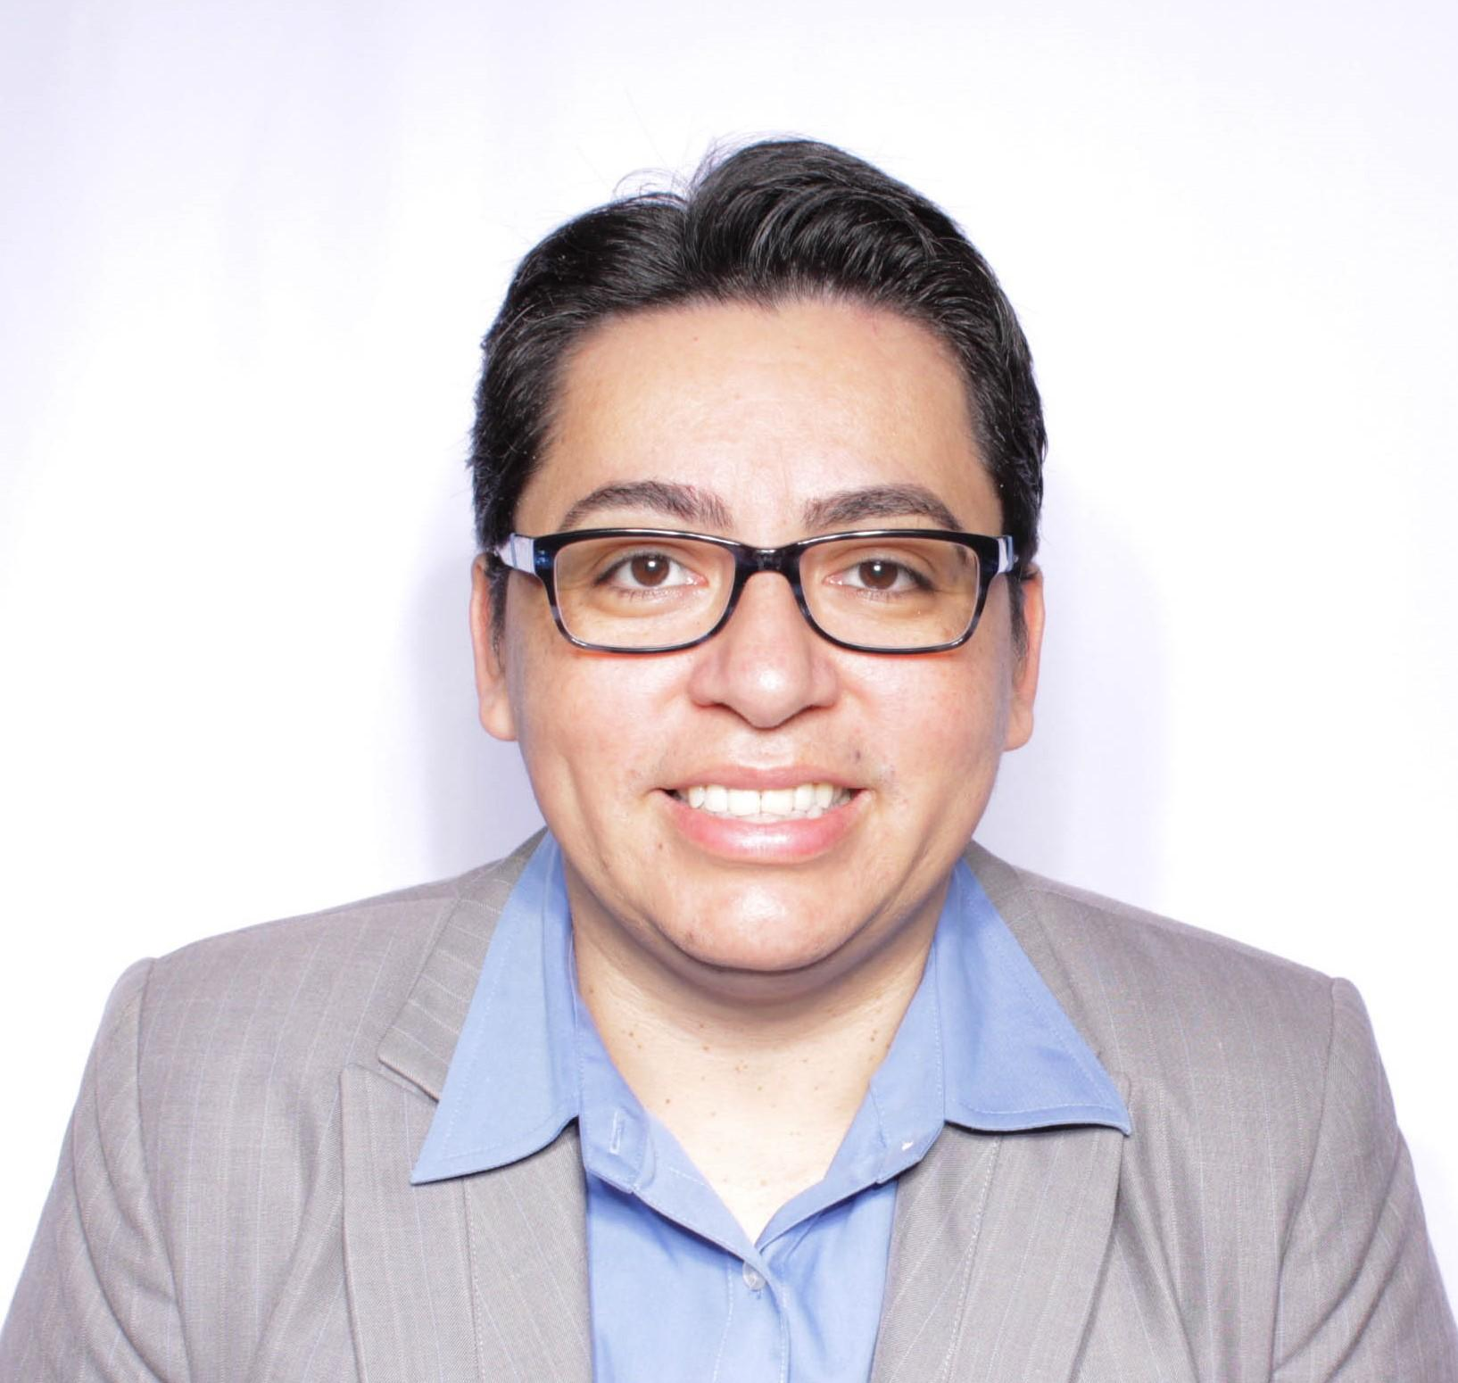
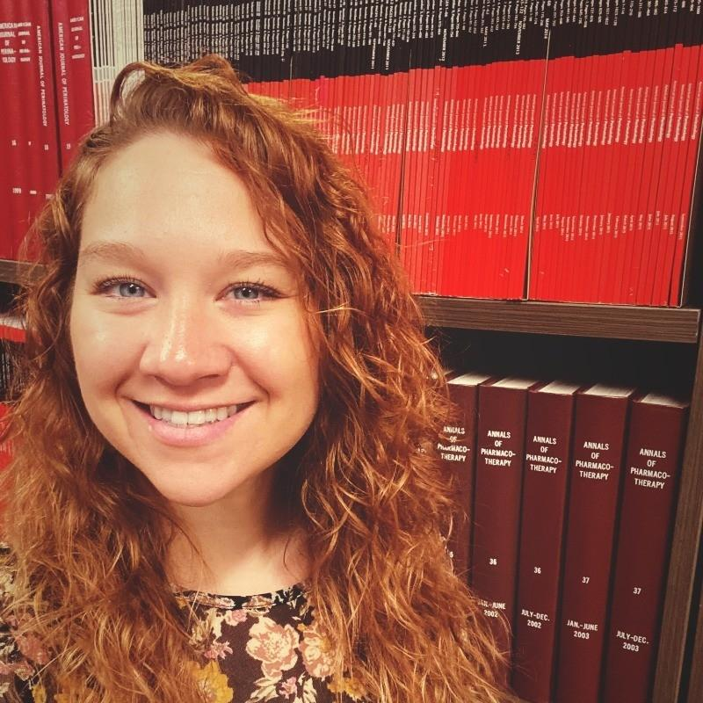
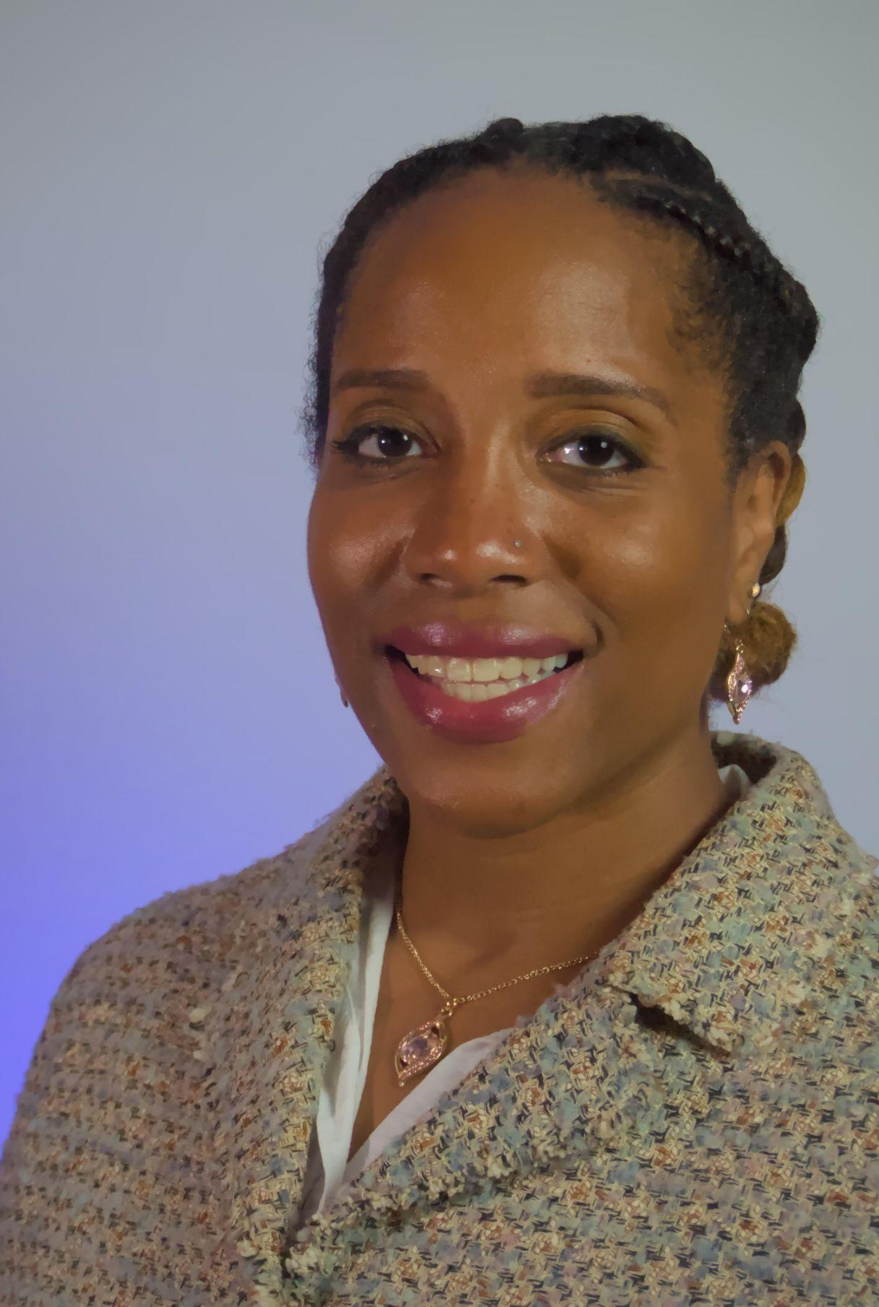
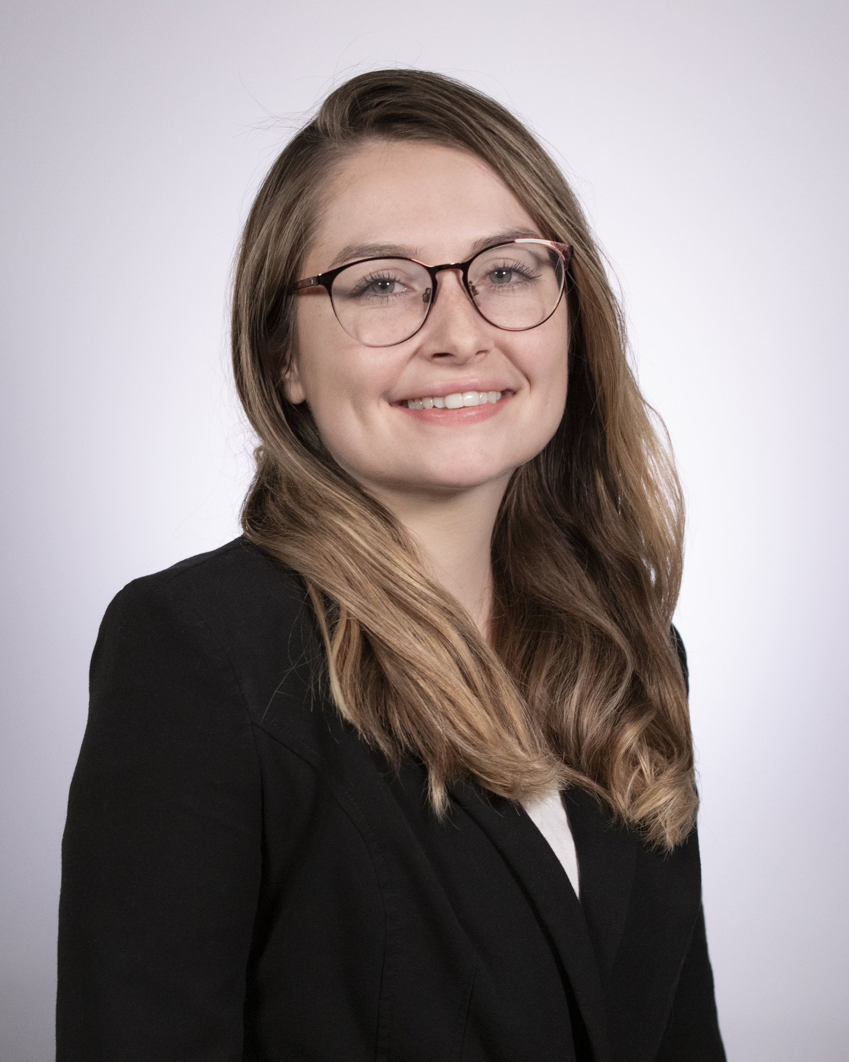
Guest Speakers
Brenda Linares, MLIS, MBA, AHIP
Adjunct Instructor
School of Library and Information Management
Emporia State University
Maggie Hairabedian, MLS, MA, BA
Medical Librarian
Wesley Medical Center (HCA) - Wichita, KS
Jamia Williams, MLS
Consumer Health Program Specialist
NNLM Training Office
University of Utah
Samantha Nunn
Program Manager
NNLM Training Office
University of Utah
Notes:
Hello, my name is Jamia Williams. I am the Consumer Health Program Specialist at the Network of the National Library of Medicine Training Office(NTO). Today, I have colleague Sam Nunn who is a Program Manager from the NTO helping me co-faciliate today’s session. Sam is here to answer any questions that you may have about the program.
In today’s session, Brenda Linares is our faculty spotlight speaker and Maggie Hairabedian is our student spotlight speaker

Slide 4
The Medical Library Association
The Medical Library Association (MLA) is a global, nonprofit educational organization, with a membership of more than 400 institutions and 3,000 professionals in the health information field. Since 1898, MLA has fostered excellence in the professional practice and leadership of health sciences library and information professionals to enhance health care, education, and research throughout the world. MLA educates health information professionals, supports health information research, promotes access to the world’s health sciences information, and works to ensure that the best health information is available to all.
Website: https://www.mlanet.org
Notes:
I want to set the foundation for today’s session with some background information.
The Medical Library Association (MLA) is a global, nonprofit educational organization, with a membership of more than 400 institutions and 3,000 professionals in the health information field. Since 1898, MLA has fostered excellence in the professional practice and leadership of health sciences library and information professionals to enhance health care, education, and research throughout the world. MLA educates health information professionals, supports health information research, promotes access to the world’s health sciences information, and works to ensure that the best health information is available to all.

Slide 5
What is CHIS?
Consumer Health Information Specialization is a way that librarians, other information, and health professionals to acquire skills and knowledge needed to become a confident, expert provider of health information to your community. Your CHIS shows employers, colleagues, and the public you serve that you are committed to offering quality consumer health information services and to staying current with developments in consumer health information resources, technologies, and services.
For more information about CHIS
Consumer Health Information Specialization (MLA CHIS webpage)
Chart Your Path to CHIS (NNLM CHIS webpage)
Notes:
So what is CHIS?
CHIS is the Consumer Health Information Specialization is a way that librarians, other information, and health professionals to acquire skills and knowledge needed to become a confident, expert provider of health information to your community. Your CHIS shows employers, colleagues, and the public you serve that you are committed to offering quality consumer health information services and to staying current with developments in consumer health information resources, technologies, and services.

Slide 6
Consumer Health for Library Students
In partnership with MLA, NNLM guides LIS and iSchool professors on getting their class approved to offer CHIS certificates to students.
Students earning a CHIS certificate through their LIS program is a great way for students to show their future employers that they’ve gained skills and the knowledge in becoming a confident in providing health information services to consumers.
Notes:
In partnership with MLA, NNLM guides LIS and iSchool professors on getting their class approved to offer CHIS certificates to students.
Students earning a CHIS certificate through their LIS program is a great way for students to show their future employers that they’ve gained skills and the knowledge in becoming a confident in providing health information services to consumers.
Additionally, this is a great tool to use to recruit more students to register for your class and introduce students to the health sciences and medical librarianship.
Usually there is $99 application fee that recipients would have to pay to receive their certification. However through NNLM’s CHIS sponsorship program, NNLM will cover the entire application fee. So it is 100% free to the students.

Slide 7
Universities Approved to Offer CHIS
Notes:
There are currently 8 LIS/iSchool Programs participating in the program, with a total of 12 classes approved to offer level 1 and level 2 CHIS certificates.
Examples of classes approved to offer CHIS certificates are Consumer Health Information, Fundamentals of Medical Librarianship, Consumer Health Informatics and Graphic Novels in Libraries.
We would love to have your program be part of this list!

Slide 8
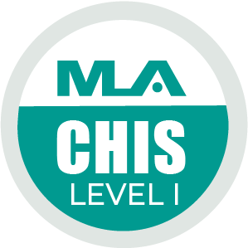
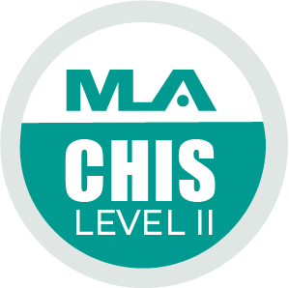
What are the Requirements to Have Your Class MLA-Approved as a Consumer Health Course?
Your course must address one or more of the eight core competencies:
CHIS Competencies
Required for Level 1
C1 - Know the Community
C2 - Know the Health Consumer
C3 - Knowledge of Subject Matter and Resources
C4 - Evaluation of Health Information
C5 - Communication, Reference, and Instruction
Required for Level 2, in addition to Level 1 requirements
C6 - Literacy and Health Literacy
C7 - Technology and Health
C8 - Ethical and Legal Issues
Notes:
In order to get approved to offer CHIS, your course must address one or more of the eight core competencies for providing consumer health information services. NNLM and MLA will work with you to ensure that your coursework entails the CHIS competencies listed.
To qualify for a level 1 certificate, the class must cover:
C1 - Know the Community
C2 - Know the Health Consumer
C3 - Knowledge of Subject Matter and Resources
C4 - Evaluation of Health Information
C5 - Communication, Reference, and Instruction
To qualify to offer level 2 certificates, the class must cover the following competencies in addition to the Level 1 requirements
C6 - Literacy and Health Literacy
C7 - Technology and Health
C8 - Ethical and Legal Issues
Each level requires 12 MLA CE credit hours of coursework.

Slide 9
Steps 1 and 2 to get course approved by MLA
Step 1: Contact Sam Nunn at NNLM and Jim Westwood from MLA to notify your interest in applying to get your course approved to become an MLA consumer health information course.
Step 2: Email Jim Westwood your course syllabus and a description of how the course covers one or more of the eight CHIS competencies for review.
You are welcome to use the table located on page 3 of the MLA Course Approval Guides to describe which competencies the course covers.
Samantha Nunn
Program Manager
NNLM Training Office
University of Utah
sam.nunn@utah.edu
Jim Westwood
Membership Concierge &
Professional Development
Administrator
jim.westwood@mlahq.org
Notes:
Now I will explain how to get your course approved to offer CHIS. The instructions I am sharing today will be made available on NNLM’s website soon.
As some of you may know, MLA’s main website and MEDLIB-ED was recently updated and there still working on getting some pages up and running, including the application to apply to offer CHIS. The steps and information required for the application will remain the same as before. Once the webpages are available, we will send all registrants the guide on how to apply to get a course approved to offer CHIS with the links to the pages.
Step 1: Contact Sam Nunn at NNLM and Jim Westwood from MLA to notify your interest in applying to get your course approved to become an MLA consumer health information course. This will let MLA and NNLM know that they will be expecting an application from you.
Step 2: Email Jim Westwood your course syllabus and a description of how the course covers one or more of the eight CHIS competencies for review. You are welcome to use the table located on page 3 of the MLA Course Approval Guides to describe which competencies the course covers.
By providing MLA the description of how the class covers the CHIS competencies prior to your official application submission, they can provide feedback on how it can be improved to ensure it covers the CHIS competencies, if necessary, and to address any questions they might have about your class. This is an opportunity to answer there questions and make any adjustments before your final submission. Plus this is a great way for MLA to get to know more about the course.

Slide 10
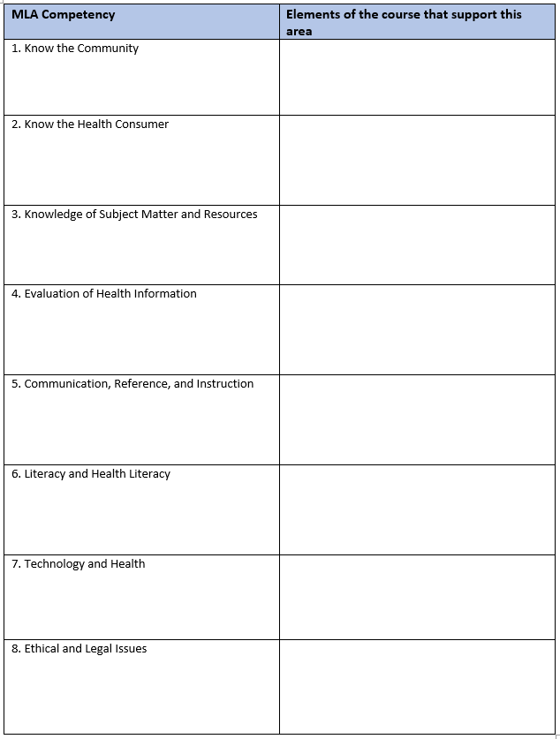
Table Example
Notes:
Here is the example of the the table located on page 3 of the MLA Course Approval Guides to describe which competencies the course covers.

Slide 11
Step 3 to get course approved by MLA
Step 3: Once Jim Westwood verifies that your course aligns with one or more CHIS competencies, go to the MLA application portal to fill out your application.
Note that you do not have to be an MLA member to apply. You will need to have an MLA account to complete the form. Feel free to request a guest account if you are not a MLA member.
Notes:
Step 3: Once Jim Westwood verifies that your course aligns with one or more CHIS competencies, go to the MLA application portal to fill out your application.
Note that you do not have to be an MLA member to apply. You will need to have an MLA account to complete the form. Feel free to request a guest account if you are not a MLA member.

Slide 12
Steps 4 and 5 to get course approved by MLA
Step 4: Throughout the process, please keep in touch with Jim and Sam on the status of your application. If you have any questions about the required information, please contact Jim Westwood or Sam Nunn for assistance.
Step 5: Once you've submitted the form, notify Jim Westwood and Sam Nunn of your completion. MLA will review your application, and a representative will contact you about your submission.
Notes:
Step 4: Throughout the process, please keep in touch with Jim and Sam on the status of your application. If you have any questions about the required information, you’re welcome to contact Jim or Sam Nunn.
Step 5: Once you've submitted the form, notify Jim Westwood and Sam Nunn of your completion. MLA will review your application, and a representative will contact you about your submission.

Slide 13
Items to keep in mind as you fill out the form: Submission Type
When choosing the submission type, select “NLM and NNLM Courses Only”, This selection helps MLA identify if you are participating in the Consumer Health for Library Students Program.
Notes:
Now I will share some important information to keep in mind as you fill out your application online.
When choosing the submission type, select “NLM and NNLM Courses Only”. This selection helps MLA identify that you are participating in the Consumer Health Information Specialization for Library Students program and you won’t be charged the usual fee associated with offering CHIS certificate. If you do receive a notification for payment, don’t pay the fee, reach out to Sam and Jim and they’ll take care of it.
Through this partnership, MLA will not charge the application fee for anyone participating in the program. If you receive a notification for payment, reach out to Sam Nunn.

Slide 14
Items to keep in mind as you fill out the form: Credits
When you have reached the “MLA CE Credits” section of the form, it will ask you to indicate how many MLA CE hours you seek approval. The CE hours can be determined by the number of hours of in-person work done in the class.
One hour of in-person work is equivalent to one CE credit.
Notes:
When you have reached the “MLA CE Credits” section of the form, it will ask you to indicate how many MLA CE hours you seek approval. The CE hours can be determined by the number of hours of in-person work done in the class.
One hour of in-person work is equivalent to one CE credit.

Slide 15
Items to keep in mind as you fill out the form: Approval Term
When you have reached the term approval section, it will ask you to indicate how long you would like your course to be eligible for MLA CE. Click the drop-down button and choose "3 years". The program offers to cover all the fees related to having your course offer MLA CE credit for up to 3 years.
Notes:
When you have reached the term approval section, it will ask you to indicate how long you would like your course to be eligible for MLA CE. Click the drop-down button and choose "3 years". This will allow you to offer MLA CE credit for up to 3 years. There are no additional fees.

Slide 16
Items to keep in mind once class is approved
If you are planning to teach your class again, you will need to fill out the “Schedule a Course on the MEDLIB-ED" form to schedule the course on MEDLIB-ED before the semester begins.
This form notifies MLA that you are teaching the class again. They will generate a new code for you to give to your future students to claim credit after completing the course.
If you don’t want your class listed on MEDLIB-ED, you can notify MLA to remove your class from the list.
Notes:
If you are planning to teach your class again, you will need to fill out the “Schedule a Course on the MEDLIB-ED" form to schedule the course on MEDLIB-ED before the semester begins.
This form notifies MLA that you are teaching the class again. They will generate a new code for you to give to your future students to claim credit after completing the course.
If you don’t want your class listed on MEDLIB-ED, you can notify MLA to remove your class from the list. Some universities like having their class promoted on the MEDLIB-ED. While others prefer to have it not listed.

Slide 17
Brenda Linares, MLIS, MBA, AHIP (she/her)
Linares is an adjunct instructor in the School of Library and Information Management at Emporia State University.
She teaches courses on information seeking behavior, consumer health, and health sciences librarianship.
Her research interests include outreach, consumer health, instruction and technology, health literacy, patient education and evidence-based research, mentoring, DEI, and leadership and management.
Notes:
Brenda Linares, the Associate Dean of Library Services at UMKC Libraries at the University of Missouri-Kansas City (UMKC).
Brenda was previously the School of Nursing liaison at the University of Kansas Medical Center. Brenda received her bachelor’s in finance from California State University, Northridge. She also has a Master of Library and Information Science from the University of California, Los Angeles, and a Master of Business Administration from North Carolina State University. She is a member of the Academy of Health Information Professionals (AHIP).
She loves working and building relationships with students, faculty, researchers, and the community. Brenda currently serves on the Medical Library Association (MLA) Board of Directors. She recently started her term as President of the Medical Library Association (2024-2025).
She has worked with diverse populations promoting health literacy and consumer health education. Her interests include outreach, consumer health, instruction and technology, health literacy, patient education and evidence-based research, mentoring, DEI, and leadership and management. Her extensive expertise and experience as a health sciences librarian has provided her with the opportunity to teach as an adjunct instructor for Emporia State School of Library and Information Management (SLIM) where she has taught courses on Information Seeking Behavior, Consumer Health, and Health Sciences Librarianship.
Brenda will share her success story in teaching CHIS-certified courses through Emporia State University.

Slide 18
Maggie Hairabedian (she/her)
Hairabedian is a Medical Librarian at Wesley Medical Center (HCA) in Wichita, KS.
Education
Master of Library Science - Emporia State University
Master of Art in English - Pittsburg State University
Bachelor of Art in English - Pittsburg State University
MLA’s Consumer Health Information Specialization - Level II
Notes:
Maggie will share her experience receiving a CHIS certification from ESU’s LIS program. Now we will give the floor to Maggie!
Questions to ask Maggie (if she hasn’t already answer them)
How did you hear about the certification?
Share your experience receiving a CHIS certificate through your LIS program.
Share your experience applying for the certification. Was it easy, straightforward, etc.
How did the certification benefit your current or future role? Give examples of applying what you’ve learned in the CHIS-certified class in your current work or future librarian role.
Do you have any advice for LIS/iSchool students looking to earn their CHIS certification?
Any advice for professors on the fence about offering CHIS certificates?

Slide 19
Questions?
Notes:
Thank you for attending today’s session. We appreciate hearing from our speakers and thank you for speaking with us today.
Now we will move on to the Q & A portion of today’s session. Please feel free to put your questions in the chat or raise your hand so we can call on you to speak.
sam and jamia

Slide 20
Contact Information
Jamia Williams, MLS
Consumer Health Program Specialist
NNLM Training Office
University of Utah
jamia.williams@utah.edu
Brenda Linares, MLIS, MBA, AHIP
Adjunct Instructor
School of Library and Information Management
Emporia State University
blinares@emporia.edu
Samantha Nunn
Program Manager
NNLM Training Office
University of Utah
sam.nunn@utah.edu
Notes:
Here is our contact information. Please feel free to email us with any questions that you may have. Thank you again for attending today’s session.
sam and jamia

