Slide 1
Finding Environmental Health Information in PubMed
Kelly Miller & Stacey Mantooth Vista Technology Contractors NIEHS Library National Institute of Environmental Health Sciences

Slide 2
About NIEHS
One of the 27 institutes and centers that make up the National Institutes of Health (NIH), which is part of the US Department of Health and Human Services
Dedicated to the study of environmental health
Also home to the National Toxicology Program
Located in Durham County, NC in Research Triangle Park
Notes:
First, a little about the NIEHS. We’re one of the 27 institutes that make up the National Institutes of Health and our focus is on the study of environmental health. We’re located in what’s known as Research Triangle Park, which is the largest research park in the United States, occupying 7,000 acres and hosting more than 300 organizations. It’s called Research Triangle Park because of its location relative to the three surrounding cities of Raleigh, Durham, and Chapel Hill, or more specifically, for the three major research universities here: North Carolina State University in Raleigh, Duke University in Durham, and the University of North Carolina at Chapel Hill.

Slide 3
Learning Objectives
By the end of this webinar, participants will be able to:
Define environmental health and identify possible environmental health exposures
Summarize environmental health related resources and features within PubMed
Use the PECO framework to develop a research question
Select and apply relevant MeSH terms to create a search query
Notes:
So, today I am going to start by giving a brief overview of environmental health, including the different types of environmental exposures and some of the major concepts in environmental health. Then, I’ll talk about what type of environmental health information you can expect to find in PubMed. Then I’ll hand it over to Stacey to talk about developing research questions using the PECO framework, selecting relevant Mesh terms, and for a demonstration on finding environmental health information in PubMed.

Slide 4
What is environmental health?
“Environmental health is the branch of public health that: focuses on the relationships between people and their environment; promotes human health and well-being; and fosters healthy and safe communities. Environmental health is a key part of any comprehensive public health system. The field works to advance policies and programs to reduce chemical and other environmental exposures in air, water, soil and food to protect people and provide communities with healthier environments.” (American Public Health Association, “Environmental Health”)
Notes:
So, what is environmental health? Many people might hear “environmental health” and think that means “the health of the environment”, but it’s actually a branch of public health that focuses on how the environment affects human health. It’s a very broad umbrella of topics that includes things you might typically think of, like air pollution, and also things you may not have considered, like lifestyle or socioeconomic factors.

Slide 5
Why is environmental health important?
“13.7 million of deaths per year in 2016, amounting to 24% of the global deaths, are due to modifiable environmental risks. This means that almost 1 in 4 of total global deaths are linked to environment conditions.” (WHO, “Environmental Health”)
Notes:
So, why is “environmental health” important? As you can see from this data from the World Health Organization, almost a quarter of global deaths can be attributed to environmental factors. The environment plays a major role in our health and so it’s critical that we better understand how and why the environment affects us.
Image Source: https://www.who.int/data/gho/data/themes/public-health-and-environment

Slide 6
Top Causes of Death from the Environment
Ischaemic Heart Disease: 2.4 million
Chronic Respiratory Diseases: 1.9 million
Cancers: 1.8 million
Unintentional Injuries: 1.5 million
Respiratory Infections: 1.5 million
Stroke: 1.5 million
Diarrhoeal Diseases: 829,000
Diabetes: 391,000
Malaria: 355,000
Neonatal Conditions: 244,000
8.5 million out of 13.7 million deaths caused by the environment are due to non-communicable diseases.
From the World Health Organization
Notes:
This infographic shows the leading causes of death from environmental factors. Most of them are caused by noncommunicable diseases like heart disease, diabetes, cancer, and respiratory diseases. But there are also communicable diseases like malaria and, of course, things like covid-19 which has become a leading cause of death in recent years (though is not reflected here since this infographic is from 2019).
Image Source: https://www.who.int/activities/environmental-health-impacts

Slide 7
How the environment impacts your health
Notes:
This is another infographic from the WHO that gives a nice overview of the different types of environmental exposures, which I’ll now go into a little more detail on.
Image Source: https://www.who.int/activities/environmental-health-impacts

Slide 8
Air Pollution
Outdoor air pollution
Smog
Wildfire smoke
Vehicle emissions
Pollen
Indoor air pollution
Smoke from stoves/fireplaces
Dust/pet dander/mold
Noxious gases (ie: carbon monoxide)
Particulate Matter (PM): a mixture of solid and liquid droplets found in the air that can contain up to hundreds of different chemicals
Particle pollution includes:
PM10 : inhalable particles, with diameters that are generally 10 micrometers and smaller; and
PM2.5 : fine inhalable particles, with diameters that are generally 2.5 micrometers and smaller.
Notes:
First, we have air pollution, which is usually categorized as either outdoor air pollution – things like smog or wildfire smoke or even pollen - or indoor air pollution – such as from smoke from stoves/chimneys, dust/pet dander or gases like carbon monoxide. One of the most important concepts related to air pollution is particulate matter, which is a mixture of solid and liquid droplets in the air that can be inhaled and can contain up to hundreds of different chemicals. As you can see from this graphic from the EPA, particulate matter is very small – small enough to get into your lungs or bloodstream, which is why particulate matter is so harmful.
Image Source: https://www.epa.gov/pm-pollution/particulate-matter-pm-basics

Slide 9
Water Pollution
Chemical run-off from factories/agriculture
Waste/plastic pollution
Harmful algal blooms
Chemicals in drinking water
Oil spills
Notes:
Next, we have water pollution, such as from chemical run-off from factories like the one in the top right (a factory in Russia). Another example is waste/plastic pollution – for instance, you may have heard of the “Great Pacific Garbage patch” which is a large area of waste in the Pacific. That’s actually only 1 of 5 “garbage patches” in the world’s oceans. There’s also things like toxic algae blooms, as shown in the bottom right picture, and things like lead or other chemicals in drinking water, as well as man-made disasters like oil spills.

Slide 10
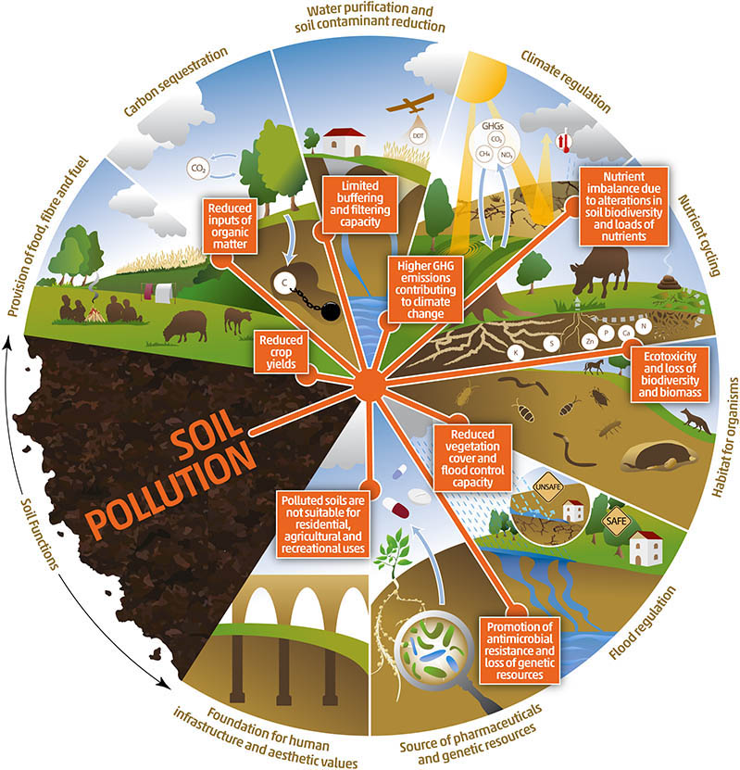
Soil Pollution
Contamination from:
Industrial waste/landfills
Agriculture
Radioactive sites/nuclear disasters
Vehicle emissions/fluid leaks
Common contaminants:
Heavy metals (lead, arsenic, etc.)
Gases like radon
Pesticides/agricultural chemicals
Petroleum products
Radioactive substances like uranium
Notes:
Then, we have soil pollution, which can come from a variety of sources – landfills, agriculture, nuclear power plants, and even from vehicles. These sources can contaminate soil with things like heavy metals, radon, pesticides/herbicides, petroleum products, and radioactive substances. This graphic shows some of the important functions of soil such carbon sequestration, climate regulation, flood regulation and how pollution of the soil has detrimental effects such as increased greenhouse gas emissions, reduced crop yields, and reduced vegetation and therefore reduced flood control capacity.
Image Source: https://www.fao.org/3/cb4894en/online/src/html/chapter-04-2.html

Slide 11
Food-related Pollution
Pollutants in food (ie: mercury in tuna, arsenic in rice, microplastics in seafood)
Nutritional content of food affected by the quality of soil/water/air
Antibiotics used in animal agriculture
Antibiotic resistance
Food-borne illnesses/food poisoning (ie: E. coli, Salmonella, etc.)
“An estimated 600 million – almost 1 in 10 people in the world – fall ill after eating contaminated food and 420,000 die every year, resulting in the loss of 33 million healthy life years (DALYs).” (WHO, “Food Safety”)
Notes:
There’s also food-related pollution, which often stems from air/water/soil pollution. Not only can food be polluted with harmful levels of chemicals like lead or arsenic or even microplastics, but the nutritional content and quality of food can also be affected by the quality of the soil/water/air that it's grown in or consumes. Antibiotic use in animal agriculture is also a big issue, as overexposure to antibiotics can lead to antibiotic resistance. And of course, there are outbreaks of things like e. coli and other foodborne pathogens that cause illness, which make an estimated 600 million people ill every year and kills around 420,000 people each year.

Slide 12
Harmful Chemicals in Consumer Products
Endocrine disrupting chemicals like phthalates in cosmetics
Bisphenol-A (BPA) in plastic containers and canned goods
Microplastics
Flame retardants used in furniture and electronics
Phytoestrogens in soy products
“Many chemicals, both natural and man-made, may mimic or interfere with the body’s hormones, known as the endocrine system. Called endocrine disruptors, these chemicals are linked with developmental, reproductive, brain, immune, and other problems.” (NIEHS, “Endocrine Disruptors”)
Notes:
There’s also many pollutants in consumer products, such as endocrine disrupting chemicals like phthalates commonly found in cosmetics or BPA (also an EDC) in plastic/canned goods (you may see “BPA free” often on plastic/canned items), flame retardants often used in furniture and electronics, and phytoestrogens found in soy products.

Slide 13
Pollution of the Built Environment
Noise/light pollution
Traffic pollution
Mold/bacteria
Pests and pesticides
Chemicals in buildings and building materials
Lead paint, lead pipes
Volatile organic compounds (VOCs) like formaldehyde used in wood treatment/building materials
Asbestos in insulation and building materials
Indoor air pollution
Sick Building Syndrome: “used to describe a situation in which the occupants of a building experience acute health- or comfort-related effects that seem to be linked directly to the time spent in the building. No specific illness or cause can be identified.” (Joshi, “The Sick-Building Syndrome”)
Building-related illnesses: “when the symptoms of diagnosable illness are identified and attributed directly to airborne building contaminants.” (Joshi, “The Sick-Building Syndrome”)
An example of a building-related illness is Legionnaire's disease, which comes from the Legionella bacteria that can grow and spread in water systems in buildings
Notes:
There’s also the concept of “pollution of the built environment”, which refers to anything man-made – from houses and office buildings and schools to neighborhoods and towns/cities. For example, cities tend to have increased levels of noise and light pollution, as well as traffic emissions. Buildings can become infested with mold or pests. And many building materials contain harmful chemicals like lead, formaldehyde, and asbestos. There’s even a phenomenon called “sick-building syndrome” that refers to a situation where someone experiences acute health effects from spending time in a specific building. There’s also “building-related illness”, which refers to a diagnosable illness caused by contaminants in a building, such as legionnaire’s disease that is caused by the legionella bacteria in water systems in buildings.

Slide 14
Radiation
Ultraviolet (UV) radiation
Nuclear power/nuclear disasters (ie: Chernobyl, Fukushima)
Electromagnetic and radiofrequency radiation
Radioactive materials in soil/water/air
Medical radiation (ie: X-rays, CT scans)
Notes:
Another environmental exposure is radiation. All of us are exposed to small amounts of radiation every day, from both natural sources such as minerals in the ground and cosmic radiation and from man-made sources such as medical x-rays and CT scans. According to the National Council on Radiation Protection and Measurements (NCRP), the average annual radiation dose per person in the U.S. is 620 millirem. To put that into perspective, it takes a short-term dose of greater than 500,000 millirem to kill someone. This chart from the EPA shows some of the most common radiation sources and how much radiation they produce.
Image Source: https://www.epa.gov/radiation/radiation-sources-and-doses#dosescommon

Slide 15
Zoonotic/Vector-borne Diseases
Zoonotic diseases
Covid-19
Bubonic plague
Swine/bird flu
Tick-borne diseases
Lyme disease
Rocky Mountain Spotted Fever
Mosquito-borne diseases
Malaria
West Nile Virus
Zika Virus
Dengue Fever
“Vector-borne diseases account for more than 17% of all infectious diseases, causing more than 700,000 deaths annually.” (WHO, “Vector-borne Diseases”)
Notes:
An environmental exposure we’re all much too familiar with is zoonotic and vector-borne diseases. Zoonotic diseases include things like covid, bubonic plague, and swine and bird flu. And then there are vectors like ticks and mosquitos that are responsible for almost 1/5th of infectious diseases (such as lyme disease, malaria, and dengue fever) and cause more than 700,000 deaths per year.

Slide 16
Weather and Natural Disasters
Extreme temperatures
Heatwaves
Cold snaps
Blizzards
Droughts
Floods
Wildfires
Severe storms/hurricanes
Acid rain
Earthquakes/tsunamis
Volcanic eruptions
Notes:
Another environmental exposure we’re all familiar with is weather and natural disasters, like heatwaves, hurricanes, floods, droughts, and wildfires, as well as more rare phenomena like acid rain and volcanic eruptions. These can all harm human health directly, like heat stroke caused by high temperatures or hypothermia from extreme cold temperatures, and also in a more indirect manner, like worsening air quality from particulate matter in the ash and smoke from a volcanic eruption or wildfire which can spread for hundreds or even thousands of miles.

Slide 17
Social Factors/Determinants
Lifestyle factors and behavior
Geographic factors
Socioeconomic factors
Access & Disparities
Environmental Justice
“The socioeconomic environment also interacts with the built environment, so that lower-income neighborhoods and homes are more likely to experience high rates of lead paint exposures, noise, air pollution, mold growth and extremes of heat and cold, while also less likely to have access to nature, safe areas for walking, affordable fresh food, and parks and playgrounds for physical exercise. All of these can lead to poorer health outcomes…”
(Hepp & Walker, “Socioeconomic Environment”)
Notes:
In addition to the physical environmental exposures, there are also social factors that come into play, such as your lifestyle, where you live/work, and your demographics. These are all determinants of your environment and your health. For example, lower-income people often experience worse environmental exposures to things like lead paint, noise and air pollution, and extreme temperatures, and also have more issues with access to things that enable a healthy lifestyle, like healthy fresh food and safe places to exercise.

Slide 18
Lifestyle Factors & Behavior
Smoking/drinking
Diet/nutrition
Physical activity
Sleep
Stress
Trauma/violence
Notes:
Lifestyle factors include things like substance use, diet, exercise, sleep, stress, and even experiences of trauma or violence.

Slide 19
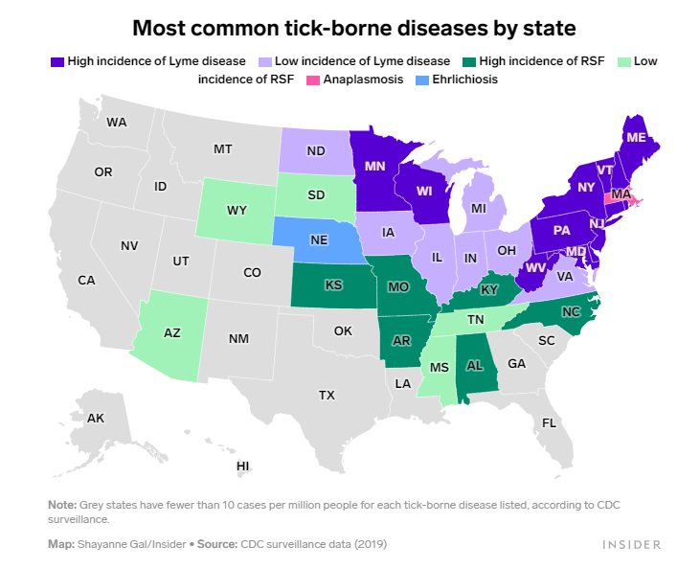
Geographic Factors
Living in a food desert
Living near industrial sites/landfills/etc.
Living in an area with certain disease vectors (ie: ticks, mosquitos, etc.)
Living in certain climates
Living in areas with certain weather events (ie: earthquakes, volcanos, hurricanes, etc.)
Living in areas with poor infrastructure
Notes:
Where you live and work are also major determinants of your environmental exposures and health – for example, living in food deserts or areas with poor infrastructure, or living in certain climates or regions with certain disease vectors or that are prone to certain natural disasters. For example, this map of tick-borne diseases in the U.S. shows how people in New England are at increased risk of Lyme disease because the ticks in that region tend to carry that the bacteria that causes that disease, whereas in the West and Midwest, people are at higher risk of Rocky Mountain Spotted Fever because the ticks there tend to carry the bacteria for that.
Image Source: https://www.insider.com/map-states-with-lyme-disease-other-tick-borne-illnesses-2022-5

Slide 20
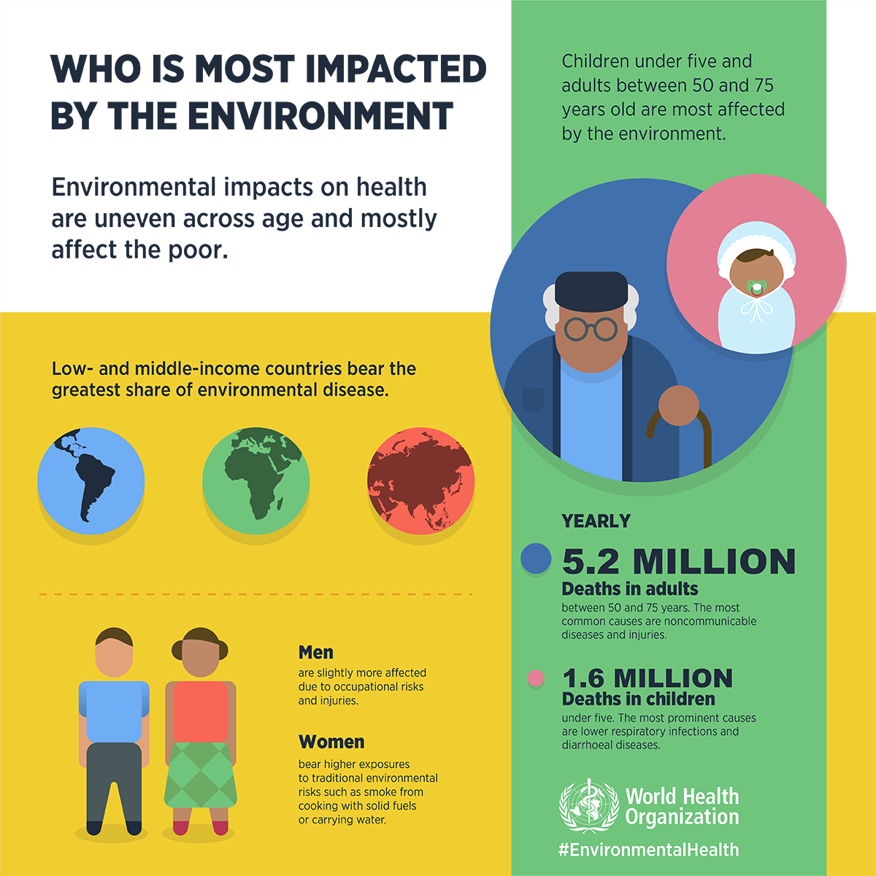
Socioeconomic Factors
Age
Sex/Gender
Sexual Orientation
Race/Ethnicity
Income/wealth
Education
Occupation
Notes:
Demographic and socioeconomic factors are of also major social determinants of health. As this graphic from the WHO shows, low- and middle-income countries tend to suffer more environment-related health issues, as do small children and adults over 50. Men tend to have more occupational exposures/injuries, whereas women tend to have exposures from things like cooking and gathering water. There’s also a lot of data on how race/ethnicity affect one's environmental exposures, which I have an example of on the next slide.
Image Source: https://www.who.int/activities/environmental-health-impacts

Slide 21
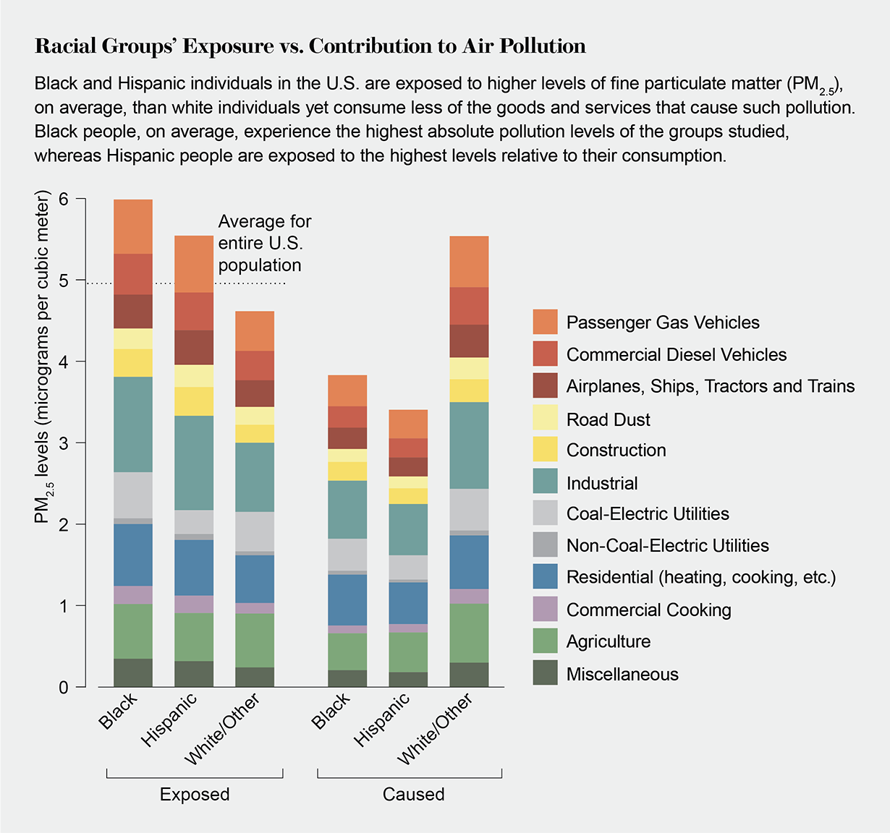
Access & Disparities
Access to things like clean water, proper sanitation, health care, etc.
Disparities in environmental exposures, in health care, etc.
“A study published in March (2019) in the Proceedings of the National Academy of Sciences USA shows that even though black and Hispanic people in the U.S. are exposed to more air pollution than white people, these groups consume less from the industries generating much of that pollution. The findings put hard data behind inequities that environmental justice advocates have reported on the ground, revealing that racial minorities bear a disproportionate amount of the costs of emissions tied to higher levels of consumption.” (Thompson, Scientific American)
Notes:
Related to these social factors are the concepts of access and disparity. Those different socioeconomic and geographic and lifestyle factors can all contribute to whether someone has access to things like clean water, proper sanitation, or health care. There are disparities not only in who does and does not have access to certain things, but also disparities in terms of things like the level of environmental pollutants people are exposed to. This 2019 study on air pollution perfectly illustrates this – it found that while white people in the U.S. are responsible for much of the consumption driving higher emissions in various industries, Black and Hispanic people are exposed to higher levels of air pollution from those industries, disproportionately bearing the health effects of the air pollution caused by those emissions.
Image Source: https://www.scientificamerican.com/article/minorities-breathe-more-than-their-share-of-polluted-air/

Slide 22
Environmental Justice
Environmental Justice: “the fair treatment and meaningful involvement of all people regardless of race, color, national origin, or income, with respect to the development, implementation, and enforcement of environmental laws, regulations, and policies.” (EPA, “Environmental Justice”)
“Whether by conscious design or institutional neglect, communities of color in urban ghettos, in rural 'poverty pockets', or on economically impoverished Native-American reservations face some of the worst environmental devastation in the nation.”
– Dr. Robert Bullard
(“Father” of the Environmental Justice movement)
Notes:
In an effort to recognize, understand, and address these disparities and inequities, the environmental justice movement was born. Environmental justice seeks to ensure fair treatment and meaningful involvement of all people regardless of things like race/ethnicity, gender, nationality, or income, in regards to environmental laws, regulations, and policies. This is an important concept and has become a major area of focus in environmental health science.

Slide 23
Genetics/Epigenetics
“Subtle differences in one person’s genes can cause them to respond differently to the same environmental exposure as another person. As a result, some people may develop a disease after being exposed to something in the environment while others may not.” (NIEHS, “Gene and Environment Interaction”)
“Epigenetics is the study of how your behaviors and environment can cause changes that affect the way your genes work. Unlike genetic changes, epigenetic changes are reversible and do not change your DNA sequence, but they can change how your body reads a DNA sequence.” (CDC, “What is Epigenetics?”)
Examples of epigenetic changes:
Infections: germs can change your epigenetics to weaken your immune system to help the germs survive
Cancer: certain epigenetic changes can increase your risk of cancer, such as how having a mutation in the BRAC1 gene can increase your risk of breast cancer
Nutrition during pregnancy: a mother’s diet can change the baby’s epigenetics – for example, children born to women who experienced famine can end up with increased risk of developing certain diseases
“Smoking can result in epigenetic changes. For example, at certain parts of the AHRR gene, smokers tend to have less DNA methylation than non-smokers. The difference is greater for heavy smokers and long-term smokers. After quitting smoking, former smokers can begin to have increased DNA methylation at this gene. Eventually, they can reach levels similar to those of non-smokers. In some cases, this can happen in under a year, but the length of time depends on how long and how much someone smoked before quitting.” (CDC, “What is Epigenetics?”)
Notes:
Another major concept in environmental health science is genetics and the interaction between your genes and your environment, which can affect your health in unique ways. While most people are familiar with the concept of genetics, you may not be as familiar with epigenetics, which is the study of how your behaviors and environment can cause changes that affect how your genes work. While genetic changes are permanent and alter your actual genes or DNA, epigenetic changes are often reversible and do not alter the actual structure of your genes, but instead change how your body reads your genes/DNA. A great example of how environmental exposures can cause epigenetic changes is smoking cigarettes. In the study cited on the right, researchers found that smokers had less DNA methylation, which is basically a method/mechanism of epigenetic change, at certain parts of a specific gene than non-smokers. But as this study showed, those changes are reversible – smokers who quit can end up with similar levels of DNA methylation as non-smokers over time.

Slide 24
Climate Change
NIEHS Climate Change and Human Health Program
The NIEHS Climate Change and Human Health Program provides coordination and leadership for NIEHS-supported research and activities related to the human health impacts of climate change. This program also coordinates climate change and health collaborations across NIEHS, NIH, and other federal agencies.
“Between 2030 and 2050, climate change is expected to cause approximately 250,000 additional deaths per year, from malnutrition, malaria, diarrhea and heat stress.” (WHO, “Climate Change and Health”)
“The direct damage costs to health (i.e. excluding costs in health-determining sectors such as agriculture and water and sanitation), is estimated to be between USD 2-4 billion/year by 2030.” (WHO, “Climate Change and Health”)
NIH Climate Change and Health Initiative
The NIH Climate Change and Health Initiative is an urgent, cross-cutting NIH effort to reduce health threats from climate change across the lifespan and build health resilience in individuals, communities, and nations around the world, especially among those at highest risk. The NIH Climate Change and Health Initiative is led by an Executive Committee comprising the Directors of seven NIH Institutes and Centers. The NIEHS Director chairs the Executive Committee and NIEHS provides the Initiative's administrative home.
Notes:
And of course, climate change deserves it’s own slide. Climate change is one of the biggest threats to our environment and our health, with the WHO estimating that we could see approximately a quarter of a million excess deaths per year because of climate change between 2030 and 2050. And the health effects of climate change could cost 2-4 billion per year by 2030. Climate change is a major area of focus in environmental health research – for example, here at the NIEHS we have our own climate change and health program, as well as being the administrative home of the broader NIH-wide climate change and health initiative that spans all the different institutes, like the National Cancer Institute and the National Institute for Child Health and Human Development, to name a few.

Slide 25
Examples of Literature Search Topics
Climate change and rheumatic diseases
Climate change and sleep
Covid-19 pandemic and sleep
Covid-19 and climate/environmental factors
Endocrine disrupting chemicals and hair care products
Endocrine disrupting chemicals and menopause
PFAS and cancer
PFAS and infections
Vitamin D and fertility
Outdoor air pollution and fertility
Lead and ovarian aging
Lead, drinking water, and reproductive development in Puerto Rico
Racial/ethnic discrimination and hypertension risk in women
Traumatic childhood experiences and metabolic syndrome in women
Cigarette smoke and cervical cancer
Cigarette smoke and epigenetics
Harmful algal blooms and toxicology
The effects of cannabinoids on the nervous system
Developmental effects of persistent organic pollutants
Chemical exposures and cardiometabolic health
Mold exposure and human health
Environmental exposures in housing in the Caribbean/South America
Air pollution and birth weight/growth stunting in Africa
Agent Orange and generational health effects/epigenetics
Notes:
So now that we’ve covered what environmental health is and seen the many exposures and major concepts in environmental health, I thought it’d be interesting to show some examples of topics of actual literature searches that we have done for our researchers here at the NIEHS. We actually all just finished working on a series of searches on climate change and rheumatic diseases for a scientist here, including one on toxicology, one on epigenetics, and one on gene-environment interactions specifically. We also have done a lot of covid-related searches over the past few years. You can also see some searches that integrate those social determinants – such as socioeconomic factors like “racial/ethnic discrimination and hypertension risk in women”, lifestyle factors like “climate change and sleep”, and geographic factors like “environmental exposures in housing in the Caribbean and South America” or the one growth stunting and air pollution in Africa.

Slide 26
What kind of environmental health information can I find in PubMed?
PubMed is focused on biomedical literature and scholarly journal articles
Won’t find things like:
“Grey literature” (government documents, industry reports, “white papers”, policy papers, etc.)
Consumer health resources (such as handouts or fact sheets or infographics)
Books/book chapters
Conference proceedings/meeting abstracts
PubMed does index study/publication types and you can search for/filter by specific study types (like observational studies, case reports, or controlled trials) or use MeSH terms for some study types
Environmental Health Study Types
Epidemiological studies
Observational studies
Case Series/Reports
Cross-sectional studies
Longitudinal studies
Case-control studies
Cohort studies
Experimental studies
Clinical trials
Genetic association studies/genome-wide analyses
Toxicological studies
Toxicity studies (reproductive toxicity, genotoxicity, etc.)
Carcinogenicity studies
Notes:
So, what kind of environmental health information can you expect to find in PubMed? As a reminder, PubMed is a scholarly, biomedical database, so it is very focused in scope, unlike something like Web of Science or Scopus which are much bigger, multidisciplinary databases. PubMed doesn’t really have a lot in the way of “grey literature”, consumer health resources, books, conference reports, etc. If you’re needing to find information that is more patient/consumer friendly, you’d be better using some like Medline Plus, which is a good resource for that type of information. PubMed is mostly going to have original research studies and review articles, including things like systematic reviews. PubMed does have filters for different publication/study types, as well as some MeSH terms and other ways of searching for specific publication/study types, which can be very helpful if you’re looking for something specific. I’ve listed over here to the right the main study types in environmental health research – most studies will fall into the category of either an epidemiological study or a toxicological study.

Slide 27
Article Type” filter in PubMed
Notes:
This is an example of using the “Article Type” filter – you can see that the article is labeled as a comparative study. Not all studies will be fully indexed with study types, especially older ones, but it can be a useful tool.

Slide 28
MeSH terms for study types/methods
Notes:
This is an example of MeSH terms for study types/methods, which also are not always added to every study, but can again be helpful when you’re looking for a specific type of study.

Slide 29
Environmental Health Journals Indexed in PubMed
Journal of Environmental Science and Health
Current Environmental Health Reports
Journal of Environmental and Public Health
Journal of Exposure Science and Environmental Epidemiology
Archives of Environmental and Occupational Health
International Journal of Environmental Research and Public Health
International Journal of Environmental Health Research
Environmental Health
Environment International
International Journal of Hygiene and Environmental Health
International Journal of Occupational Medicine and Environmental Health
Environmental Toxicology
Journal of Toxicology and Environmental Health
Environmental Health and Preventative Medicine
Environmental Toxicology and Pharmacology
Journal of Occupational and Environmental Medicine
Environmental Science and Pollution Research International
Reviews of Environmental Contamination and Toxicology
Reproductive Toxicology
Environmental Geochemistry and Health
Environmental Toxicology and Chemistry
Ecotoxicology and Environmental Safety
Environmental Health Perspectives (NIEHS)
Reviews on Environmental Health
The Science of the Total Environment
Environmental Research
Environmental Science and Technology
Notes:
I’ve listed here some of the major environmental health/science journals that are indexed in PubMed. This is certainly not an exhaustive list but shows that there is a lot of environmental health related content in PubMed, including the journal Environmental Health Perspectives which is actually published by the NIEHS.

Slide 30
Journal field tag
Notes:
You can search for specific journals in PubMed using the journal field tag, as shown here.

Slide 31
PubMed Central (PMC)
A repository of free full-text articles
A subset of PubMed
There is a “Text Availability” filter in PubMed so you can limit to only free full-text articles
NIH Public Access policies require all peer-reviewed articles funded by NIH or authored by NIH staff to be deposited into PMC, so any study done by NIEHS will be in PMC (eventually)
The Environmental Protection Agency (EPA) and the Centers for Disease Control and Prevention (CDC) have similar policies (as well as many other organizations – federal, private, and international)
For more information on PMC and Research Funder Policies: https://www.ncbi.nlm.nih.gov/pmc/about/public-access/
For more information on the difference between PubMed and PubMed Central: https://www.nlm.nih.gov/bsd/difference.html
PubMed
PMC
Notes:
I also want to mention PubMed Central, which you can think of as a subset of PubMed that serves as a repository of free full-text articles. While PubMed is a free, open citation database, not all the articles in it will be free to access – it will depend on what journals you have subscriptions to via your institution or whether journals are open access or not. So, if you know you don’t have access to a lot of journals, you can actually filter your search results in PubMed to only show you things available full-text for free, such as the things in PMC, that way you know you’ll be able to actually read the studies you’ve found. The NIH (and therefore the NIEHS), as well as many other federal agencies and research organizations including the EPA and CDC, actually have policies that mandate that research done or funded by them is made available in PMC (though there are sometimes embargo periods so it may take up to a year after publication before things are available in PMC), but the point is that because of these policies there is a wealth of environmental health-related research in PMC that is freely available for anyone to access.

Slide 32
“free full text” filter
Notes:
And this is an example of using the “free full text” filter I mentioned to only show articles that are freely available, like those in PMC. Now, I’ll turn it over to Stacey…

Slide 33
Research Question
Break down information need into a question or series of questions
Our first example research question will be: Does prenatal exposure to di-(2-ethylhexyl) phthalate (DEHP) affect birth weight?

Slide 34
PECO/PEO Framework
Population/Patients/Problem: who or what is the study being conducted in (ex. human groups, in vivo, in vitro, in silico)
Exposure: the environmental factors of interest
Comparator: comparison between exposures
Outcome: the effect of the exposure
Optional:
Timing: Is there a time element involved such as when sampling occurs?
Study type/Setting: Is there a specific study type or setting of interest?
Notes:
Reference: Morgan RL, Whaley P, Thayer KA, Schünemann HJ. Identifying the PECO: A framework for formulating good questions to explore the association of environmental and other exposures with health outcomes. Environ Int. 2018;121(Pt 1):1027-31.
doi: 10.1016/j.envint.2018.07.015. PubMed PMID: 30166065.

Slide 35
PECO/PEO Framework (cont.)

Slide 36
Gathering Search Terms Part 1
PEO Topics | Keywords | MeSH
Prenatally exposed | Prenatal exposure Prenatally exposed In utero exposure Fetal/Foetal exposure Maternal exposure
di-(2-ethylhexyl) phthalate (DEHP) exposure | di-(2-ethylhexyl) phthalate Bis(2-ethylhexyl)phthalate Dioctyl Phthalate (DEHP AND phthalate*) *could add metabolites
Birth weight | Birth weight/size birthweight Size/weight at birth Adverse birth outcomes

Slide 37
Environmental Health MeSH Part 1
Topic | Possible MeSH Terms
Air Pollution | "Air Pollution"[Mesh], "Air Pollutants"[Mesh], "Benzene"[Mesh], "Ozone"[Mesh], "Particulate Matter"[Mesh], "Sulfur Dioxide"[Mesh], "Vehicle Emissions"[Mesh], "Volatile Organic Compounds"[Mesh], "Air Pollutants" [Pharmacological Action]
Allergens (Respiratory) | "Allergens"[Mesh], "Cockroaches"[Mesh], "Dander"[Mesh], "Dust"[Mesh], "Dust Mite Allergy"[Mesh], "Fungi"[Mesh], "Pollen"[Mesh], "Pyroglyphidae"[Mesh]
Built Environment | "Environment, Controlled"[Mesh], "Built Environment"[Mesh], "Light Pollution"[Mesh], "Noise"[Mesh], "Population Health"[Mesh], "Residence Characteristics"[Mesh],
Climate Change | "Climate Change"[Mesh], "Climatic Processes"[Mesh], "Natural Disasters"[Mesh], "Weather"[Mesh], "Heat Stroke"[Mesh], "Water Insecurity"[Mesh], "Food Supply"[Mesh],
Dioxins | "Dioxins"[Mesh]
Endocrine Disruptors | "Endocrine Disruptors"[Mesh], "bisphenol A" [Supplementary Concept], "perchlorate" [Supplementary Concept], "Endocrine Disruptors" [Pharmacological Action]

Slide 38
Environmental Health MeSH Part 2
Topic | Possible MeSH Terms
Flame Retardants | "Flame Retardants"[Mesh], "Halogenated Diphenyl Ethers"[Mesh], "Polybrominated Biphenyls"[Mesh], "Flame Retardants" [Pharmacological Action]
Heavy Metals/ Metalloids | "Metals, Heavy"[Mesh], "Heavy Metal Poisoning"[Mesh], "Heavy Metal Poisoning, Nervous System"[Mesh], "Metalloids"[Mesh]
General Environment | "Environmental Health"[Mesh], "Environmental Pollution"[Mesh], "Toxic Actions"[Mesh], "Carcinogens, Environmental" [Pharmacological Action], "Environmental Pollutants" [Pharmacological Action], "Soil Pollutants" [Pharmacological Action], Water Pollutants, Chemical" [Pharmacological Action],
Genetics, Epigenetics | "DNA Methylation"[Mesh], "Epigenomics"[Mesh], "Epigenome"[Mesh], "Gene-Environment Interaction"[Mesh]
Occupational | "Occupational Exposure"[Mesh], "Occupational Groups"[Mesh], "Workplace"[Mesh]

Slide 39
Environmental Health MeSH Part 3
Topic | Possible MeSH Terms
Other | "Disorders of Environmental Origin"[Mesh], "Prenatal Exposure Delayed Effects"[Mesh], "Risk"[Mesh],
PFAS | "Fluorocarbons"[Mesh], "Alkanesulfonic Acids"[Mesh], "perfluorooctane sulfonic acid" [Supplementary Concept], "perfluorohexanesulfonic acid" [Supplementary Concept], "perfluorooctanoic acid" [Supplementary Concept]
Pesticides | "Pesticides"[Mesh], "Pesticides" [Pharmacological Action]
Phthalates/ Plasticizers | "Phthalic Acids"[Mesh], "Plasticizers"[Mesh], "Plasticizers" [Pharmacological Action]
Phytoestrogens | "Phytoestrogens"[Mesh], "Genistein"[Mesh], "Soy Foods"[Mesh], "Phytoestrogens" [Pharmacological Action]
Polychlorinated biphenyls (PCBs) | "Polychlorinated Biphenyls"[Mesh]
Polycyclic Aromatic Hydrocarbons (PAHs) | "Polycyclic Aromatic Hydrocarbons"[Mesh]

Slide 40
Gathering Search Terms Part 2
PEO Topics | Keywords | MeSH
Prenatally exposed Humans/animals | Prenatal exposure Prenatally exposed In utero exposure Fetal/Foetal exposure Maternal exposure | "Prenatal Exposure Delayed Effects"[Mesh] "Fetus"[Mesh] "Pregnancy"[Mesh]
di-(2-ethylhexyl) phthalate (DEHP) exposure | di-(2-ethylhexyl) phthalate Bis(2-ethylhexyl)phthalate Dioctyl Phthalate (DEHP AND phthalate*) *could add metabolites | "Diethylhexyl Phthalate"[Mesh] "Phthalic Acids"[Mesh]
Birth weight | Birth weight/size birthweight Size/weight at birth Adverse birth outcomes | "Birth Weight"[Mesh] "Infant, Low Birth Weight"[Mesh] "Infant, Large for Gestational Age"[Mesh]

Slide 41
Tips for Finding Chemicals in PubMed and MeSH
PubMed will automatically try to translate and map to relevant MeSH terms
Double check PubMed translations to verify correctness
In MeSH database for chemicals like di-(2-ethylhexyl) phthalate with dashes, numbers, parentheses, try searching with just words and spaces
Di ethylhexyl phthalate to find "Diethylhexyl Phthalate"[Mesh]
Can use PubChem to verify substances and find synonyms. Will have link to MeSH term.

Slide 42
Supplementary Concepts
New chemicals/drugs are added to MeSH as supplementary concepts as they appear
May be changed to MeSH term later with annual MeSH update
Not part of the MeSH hierarchy (won’t appear in tree) but are mapped to MeSH term in the hierarchy
Automatic term mapping still applies meaning that searching the MeSH term will automatically search all supplementary terms mapped to it

Slide 43
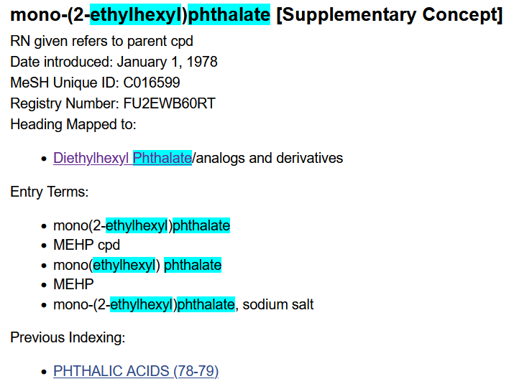
Supplementary Concepts (cont.)
Example: "mono-(2-ethylhexyl)phthalate" [Supplementary Concept] maps to "Diethylhexyl Phthalate"[Mesh]

Slide 44
Pharmacological Actions
“Each pharmacologic action term index is created with the drug/substance terms known to have that effect. This includes both MeSH terms and terms for Supplementary Concept Records.” – PubMed User Guide
List of Pharmacological Actions in MeSH
Automatic term mapping will look for the MeSH term and pharmacological action

Slide 45
MeSH Subheadings
Focuses on a particular aspect of a subject
Ex. "Diethylhexyl Phthalate/blood"[Mesh] when present in blood or "Diethylhexyl Phthalate/adverse effects"[Mesh]
Scope notes for subheadings
Can be searched independently of a MeSH term
Ex. "toxicity"[sh]

Slide 46
Creating the Search Query
Prenatally exposed Humans/ animals | "Prenatal Exposure Delayed Effects"[Mesh] OR "Fetus"[Mesh] OR "Pregnancy"[Mesh] OR "Maternal Exposure"[Mesh] OR "prenatal exposure"[tiab:~2] OR "prenatal exposures"[tiab:~2] OR "pre-natal exposure"[tiab:~2] OR "pre-natal exposures"[tiab:~2] OR prenatally exposed[tiab] OR pre-natally exposed[tiab] OR in utero exposure*[tiab] OR fetal exposure*[tiab] OR foetal exposure*[tiab] OR maternal exposure*[tiab]
AND
di-(2-ethylhexyl) phthalate (DEHP) exposure | "di ethylhexyl phthalate"[tiab:~1] OR "di ethyl hexyl phthalate"[tiab:~1] OR OR diethylhexyl phthalate*[tiab] OR "Bis ethylhexyl phthalate"[tiab:~1] OR "bis ethyl hexyl phthalate"[tiab:~1] OR dioctyl phthalate[tiab] OR di-octyl phthalate[tiab] OR (DEHP[tiab] AND phthalate*[tiab]) OR "Diethylhexyl Phthalate"[Mesh]
AND
Birth weight | "Birth Weight"[Mesh] OR "Infant, Low Birth Weight"[Mesh] OR "Infant, Large for Gestational Age"[Mesh] OR "birth weight"[tiab:~2] OR birthweight*[tiab] OR "birth size"[tiab:~3])

Slide 47
PubMed Preliminary Test Search
("di ethylhexyl phthalate"[tiab:~1] OR "di ethyl hexyl phthalate"[tiab:~1] OR diethylhexyl phthalate*[tiab] OR "Bis ethylhexyl phthalate"[tiab:~1] OR "bis ethyl hexyl phthalate"[tiab:~1] OR dioctyl phthalate[tiab] OR di-octyl phthalate[tiab] OR (DEHP[tiab] AND phthalate*[tiab]) OR "Diethylhexyl Phthalate"[Mesh]) AND ("Prenatal Exposure Delayed Effects"[Mesh] OR "Fetus"[Mesh] OR "Pregnancy"[Mesh] OR "Maternal Exposure"[Mesh] OR "prenatal exposure"[tiab:~2] OR "prenatal exposures"[tiab:~2] OR "pre-natal exposure"[tiab:~2] OR "pre-natal exposures"[tiab:~2] OR prenatally exposed[tiab] OR pre-natally exposed[tiab] OR in utero exposure*[tiab] OR fetal exposure*[tiab] OR foetal exposure*[tiab] OR maternal exposure*[tiab]) AND ("Birth Weight"[Mesh] OR "Infant, Low Birth Weight"[Mesh] OR "Infant, Large for Gestational Age"[Mesh] OR "birth weight"[tiab:~2] OR birthweight*[tiab] OR "birth size"[tiab:~3])

Slide 48
Approaches for Non-chemical Searches
How does climate change affect sleep?
Defining Population/Outcome
Sleep measures
Special populations or settings
Occupational (Shift work, jet lag, astronauts, etc.)
Hospitals, care facilities
Unstably housed
Infants, pregnant, elderly
Sleep disorders (insomnia, sleep apnea, narcolepsy, bruxism, etc.)
Napping, drowsiness
Other countries or cultures (siestas, sleeping rough)
Circadian rhythm

Slide 49
Approaches for Non-chemical Searches Part 2
How does climate change affect sleep?
Defining Exposures
What’s involved in climate change
Extreme weather/temperatures
Ocean changes
Pollution
Water/food supply
UV radiation
What are possible environmental exposures?
Sleep space microenvironment
Air quality
Chemical exposures
Physical exposures
Light, temperature, humidity, seasonality, smell
Social Environment
Stress, unstable housing, resource scarcity

Slide 50
For Additional Searching Instruction
Drug and Chemical Information - On Demand: https://www.nnlm.gov/training/class/drug-and-chemical-information-demand
PubMed Online training: https://learn.nlm.nih.gov/documentation/training-packets/T0042010P/

Slide 51
Contact Us
Stacey Mantooth
Information Services Librarian
stacey.mantooth@nih.gov
Kelly Miller
Library Fellow
kelly.miller2@nih.gov
Library email: library@niehs.nih.gov
The NIEHS Library is operated and staffed by Vista Technologies, Inc.

