Slide 1
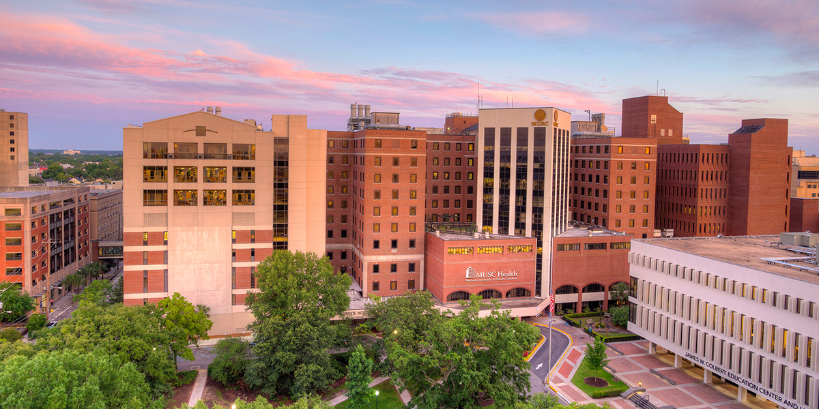
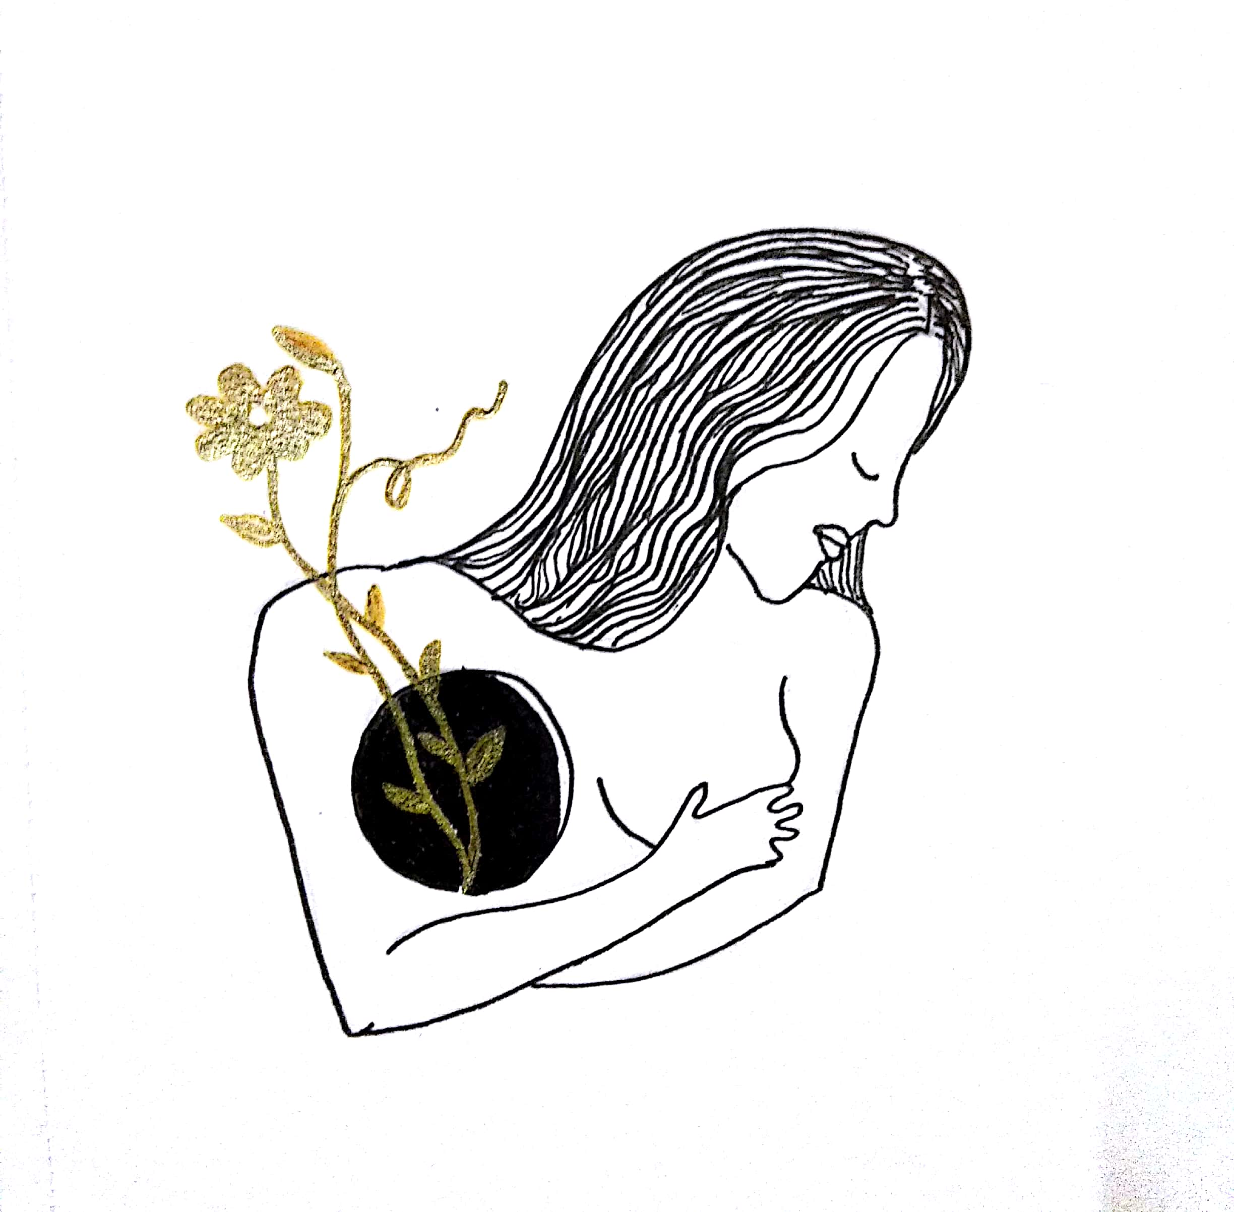
Tatas Tales/
Los Cuentos de las Tatas: Building Resilience Through Poetry Therapy and Theatre/Fomentando la Resilencia a Través de la Poesia y el Teatro
Irania Macias, Certified Poetry Therapy Failitator and Outreach Specialist for Charlotte Mecklenburg Library and Beth Murray, Ph.D. Associate Professor of Theatre Education University of North Carolina-Charlotte

Slide 2
Agenda
Presenters
Project Overview & Phases (with video)
Poetry Therapy Work
Playscript Development and Performance Work
Arts-based Medical Curriculum Module Work
Learnings & Analysis
Hopes, Moving Forward
Questions & Contact

Slide 3
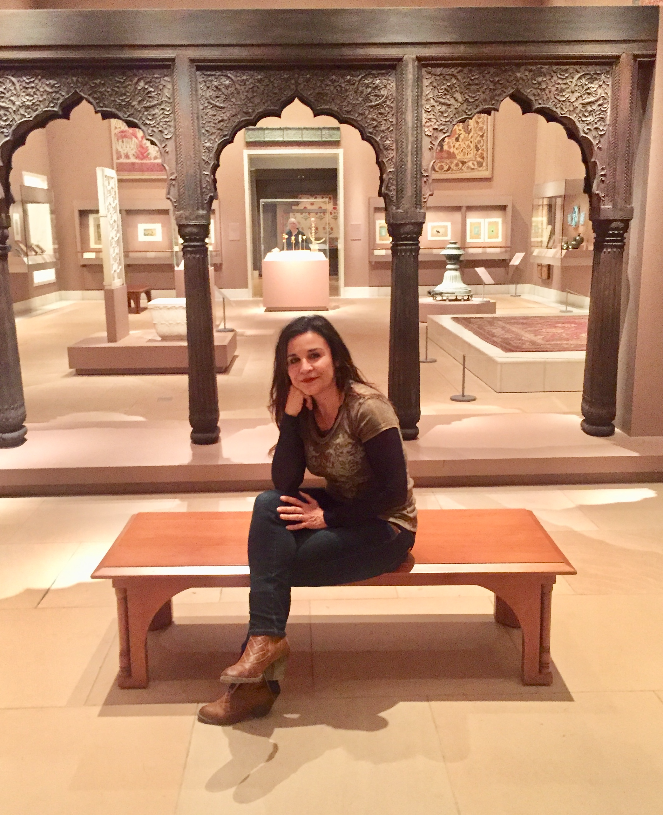
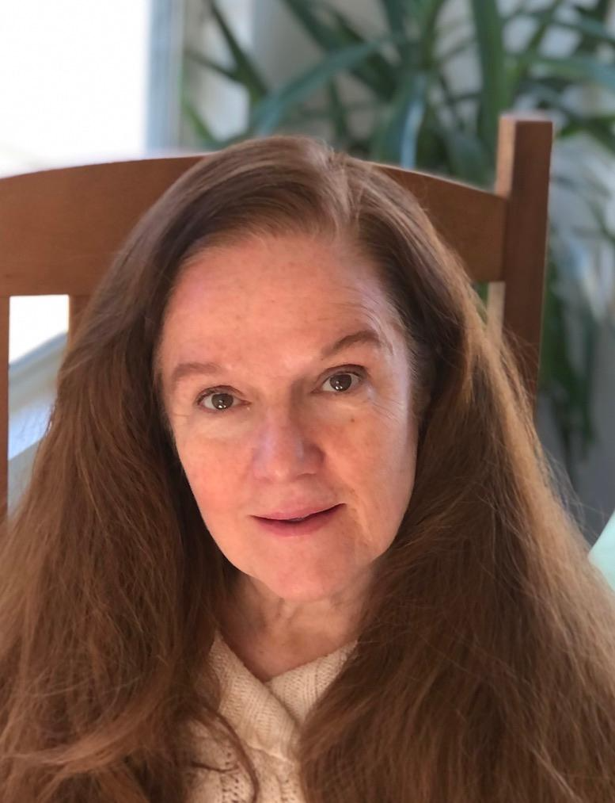
Introductions
Irania Macias
Poetry Therapy Facilitator
Teaching Artist
Library Community Outreach Specialist, Bilingual Programs at Charlotte Mecklenburg Libraries
Beth Murray
Associate Professor of Theatre
Education at University of North Carolina-Charlotte

Slide 4
PROJECT OVERVIEW

Slide 5
Tatas Tales/Los Cuentos de las Tatas Project
Began as creative arts in mental health project for breast-cancer survivors to:
build resilience and foster intercultural exchange
connect survivor stories creatively
reduce stigma and fear about breast cancer conversations
Writings, drawing and talk from survivors became the basis for a playscript in Spanish and English which has been performed and “worked” as a concert reading across the community.
Currently developing, piloting and researching the impact of arts-based curriculum modules with colleagues in nursing education building on the script, methods used in poetry group sessions, and applied theatre strategies

Slide 6
POETRY THERAPY GROUPS
2018-present

Slide 7
The mission at the poetry table
To support local Latina and non-Latina breast cancer survivors to build resilience, and foster intercultural exchanges by connecting their stories creatively, and reducing stigma and fear about breast cancer conversations

Slide 8
Basic poetry session components
Entry: I am here, it is the literature that brings me in.
Engaged: I am here and it reaches me (the recognition of the self in the process).
Involved: I feel and I think and it touches me.
Incorporated: I tried it on and it moves me (walking the talk and being. aware of new possibilities)
Initiative: I do and I take it with me.
Notes:
Iraniia: Can you please add two or three key words to describe each step? You can fill in details as you speak.

Slide 9
At the poetry table

Slide 10
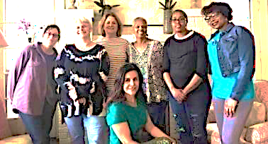
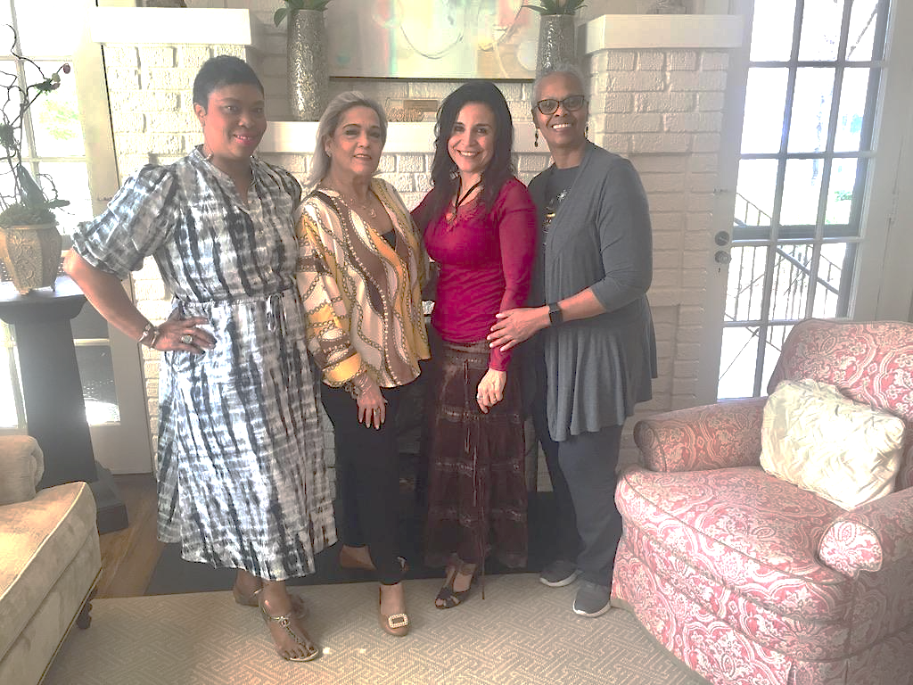
Building community--

Slide 11
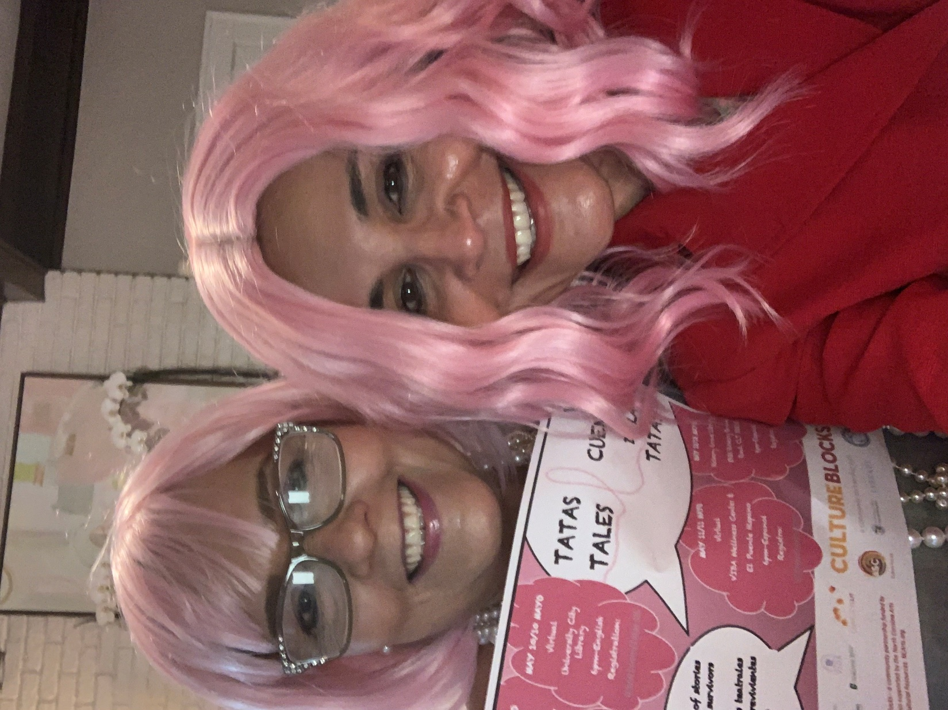
--and connecting beyond the words

Slide 12
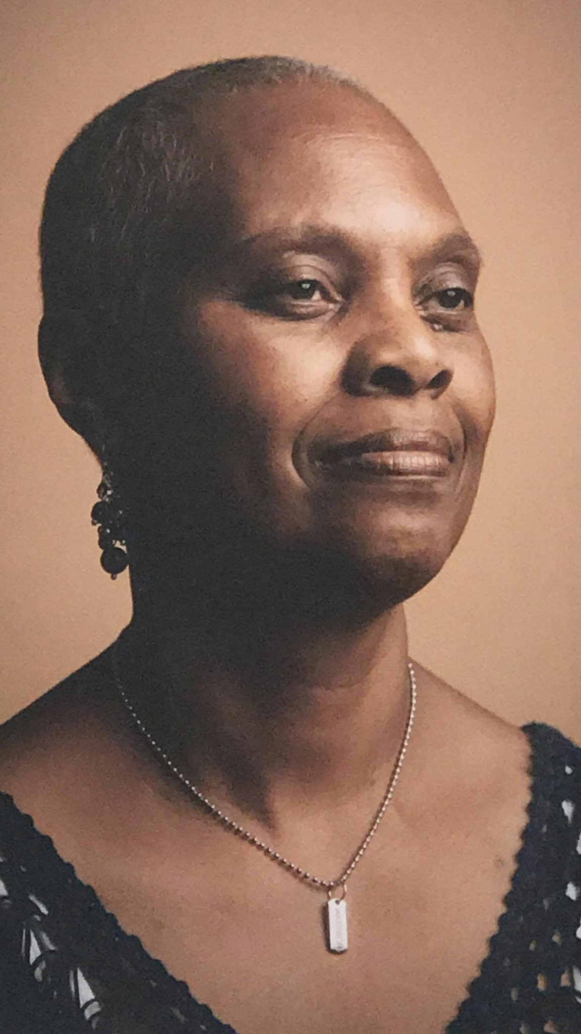
Having Come This Far
Faye Harvin
My first words were inconvenienced and disappointed. Slowly my words changed to adjustment.
I've been through what my through was to be. I did what I could and couldn't. I was never sure how I would get there. All that I knew was that I had to keep going and I could only look back to see how far I had come. First there was diagnosis then surgery, treatment and then another surgery. Recover, then surgery again, recover, then surgery again. Did you just hear that echo? Yet there was a point when I realized that I was thriving through and through; thriving, through my through, and then I had to go through an unexpected through and now again I find myself in recovery. Down the road I see adjustment, acceptance, survivorship and then thriving. Yes, thriving through and through, thriving through my through. I am a Sur thriver.
Notes:
Irania, can you please re-add one slide here that shows Faye and her writing?

Slide 13
PLAYSCRIPT DEVELOPMENT & READINGS
2020-present

Slide 14
Intersections
Poetry
Theatre/
drama
Mental well-being

Slide 15
Playwriting phases
Pink House-La Casa Rosada poetry therapy groups begin (2018)
Exploring theatre possibilities (2019 to 2020) *
Collecting written materials and recording sessions (2020) *
Script draft 1 zoom readings and feedback (2021) *
Script revisions (2021) *
Translation (2021- 2022)**
Community actor live readings and response (2022) ***
Project curation and continued quest for full production (2022+)
* Vision Grant (Arts and Science Council)
**Equity and Inclusion Grant (North Carolina Arts Council)
***Cultural Block Grant (Mecklenburg County and ASC)
Notes:
Irania: Can you please re-add the slide about the play process that was cut?

Slide 16
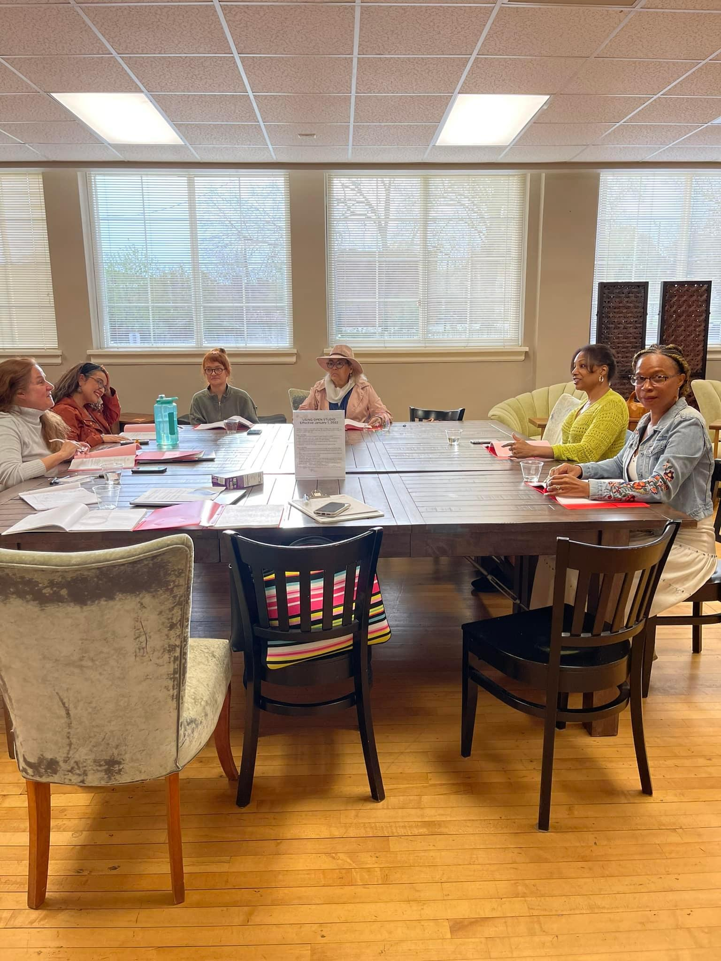
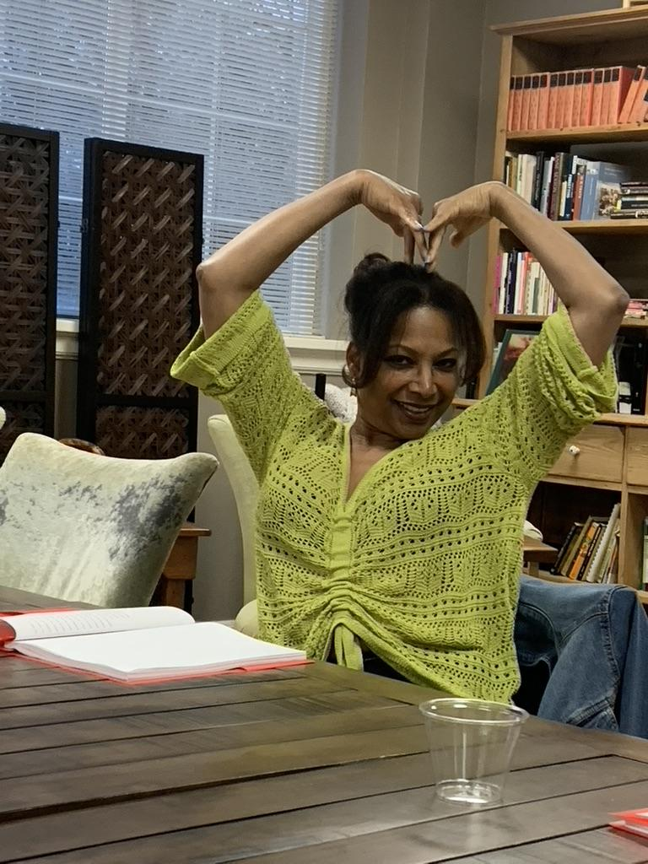
Reading rehearsals

Slide 17
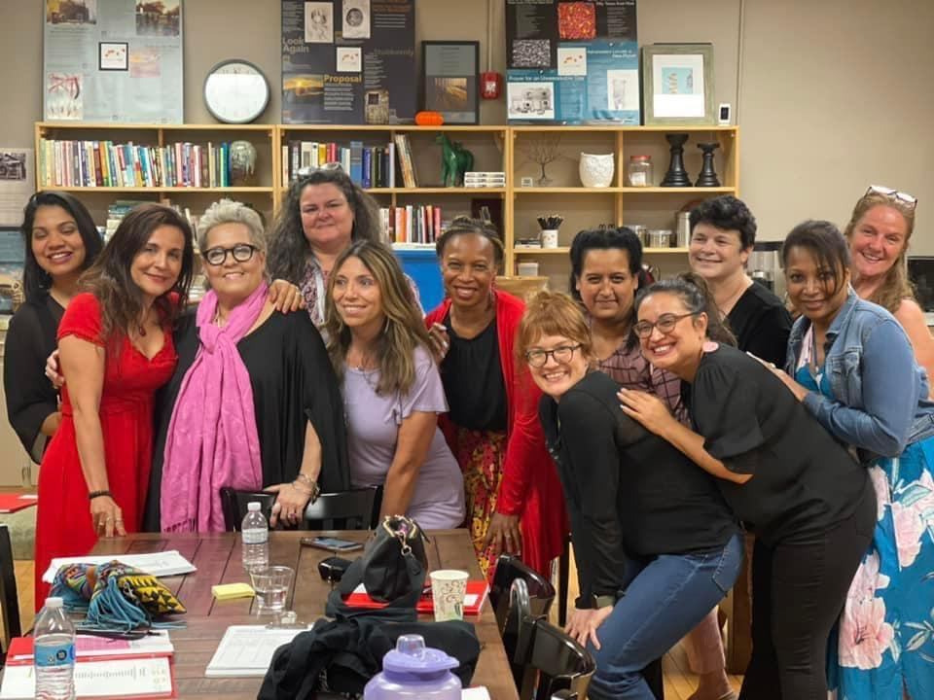
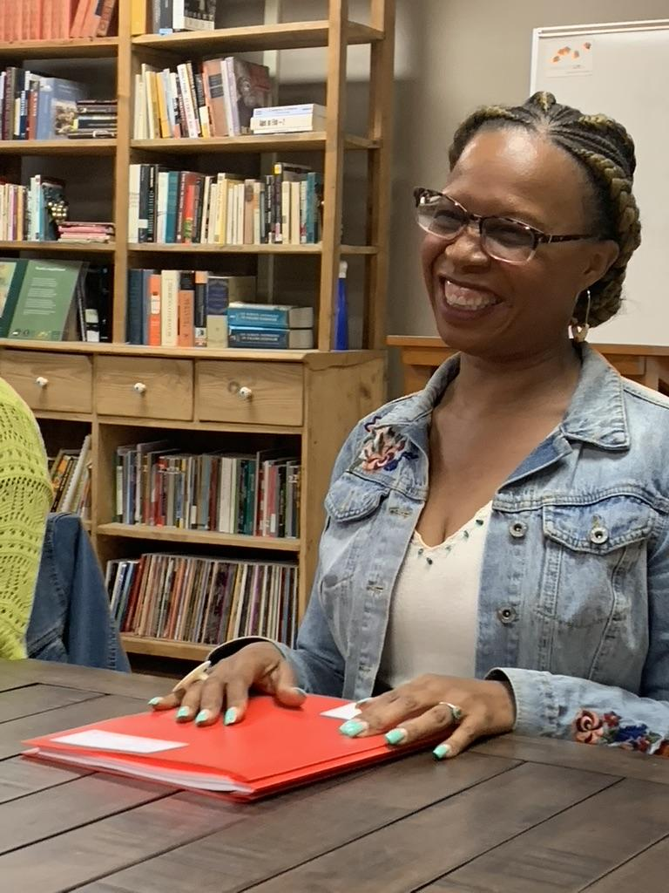
People

Slide 18
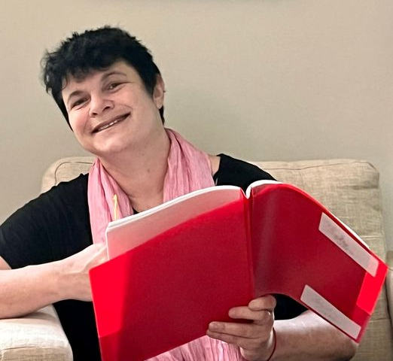
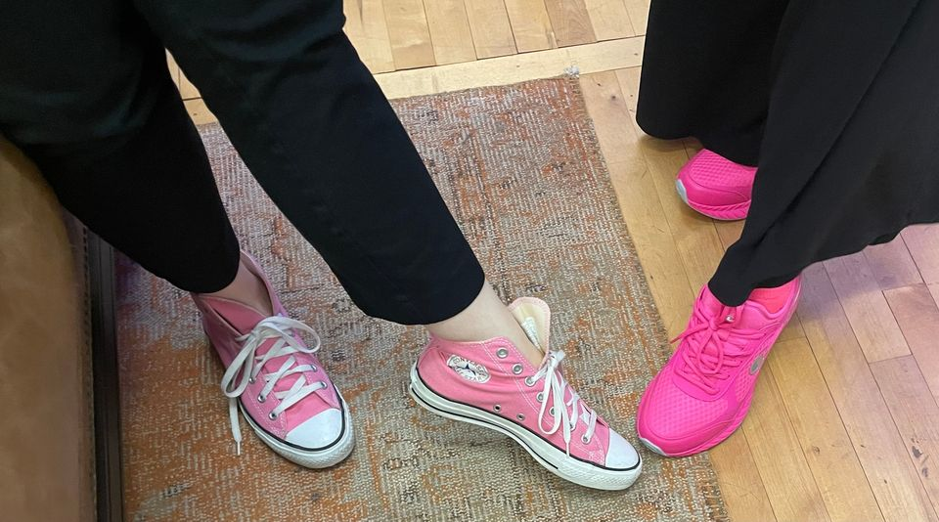
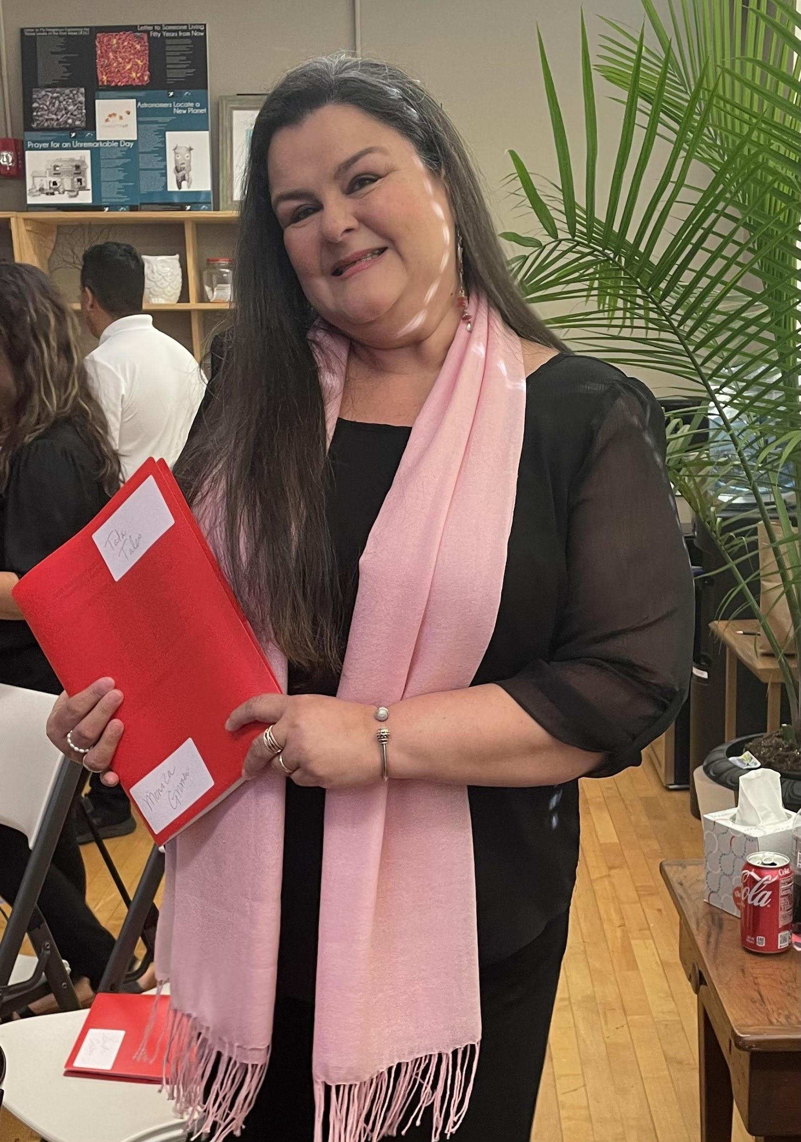
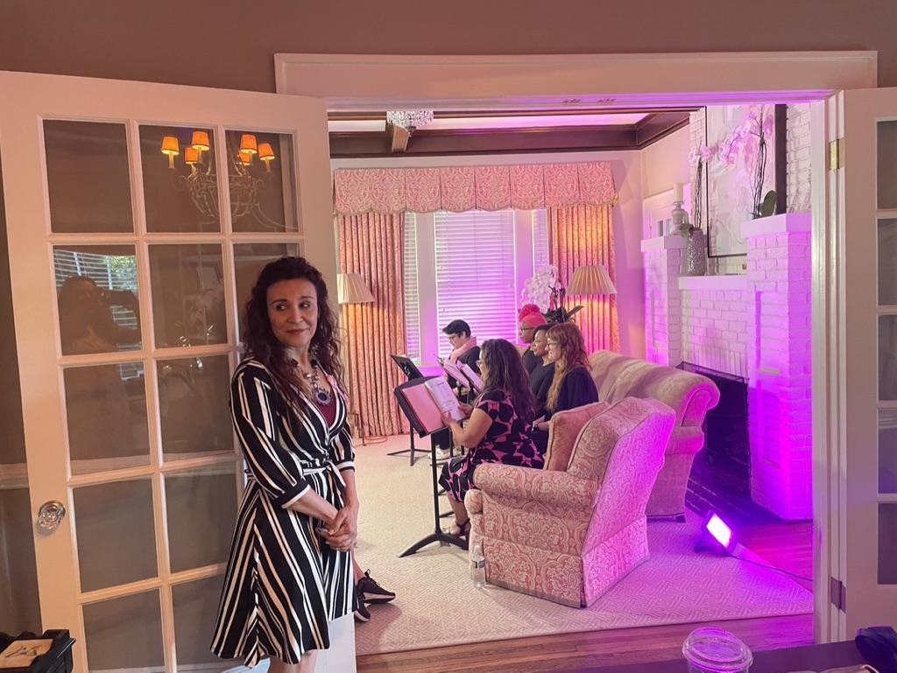
Reading performances

Slide 19
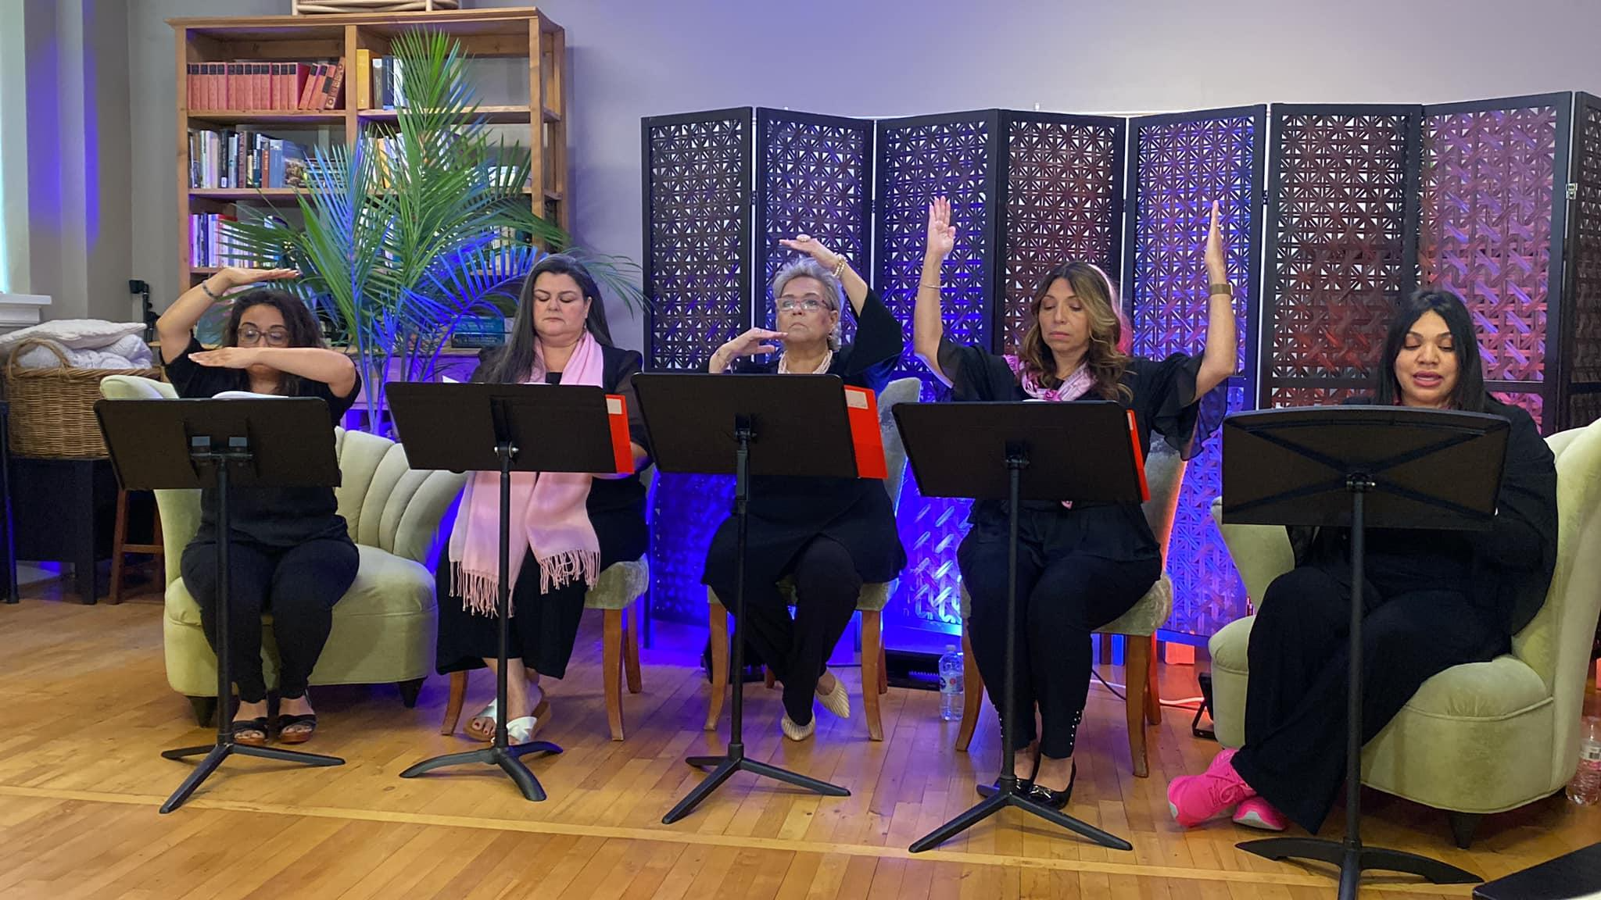
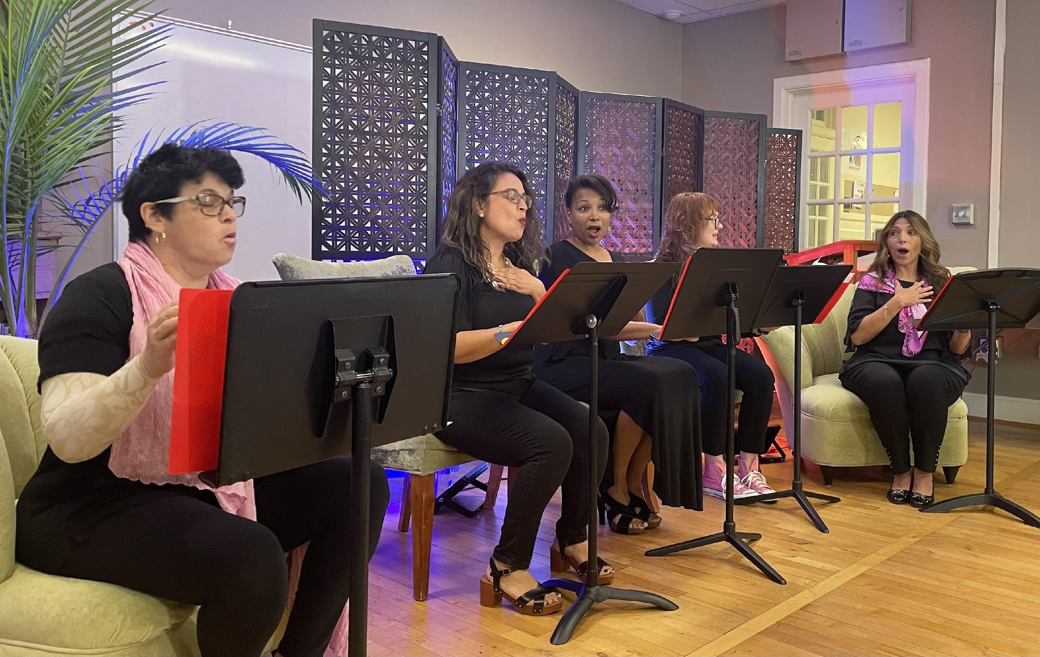
Music

Slide 20
Sharing
across
communities
in
Spanish
and
English

Slide 21
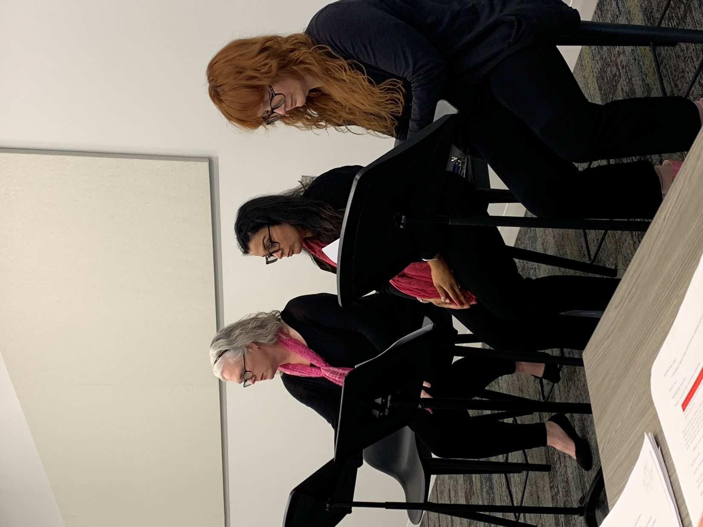
Building community—
beyond the performance . . . including at library staff training.

Slide 22
Video
A brief overview video created during the concert reading rehearsal process (2022)
https://fb.watch/rvwErlvWza/
Notes:
Irania: Please make sure the link here is the one that can be viewed/accessed publicly. I do not think I did it correctly.

Slide 23
ARTS-BASED MEDICAL CURRICULUM MODULE DEVELOPMENT & IMPACT RESEARCH
2023-present

Slide 24
Medical Learning Possibilities
Arts-based approaches help humanize.
Arts-based approaches embrace—and often embody--multiple perspectives; multiple right ways.

Slide 25
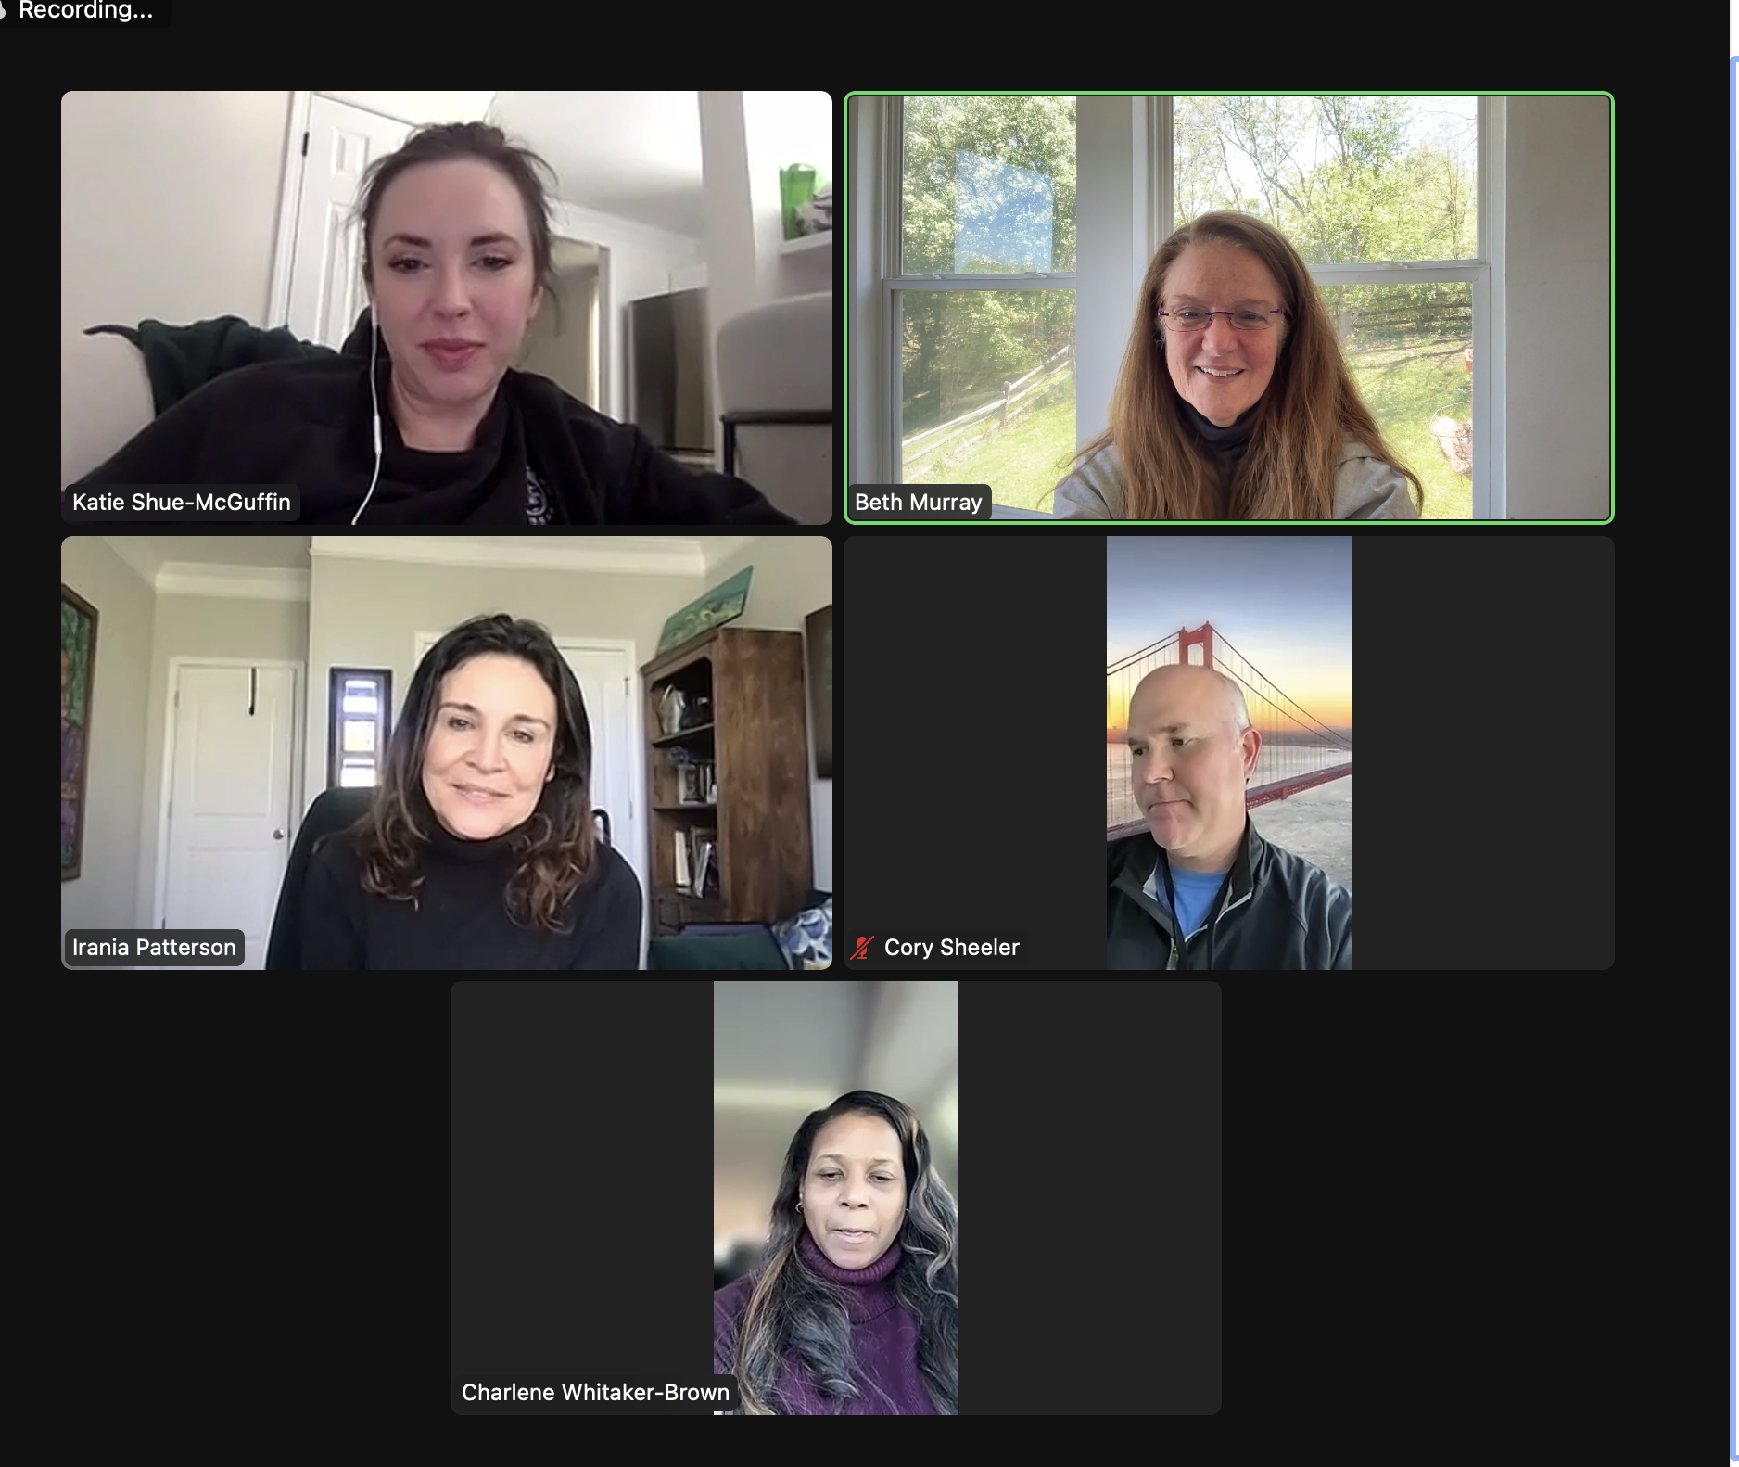
Our Team
Katie Shue-McGuffin, DNP, MSN, APRN, FNP-C, Doctor of Nursing Practice Program Coordinator
Cory Sheeler, DNP, FNP-BC, ENP
Clinical Assistant Professor
Charlene Whittaker-Brown, DNP, MSN, FNP-C, PMHNP-BC, CHFN,
Clinical Professor, School of Nursing and Gerontology Program

Slide 26
Two types of module
Video-based with Discussion
Arts-based
Adapted from a scene in the script
One video is about patients on their way to appointments and in a waiting room, revealing diversity in medical histories and lived experiences.
Another video is about a patient who trades places with the doctor in an exam room.
Learn in and through individual and collective poetry and theatre activity
One lesson centers around a poem and explores observation, non-verbal communication, and responsiveness.
Another lesson uses applied theatre strategies, particularly forum theatre, to help students explore balancing complex medical knowledge and humanizing communication with patients.

Slide 27
Self Study
Asking questions about how we are learning with and from each other across disciplinary borders.

Slide 28
EMERGING LEARNINGS

Slide 29
Some key insights
Asking “Whose voice or perspective is missing?” is a continual important habit.
Process matters.
The art of collective curation, such as the Tatas Tales/Los Cuentos de las Tatas Facebook page, is data in community-centered research.
Stories of navigating medical system language, cultural, social and economic borders are universal, even if patients share a home language with their care provider.
Everyone is creative. Creative approaches hold space for diversity and complexity.

Slide 30
NEXT?

Slide 31
Hopes: Looking Forward
Who’s still missing? Do we seek more people experiencing this play or more theatre-based processes tailored to specific needs and communities? Or both?
How do we build on medical/clinical/social service interest in video and arts-based modules in training and education? (pilot curricula; replicating/revising process inclusively, with belonging embedded)
Fully-mounted production?

Slide 32
Moving Forward
How can YOU get involved?

Slide 33
Responses, Take aways and Questions?

Slide 34
Keep in touch
Irania Macias
iraniapatterson@gmail.com
Beth Murray
emurra17@charlotte.edu

