Slide 1
Precontemplation
“I won’t do it”

Slide 2
Discussion points from last module
What cues do you currently use to understand your patients’ readiness to change?
How do you try to help them move forward?
Notes:
[NOTE TO FACILITATOR: If you are completing these modules in an order other than suggested in the facilitation guide, you may need to adjust these discussion points.]

Slide 3
Objectives
By the end of the program, participants will:
Define the precontemplation stage
Discuss MI techniques for patients in precontemplation

Slide 4
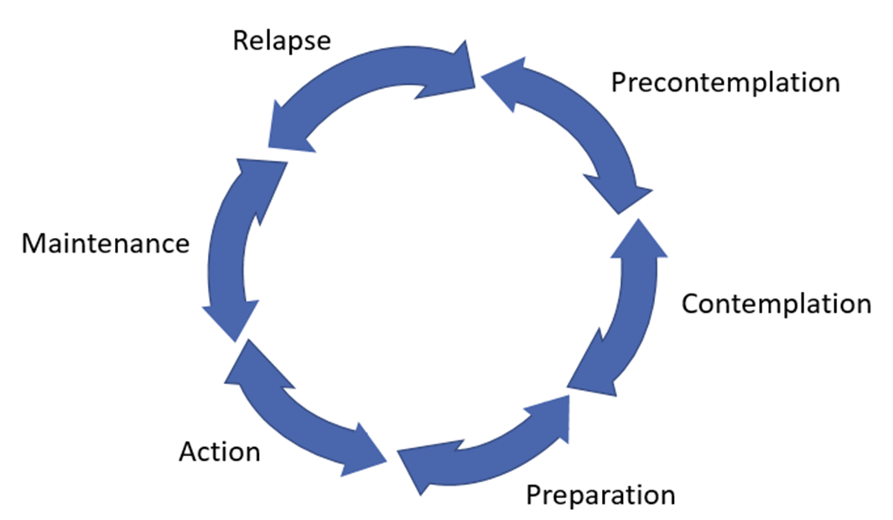
Precontemplation
Express empathy & roll with resistance
Increase awareness
Shows no intent
Precontemplation
Figure 1. Adapted from Tuccero, Railey, Briggs & Hull (2016). Behavioral Health in Prevention and Chronic Illness Management, Primary Care: Clinics in Office Practice, 43, 191-102. doi: 10.1016/j.pop.2016.01.006
Notes:
You may recognize this image from our last conversation. However, this time, since we are discussing the precontemplation stage, it is filled in with a definition of this stage along with the goal for coaching someone in this stage and the MI core principles that best match with this goal. For this stage, the goal is to increase awareness. The core principles suggested are to express empathy and roll with resistance¹. Remember that the core principles are not concrete skills - but you can use OARS skills in conjunction with these principles.
[NOTE TO FACILITATOR: If you are completing these modules in an order other than suggested in the facilitation guide, you may need to adjust this note.]

Slide 5
What is Precontemplation?
The patient does not intend to make a change to their behavior in the next six months²
They either have not considered change, are not ready, or do not see their current behavior as a problem^{3,4}
These people can be seen as resistant or unmotivated, but some argue that typical health promotion programs were not created to match their needs²
Notes:
Precontemplation is the stage of change where a patient does not intend to make a change to their behavior in the next six months². These patients may be in this stage for different reasons. They may not have considered change, are not ready to change, or do not see their current behavior as a problem^{3,4}. It’s easy to see these patients as unmotivated or resistant, but one author argues that typical health promotion programming simply was not created to match their needs based on this stage of change². Think about a behavior related to chronic disease such as reducing fried foods. Someone who has been eating fried food daily for their entire life and has no intention of reducing these foods is not likely to respond in a productive way to the recommendation that they cut these out completely right away.

Slide 6
Recognizing Precontemplation
Patients in precontemplation may:
Avoid talking about a behavior²
Deny a behavior is an issue³
Make excuses for a behavior³
Indicate that change is not a priority⁴
Notes:
How can you tell that a patient is a precontemplator? It’s unlikely that you’ll actually ask them if they intend to change in the next six months, but you can listen to statements they make (or their lack of interest in a topic) to know that they are in precontempation. They may be someone who doesn’t want to talk about a behavior² and when they do, they deny that their behavior is an issue for them³. They may also make excuses or blame someone else for the behavior³. An example of blaming others may be, “My husband always brings unhealthy foods home with him.”³

Slide 7
Precontemplation - what to do?
A good place to start: ask for more information about the patient’s thoughts on their behavior⁴
May be in this stage because:
Lack of information about risk
Lack of self-confidence in changing³
Notes:
A good place to start is to ask for a patient’s thoughts about the behavior.⁴ This may mean that you speak with them as though you’re curious but not necessarily approving or disapproving of the behavior¹. It’s also a great time to use an open-ended question, which was one of the strategies in OARS. A patient may be in this stage because they lack information about the risks associated with the behavior or because they tried to change the behavior in the past and were not successful³. It’s important to understand where the patient is coming from before offering solutions⁴. If you think you need to educate the patient about the positives of changing, it is suggested that you ask for permission first³. For example, “Would it be okay if I give you some information about how your diet can affect the health of your heart?” Affirmations are one technique that can increase your patient’s confidence^{4,3}. So, finding something positive to affirm about the patient could be useful if self-confidence is a concern³.
[NOTE TO FACILITATOR: If you are completing these modules in an order other than suggested in the facilitation guide, you may need to adjust this note.]

Slide 8
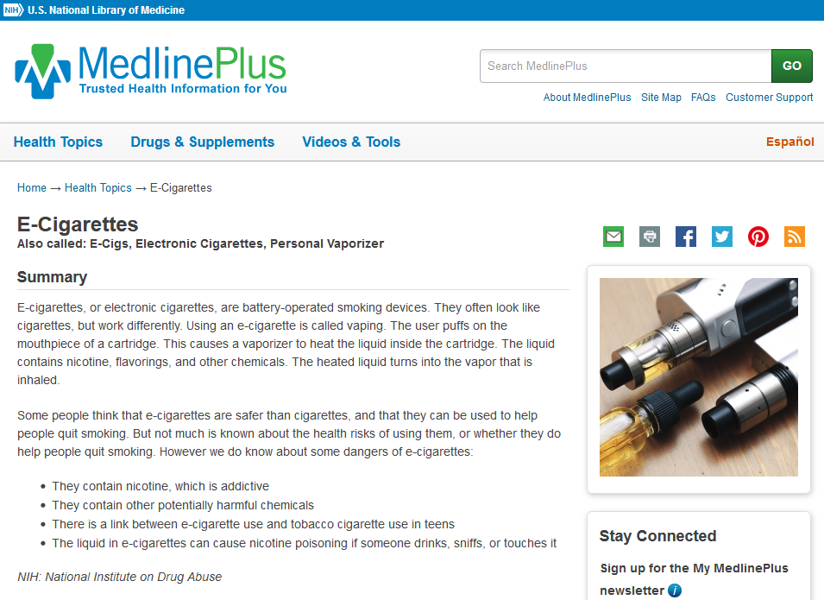
Information in MedlinePlus
Notes:
If a patient does need to be educated, you can find information using MedlinePlus. If they want to do their own research about a health topic or the associated risks, it is helpful to direct them here because they won’t come across biased information. E-Cigarettes, for example, are a newer health related topic that still cause confusion when it comes to associated risks. Being directed to unbiased content may help someone understand the potential harms. A search using a more common search engine may direct a patient to commercial content that downplays the risks of e-cigarettes.

Slide 9
Precontemplation - what to do? (2)
Express empathy¹
Affirmations⁴
Reflections^{4,5}
Roll with resistance¹
Reflections^{6,7}
Express empathy & roll with resistance
Increase awareness
Shows no intent
Precontemplation
Figure 1. Adapted from Tuccero, Railey, Briggs & Hull (2016). Behavioral Health in Prevention and Chronic Illness Management, Primary Care: Clinics in Office Practice, 43, 191-102. doi: 10.1016/j.pop.2016.01.006
Notes:
As a precontemplative patient speaks with you, MI suggests that a person express empathy and roll with resistance¹. We discussed OARS strategies in the last module. Some skills that help express empathy are affirmations⁴ and reflections^{4,5}. These show that you are listening and understand them^{4,5}. Reflections can also help discuss a behavior while rolling with resistance^{6,7}. For example, if a patient stated that they don’t have a drinking problem, a provider might reflect back, “It hasn’t caused any problems for you.”⁶ Think about how someone might respond to this statement. They are much less likely to explore if their drinking has caused problems compared to a provider who says, “Well actually, the number of drinks you have per week is unhealthy.”
[NOTE TO FACILITATOR: If you are completing these modules in an order other than suggested in the facilitation guide, you may need to adjust this note.]

Slide 10
Take home message
Consider:
What shows you that a patient is in precontemplation?
Practice:
When you notice patients in precontemplation, what strategies discussed today work best for you?
Developed resources reported in this presentation are supported by the National Library of Medicine (NLM), National Institutes of Health (NIH) under cooperative agreement number UG4LM012342 with the University of Pittsburgh, Health Sciences Library System. The content is solely the responsibility of the authors and does not necessarily represent the official views of the National Institutes of Health.
Notes:
As we wrap up today, some things to keep in mind are: what shows you that a patient is in precontemplation and when you notice this, which strategies from today do you think will work the best for you when working with them?
[NOTE TO FACILITATOR: If you want to complete group discussion immediately following this module content, change the title of this slide to ‘Group Discussion’ and delete the slide with corresponding questions in the next module. If you would like to have discussion take place using your internal LMS system, you can include instructions here for how participants can participate. Then, adjust the slide with the corresponding questions in the next module as needed.]

Slide 11
References
Tuccero, Railey, Briggs & Hull (2016). Behavioral Health in Prevention and Chronic Illness Management, Primary Care: Clinics in Office Practice, 43, 191-102. doi: 10.1016/j.pop.2016.01.006
Glanz, K., Rimer, B. & Viswanath, K. (Eds.). (2015). Health Behavior: theory, research and practice. San Francisco: Jossey-Bass.
Constance, A. & Sauter, C. (2011). Inspiring and Supporting Behavior Change. United States: American Dietetic Association.
Gold, M., Kelly, T., Douihy, A. (2015). Motivational Interviewing: A Guide for Medical Trainees. New York: Oxford University Press.
McGinnis P., Davis M., Howk S., DeSordi M. & Thomas M. (2014). Integrating Primary Care Practices and Community-based Resources to Manage Obesity: A Bridge-building Toolkit for Rural Primary Care Practice Transformation. Rockville, MD: Agency for Healthcare Research and Quality: AHRQ Publication No. 14-0043-EF. Retrieved from URL to source
Rollnick, S., Miller, W., Butler, C. (2008). Motivational Interviewing in Healthcare. Guilford press: New York
Dartmouth Psychiatric Research Center [Dartmouth]. 2009, August 6. Practice Demonstration Video - Motivational Counseling [video file]. Retrieved from URL to Source

