Slide 1
Cultural Humility
Different from Cultural Competence…

Slide 2
Discussion points from last module
What aspects of culture are you most aware of as you go about doing your job?
Why are these aspects of culture important?
Notes:
(Note: Read the material on the slide) Say at the end of the last session you were asked to think about examples of generalizations about a culture that you had. We would like to hear about some experiences that caused you to change or reexamine those generalizations. (Ask for volunteers. If no one volunteers, can you share an example? Don’t spend more than two minutes on this discussion)

Slide 3
Objectives
By the end of the program participants will:
Understand differences between cultural humility and cultural competence.
Notes:
(Note: Read the material on the slide)

Slide 4
What is Your Experience with Cultural Competence Training?
Notes:
Facilitator: ask the audience if they have taken courses or trainings before about cultural competence. What were they like? What was something of value that they learned? What criticisms did they have about the training, if any?

Slide 5
Cultural Competence Defined
“loosely defined as the ability to understand, appreciate and interact with people from cultures or belief systems different from one's own”¹
Notes:
There are multiple definitions of cultural competence in existence. One author loosely defined cultural competence as, “…the ability to understand, appreciate and interact with people from cultures or belief systems different from one's own”¹. In the last module, we talked about the fact that culture can affect our perceptions of health and the need to understand another’s system of belief. However, there are criticisms of the concept of cultural competence.

Slide 6
Cultural Competence Critiques
“… culture can be reduced inadvertently to a simplified and static ‘tick box’ of sorts- an item to be checked-off a medical training to-do list”³
Focuses on the ‘Other’
Uses Culture as a Proxy
Implies a ‘Finite’ Learning Model³
Notes:
Some argue that cultural competence puts too much of a focus on the other³, meaning it’s designed to make one more ‘comfortable’ with others as opposed to becoming more self-aware about their own potential biases and power differentials. There’s also a critique that cultural competence uses culture as a proxy for everyone who is not white⁵. In other words, it places a strong emphasis on race and ethnicity as opposed to socioeconomic status, gender, or sexual orientation, which in turn ignores the impact these social issues play in health disparities and social inequities. Finally, there is concern that cultural competence emphasizes a finite learning model – one in which a dominant group reaches a plateau, if you will, in becoming competent in another culture. You can see a quote here that demonstrates the criticism of this, stating that through the finite learning model, “culture can be reduced inadvertently to a simplified and static ‘tick box’ of sorts- an item to be checked-off a medical training to-do list.”³

Slide 7
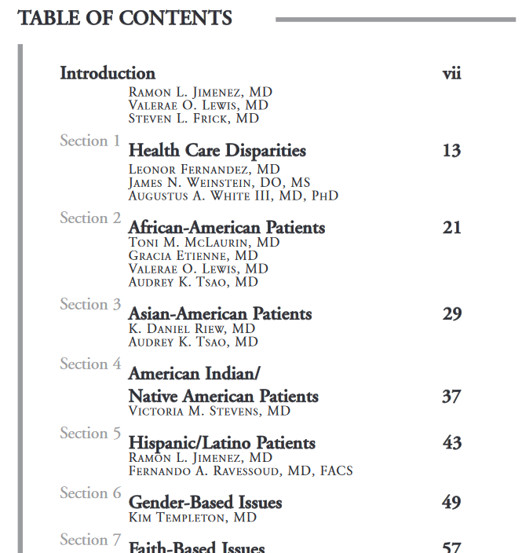
Example
“There is one characteristic that many African-American patients share, however- the tendency to carry a general mistrust of doctors…”⁷
“African-Americans are extremely spiritual…faith in God, the Bible and prayer are important factors to consider when treating an African-American patient.” ⁷
“Physical interaction is also very important to the African American patient.” ⁷
“Female-headed and single-parent households may be common in the African-American population, but you should not assume that this is always the case.” ⁷
Notes:
This is a table of contents from a 2009 document published by the American Academy of Orthopedic Surgeons titled, Culturally Competent Care Guidebook. You can see that each chapter is dedicated to a different racial or ethnic group with following sections about gender-based issues and faith-based issues. From the section about African-American patients, there is a statement that every member of this racial group is a unique individual as should be treated this way, but then immediately launches into the information you see quoted here. [Facilitator: read as many of these as you would like]. It is worth noting that the beginning of this booklet does note that they are aware that these are generalizations and cautions readers to avoid stereotypes, but believes that the information provided is a way to get healthcare providers started with learning about others.
This is an example of the critiques of cultural competence where emphasis is placed on the “other”- a patient of a certain race or ethnicity who you must get to know. In fact, this guidebook states that we often “…encounter patients who are of a different ‘world’”⁷. The focus is placed on getting to know someone else without thinking about the worldview that we bring into the room. It also demonstrates the critique about over emphasizing race. The African-American patients are one chapter with other racial and ethnic groups having their own chapter.

Slide 8
Cultural Competence Criticisms
“…socioeconomic status produces its own cultures of security and insecurity that cut across nationality, ethnic background, gender orientation, age, and political persuasion. Socioeconomic status produces new cultures defined by degrees of social security and limitations on choice that privilege some people and disadvantage others.”⁸
Notes:
This quote demonstrates another of the criticisms of cultural competence, where the emphasis is placed heavily on race while ignoring other factors. Authors discussing the influence of culture on health stated, “…socioeconomic status produces its own cultures of security and insecurity that cut across nationality, ethnic background, gender orientation, age, and political persuasion. Socioeconomic status produces new cultures defined by degrees of social security and limitations on choice that privilege some people and disadvantage others”⁸. It is clear that culture is complicated, with overlap of identities and not exclusively tied to race or ethnicity. Critics of the cultural competence ideology believe that it can be harmful as it can lead to stereotypes². To that end, there is now a growing movement to incorporate the concept of cultural humility².

Slide 9
Cultural Humility Defined
A process that requires humility…
“…as individuals continually engage in self-reflection and self-critique as lifelong learners and reflective practitioners.”⁴
“…in how physicians bring into check the power imbalances that exist in the dynamics of physician-patient communication by using patient-focused interviewing and care.”⁴
“…to develop and maintain mutually respectful and dynamic partnerships with communities...”⁴
Notes:
Here is the description of the process of cultural humility that was included in our first discussion of this topic. Cultural humility is defined as a process where people and organizations engage in self-reflection and lifelong learning, check power imbalances, and engage in mutually respectful and dynamic partnerships⁴. What is your reaction to this definition after discussing culture and the critiques of cultural competence?

Slide 10
Take home message
Consider:
What has been your past experience with cultural competence training? Did you notice the described limitations?
Practice:
How would you explain the difference between cultural competence and cultural humility to a colleague?
Developed resources reported in this presentation are supported by the National Library of Medicine (NLM), National Institutes of Health (NIH) under cooperative agreement number UG4LM012342 with the University of Pittsburgh, Health Sciences Library System. The content is solely the responsibility of the authors and does not necessarily represent the official views of the National Institutes of Health.

Slide 11
References
DeAngelis, T. (2015). In Search of Cultural Competence, Monitor on Psychology, 46(3), Retrieved from URL to source
Fisher-Borne, M., Cain, J.M., & Martin, S.L. (2015). From Mastery to Accountability: Cultural Humility as an Alternative to Cultural Competence. Social Work Education, 34(2), 165-181. doi: 10.1080/02615479.2014.977244
MacKenzie, L., Hatala, A (2019). Addressing culture within healthcare settings: the limits of cultural competence and the power of humility. Canadian Medical Education Journal, 10(1), e124-e127.
Tervalon, M., Murray-Garcia, J. (1998). Cultural Humility Versus Cultural Competence: A Critical Distinction in Defining Physician Training Outcomes in Multicultural Education. Journal of Health Care for the Poor and Underserved, 9(2), 117-125.
Malat, J. (2013). The Appeal and Problems of a Cultural Competence Approach to Reducing Racial Disparities. Journal of General Internal Medicine, 28(5), 605-607.
White, A., Logghe, H., Goodenough, D., Barnes, L., Hallward, A., Allen, I… Llerena-Quinn, R. (2018). Self-Awareness and Cultural Identity as an Effort to Reduce Bias in Medicine. Journal of Racial and Ethnic Health Disparities, 5, 34-49.
American Academy of Orthopaedic Surgeons (2009). Culturally Competent Care Guidebook. Retrieved from: URL to Source
Napier, D., Ancarno, C., Butler, B., Calabrese, J., Chater, A., Chaterjee, H… Guesnet, F. (2014). Culture and Health. The Lancet, 384, 1607-1639.

