Slide 1
Telehealth Library Partnership
Lessons Learned and Looking Ahead
Rachael Masaitis
George Strawley
Notes:
Thank you, Lauren. I am glad to be here today.
We’re going to talk about telehealth and particularly a program to increase telehealth access for rural library patrons in Idaho.

Slide 2
Disclaimers
Developed resources reported in this presentation are supported by the National Library of Medicine (NLM), National Institutes of Health (NIH) under cooperative agreement number UG4LM013732 with the University of Utah. The content is solely the responsibility of the authors and does not necessarily represent the official views of the National Institutes of Health.
Funding for this presentation was made possible in part, by the Substance Abuse Prevention Block Grant (SABG) Coronavirus Response and Relief Supplement Appropriations Act 93.959 from SAMHSA. The views expressed in written conference materials or publications and by speakers and moderators do not reflect the official policies of the Idaho Department of Health and Welfare, HHS, or SAMHSA, nor does mention of trade names, commercial practices, or organizations imply endorsement by the U.S. Government.
Notes:
First, a couple of disclaimers. The language here basically says that our views do not necessarily represent those of the National Institutes of Health, the National Library of Medicine or the Idaho Department of Health and Welfare.

Slide 3
Presenter Organizations
Notes:
These are our organizations. Rachael is with the Idaho Department of Health and Welfare and I am with the NNLM.

Slide 4
Objectives
Introduction to Telehealth
Discuss how libraries can contribute to Telehealth in their communities
Discuss educational courses focusing on Telehealth and libraries
Provide an overview of the IDHW
Third Space project from inception to present
A library is not a luxury but one of the necessities of life
– Henry Ward Beecher
Notes:
We have a few objectives today in our presentation. We will give you a very brief introduction to telehealth and discuss how libraries can aid telehealth in their communities. I will discuss a couple of ways you can learn about telehealth beyond the scope of what we can provide today. Then Rachael will provide an overview of the Idaho Department of Health and Welfare and talk specifically about their Third Space project.
There will be a spot where I will share a few QR codes with you, so I want to give you a heads-up about that. If you are not a QR code person, we’ll drop the links in the chat, too.

Slide 5
George Strawley
Network of the National Library of Medicine
Region 4
University of Utah

Slide 6
Telehealth and Telemedicine
Telehealth is not new
It can be used in nearly every medical or behavioral health field
Increases health equity and access to underserved communities and populations
Can be accompanied with mobile health and digital devices for remote monitoring
Radio News, April 1924
Notes:
To begin, we will talk about the history of telehealth and telemedicine, as well as the distinctions between the two.
Telemedicine is described as remote clinical services i.e. (Medical Doctors and Providers)
Telehealth is broader and can include remote non-clinical services i.e. (Mental and Behavioral Health). I should also mention that telehealth can include digital devices that allow for real time patient monitoring remotely.. Apple Watch is a good example of this. It has been shown in heart monitoring studies that the watch was beneficial for monitoring the patient’s heart rate
For the purposes of this presentation, we will be referring to Telehealth for both Telehealth and Telemedicine
The idea that we could provide health care services remotely has been around for a while.
In 1879, three years after the telephone was invented, Lancet medical journal highly recommended the use of telephones to meet with patients to reduce the number of unnecessary office visits.
In 1924, Radio News magazine
Article hypothesized that in the future people would no longer need to go to a doctor’s office for nonemergency care visits
Instead, the Doctor would come to them via radio and two-way screen.
Now that the future is here, telehealth can be used over the telephone or on a two-way screen in every medical and behavioral field for all or a portion of patient and client care.
This includes Non-emergency and informational visits, follow-ups, to include behavioral health therapies and assessments which all can be done via telehealth.
A University of Rochester Medical Center Study found that
telehealth was not only an effective way of delivering healthcare to patients while maintaining traditional reimbursement rates
It also increased healthcare access for underserved and vulnerable populations.

Slide 7
Importance of Telehealth
Reduces barriers to accessing Treatment
Allows for additional treatment options
Convenience and flexibility
Decreased wait times for appointments
Increased access to specialized services
Reduces the financial burden attending appointments
Notes:
Telehealth offers an array of advantages:
With respect to barriers related to access to treatment, a telehealth patient doesn’t need to travel long distances to obtain services. It is also safer during inclement weather, etc.
Convenience/Flexibility → Patients can request less time off work and don’t have to find child/elder care. Able to find a time that works better for the patient.
Telehealth also expands options regarding format of an appointment. If a patient prefers telehealth over in -erson appointments this meets that need. In turn, that increases the likelihood they will continue on and complete their treatment.
Telehealth can reduce the financial burden of a medical appointment. There are lower fuel and car maintenance costs, and no lost wages (i.e. taking less time off work because don’t need to travel as far for appointments), no additional transportation costs (i.e. uber, etc.).
Specialty services are available such as neurology, oncology, and psychiatry.

Slide 8
Retail and Telehealth
Notes:
Healthcare organizations and even retailers have begun to recognize a market for telehealth. The list of companies that have announced virtual care services include Costco, Walmart, Amazon, Walgreens and even Best Buy. Retailers’ services are often marketed directly to the consumer on a pay-as-you-go basis.
How often is telehealth really used?
2022 Study National Center for Health Statistics surveyed telehealth users over the course of a one-year period
During 2021, 37% of adults survey used telehealth for at least one service
Even with the pandemic slowly receding, future use is expected to rise as more providers offer telehealth services.
The new infrastructure bill will allow for increased broadband access in rural areas, allowing more patient/clients to use telehealth services in those regions

Slide 9
BENEFITS FOR EVERYONE
University of California Study
(December 2022)
Round Trip Miles Saved: 53,664,391
Travel Hours Saved: 1,788,831
Money Saved: $33,540,244
Lives Saved: 42.4 crash related injuries and 0.7 fatalities avoided
Based on an average of 17.6 miles round trip, 35.3 minutes in transport and $11.02 cost per encounter.
(Sharma, Yellowless, Gotthardt, Luce, Adalovic, & Marcin, 2022)
9
October 2023
Notes:
Here are highlights of telehealth data analyzed from five University of California Care Systems
The study looked at 3 Million Ambulatory Telehealth Encounters over a two-year period (March 1, 2020 - February 28, 2022).
In those five systems alone, telehealth saved healthcare systems $33.5 million over a two-year period during Covid.
They even found that telehealth saved injuries and even lives because people were not getting into accidents on their way to the doctor.

Slide 10
Library Telehealth Pilots or Programs Exist in These States
Notes:
This map shows states where there is at least somebody working on a telehealth program. In many cases, this can be one library pioneering a new service on their own. However, increasingly we are seeing state libraries like Delaware, Idaho, Wyoming and Maine launching programs to enable private and secure telehealth access at local public libraries They usually rely on federal money.

Slide 11
What a Telehealth Appointment Looks Like
Notes:
Here is a clip advertising a pilot library telehealth project that shows you one way a patron can experience a telehealth appointment. It gives you a visual of what library telehealth looks like.

Slide 12
Network of the National Library of Medicine
George Strawley
"The only thing that you absolutely have to know is the location of the library."
-Albert Einstein
Notes:
So now we will talk about a couple of telehealth resources available to you for free from the Network of the National Library of Medicine.

Slide 13
Telehealth 101
Facilitated Online Course
Three One-Hour Modules
CHIS Credit Available
Notes:
One thing N-N-L-M identified early on in our discussions about telehealth was an important need for training that answered questions specific to libraries and addressed the concerns that typically come up among staff and administrators.
We’ve developed a free course called “Telehealth 101: What Libraries Need to Know.” The course is an asynchronous course on our online platform that provides an overview of telehealth. Unlike other telehealth courses focused on providers, this one focuses on library issues. It takes three hours over the course of three weeks and carries credit toward the Consumer Health Information Specialization, which is offered by the Medical Library Association.

Slide 14
Telehealth 101: Course Objectives
Recognize
Different approaches and models to providing telehealth access in libraries
Identify
Infrastructure-related resources available to the library for providing telehealth services
Discuss
Describe
The role of the library in support of digital skills training for telehealth
Considerations such as privacy and policy for offering telehealth access within libraries
Notes:
GS:
You can see the 4 objectives for the course. Learners will recognize different approaches to telehealth in use among libraries, address some of the potential ethical and legal concerns that typically come up when librarians discuss telehealth, identify resources they can use for telehealth services, and describe the role that libraries have in support of patrons’ digital skills training and health reference questions.

Slide 15
What Learners Said
“The most useful aspect was being able to see how other libraries are using telehealth services and being exposed to new resources for telehealth information and funding.”
“Colleague discussion and recorded dialogue about implementing telehealth helped me think about how different groups that use my library could be affected by adjustments [we‘d] have to make to implement these services.”
“The offered list of funding opportunities has motivated me to consider this for my library. Seeing specific examples of telehealth helps me imagine this in my own library as well. “
“Being exposed to existing telehealth programs was invaluable. The fact that both programs were quite different in setting / funding was great to see as well.”
Notes:
These are some of the comments we have had about the course. Much of the course is structured around interviews with librarians and others who are working on telehealth access. Learners especially liked the opportunity to hear about their experiences with it. They also liked interacting with classmates who were trying to figure out telehealth for their libraries as well.

Slide 16
New Training Opportunity from NNLM
Telehealth 101: What Libraries Need to Know
Next online class Feb. 5-Mar. 1
3 one-hour modules
2 more sections to come
Notes:
We offered the course twice last summer, and both sections had full registrations. We are offering it again and unfortunately it is already filled up at this time. However, we expect the course to be offered twice more over the following year after that.
The QR code on this slide and the link that is being put in the chat will take you to information on the class and how to register. There you can track information on the next two sections.
Importantly, the course is free,
We also encourage you to sign up for an account with N-N-L-M to receive news related to this course and other training opportunities – including our live webinar series.
.

Slide 17
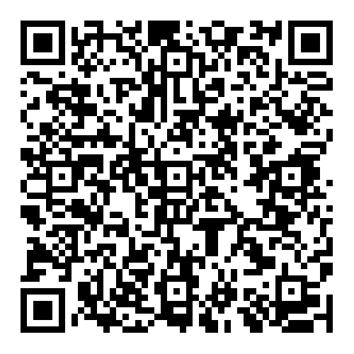
Future Plans
Bridging the Digital Divide: Telehealth and Libraries
Implementation of Telehealth Services in Rural Public Libraries
Kieran Hixon
Colorado Department of Education
Ashley Heathfield
Office of eHealth Innovation
Colorado Governor’s Office of Information Technology
April 3
1 p.m. MT / 3 ET
Notes:
So here is the information on our next webinar in our national series. It is called Implementation of Telehealth Service in Rural Public Libraries and features two speakers from Colorado state government who are working on telehealth. The webinar will be on April 3rd and again you can go to the QR code or the link in the chat to register.

Slide 18
Northwest Regional Telehealth Resource Center
https://nrtrc.org
Notes:
We also want to share some non-NNLM resources with you. For instance, you can find other support for telehealth projects from your region’s telehealth resource center. The Northwest Regional Telehealth Resource Center is at N-R-T-R-C dot org. It provides training and resources for providers and others interested in telehealth.
They recently released a course of their own called Navigating the Telehealth Neighborhood. This is designed for digital navigators assisting telehealth patients. That includes library staff.
The course is free and can be found on the website.

Slide 19
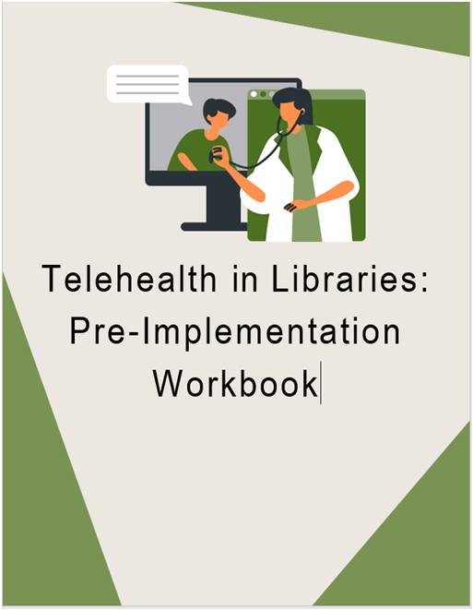
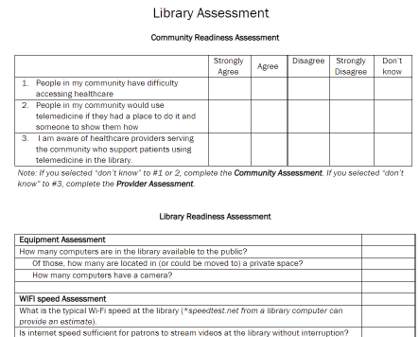
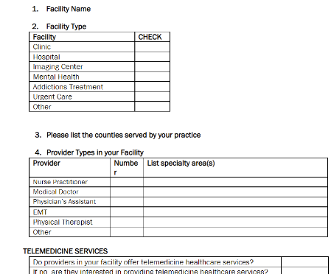
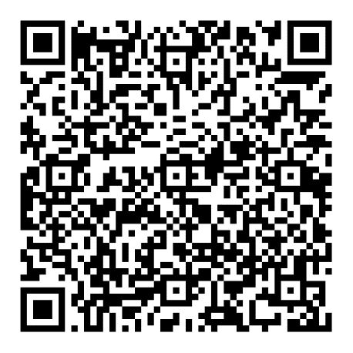
Developing Your Program
Notes:
The Indiana Rural Health Association with the help of researcher Pamela DeGuzman has developed a workbook for planning out a telemedicine service based on her research. It is available on the I-R-H-A website. It is called “Telehealth in Libraries: Pre-Implementation Workbook.”

Slide 20
Upgrade Your Space Project
Experience is a hard teacher because she gives the test first the lesson afterward.
– Vernon Law

Slide 21
Rachael Masaitis
Idaho Department of Health and Welfare
Human Services Program Specialist

Slide 22
The Goal
Increase Telehealth access to rural Idahoans by:
Providing privacy spaces
Technology
Support
Notes:
The Idaho Department of Health and Welfare received a funding supplemental Substance Use Prevention, Recovery, and Treatment through the from the American Rescue Act enacted due to the Covid-19 pandemic. The project development began in March 2021, and the legislature approved the funding to be spent beginning July 2022. The total allocation for the project is $500,000 dollars with the goal of outfitting around 20 libraries with equipment.

Slide 23
The Location: Libraries
Digital literacy education
Information resource availability
Existing confidentiality, privacy policies and compliance with state laws
Software available to purge all patron data and browser cache after ever use
Most Idaho libraries have stable and reliable broadband access even when community members do not
Notes:
Libraries already provide courses on digital literacy. This includes email, browser, and website use. In addition, there is now free digital literacy training for librarians for telehealth to assist patrons in logging in and using telehealth platforms.
Idaho libraries and the American Library Association both have existing rules and laws for treating patron privacy. This is due to library card registration, use of computer technology in the library. In addition, the computers are secure and purge patron data once the patron logs out as a standard practice. This will be helpful while using the space for telehealth.
The Idaho Chamber of Commerce’s pervious broadband initiative and current initiatives have been utilized to secure broadband access at most public libraries across the state.

Slide 24
The Process
Equipment
Applications
Rural communities
Adequate space for a privacy area
Approved by the local fire inspector
Willing to manage a scheduling system for the space
Modular pod, or room divider
Laptop
High resolution webcam with microphone
Large 24” display
Keyboard with large lettering for the visually impaired
Ring light for camera use
Headset for privacy and the hearing impaired
Notes:
The Rural communities defined as 50,000 people or less, not part of a contiguous metropolitan area.. Based on the Department of Agriculture description

Slide 25
The Third Space
Scheduling
HIPAA
Client Consent
Policies
Library Staff Emotional and Physical Safety
Provider Engagement
Marketing
Equipment Vendor
Notes:
There isn’t a road map for comparable to this project. Although libraries have been hosting spaces like these for some time, it was generally developed and implemented by the library themselves. Due to the scope and size of this project, every problem solved lead to a new issue that required a solution.
We dubbed these spaces “Third Spaces” – Services Not found in a clinic, or at home, but an alternative venue getting services generally received in a clinical environment.

Slide 26
Monitoring the schedule
THE SPACE
Clean and free of Protected Health Information or other debris.
INFORMATION
Provide information on how the privacy space works.
ASSISTANCE
Technical assistance with consent
Issues with the privacy space
SCHEDULING
LISTENING
Role
Notes:
When hosting a space, these are the roles the librarians would be most like to be responsible for

Slide 27
Responsibilities
Entertaining children during appointments
Facilitating appointments or making appointments
Providing more assistance than their education/skills allow
Librarians are Not Responsible for:
Notes:
It’s important to note, there are things that a library is not responsible for while managing a third space. Importantly, a library is just a venue.. Like a wedding venue manager, the library provides the spaces, and the client/patron is responsible for obtaining the officiate and the caterer. Notably, you may have patrons who want to discuss their issues, Dr’s appoints etc. with you, and undoubtably this probably already occurs. But be careful not to step into a counselor's role, it’s both dangerous for you and the patron. They may come back or do something called “transference” – when someone redirects their feelings on to you. We will be providing training on how to deal with these situations as well as brochures as requested once the space is installed.

Slide 28
Scheduling
Offers free online scheduling
A calendar and booking options by time slots
Individuals can see only available time slots
Will receive a text or email reminder of a schedule appointment and can cancel space reservations at anytime
Courtesy of Square.com
Notes:
Square was chosen to provide as an option for scheduling. Libraries can provide reservation access via mobile device, computer or at the library all for free. Libraries also can allow the client to schedule access to the space at the library through a librarian. Square creates a space for individuals to schedule times of use. This eliminates overlap or confusion and puts the ownership in the hands of the clients. Calendars can be used internally by library staff to manage the space and know who has reserved the space for use.

Slide 29
HIPAA, PHI, and the Library
Libraries are not:
A HIPAA covered entity
Business Associate
Notes:
A Library is still responsible for:
Staff avoiding their patron’s Protected Health Information (PHI)
Patron’s privacy while booking and using the space.

Slide 30
How Libraries can Avoid Breaching PHI
Asking
Never ask the reason the library privacy space is being used
Market
Market your telehealth space as a “Privacy or Quiet Space”
Include
Include several uses for the library privacy space above and beyond telehealth
Treat
Treat all individuals using the space the same
Shred
Shred all documents left by patrons
Scheduling
Use a scheduling system that provides as much anonymity as possible
Training
Utilize telehealth literacy as a pre-training tool for patrons
Avoid
Avoid interaction with the patron while using the privacy space
Notes:
Here as some ways to avoid inadvertently coming in contact with a client’s PHI outside of normal library duties.

Slide 31
Provider Marketing
Benefits for Providers
Improved patient outcomes
Increased patient engagement and satisfaction
Remote monitoring opportunities
Reduces no-show rates
Reduced overhead costs
Benefits for Patients
Reduce barriers to accessing treatment
Additional treatment format to meet patient preference
Greater convenience and flexibility to schedule visits
Decreased wait times for an appointment
Decreased financial burden
Increased access to specialized services
Notes:
Conducted a 15-minute video presentation about the release of the telehealth spaces and sent the information out to all providers in the rural health system, insurers, large and small medical groups, and behavioral health networks.
Patient outcomes → reducing barriers to access increases the likelihood someone will continue on with treatment, especially for people in rural areas.
Engagement/Satisfaction → telehealth decreases wait and travel times. It gives the patient more options and flexibility for receiving treatment. All of which increase the satisfaction of the Pt
Remote monitoring → Using fitness watches or tracking apps can reduce patient appointments or increase awareness of potential issues
No-show rates → reducing transportation limitations, especially for individuals in rural communities who would need to travel to larger neighboring communities for their appointments.
Overhead → Telemedicine allows for reduction in operating costs and increased efficiency in utilization of resources, while allowing flexibility in hours of operation to better meet the needs of your patient population. By delivering care using telemedicine, you don’t have the same overhead costs as you do when you’re seeing patients in-person.
https://www.providertech.com/6-benefits-of-telehealth-for-healthcare-providers/

Slide 32
The Greatest Hits! Or Misses?
A man who carries a cat by the tail learns something he can learn in no other way.
– Mark Twain
Notes:
Mark Twain said, “A man who carries a cat by the tail learns something he can learn in no other way.
This was a brand new project, not just for Idaho but for the US. Although telehealth spaces have been in libraries for some time, these spaces were placed in the library by the staff themselves, and if there were more than one in the state, they tended to be independent of one another. At a state level, especially working for the state social services authority to include state Medicaid, we have access to vast networks of providers and agencies of all sorts. The hurdles and challenges we faced was how to distribute “capital outlay” which are physical supplies to another public agency, not within the state. Here are some of our greatest hits and misses while trying to develop this project.

Slide 33
Time for a Conversation
"Conversation" by raiznext is licensed under CC BY 2.0.
"Curiosity Question I" by edenpictures is licensed under CC BY 2.0.
Notes:
So that’s our presentation. Thank you for listening. Our emails will be on the next slide, but first, what questions do you have for us?

Slide 34
Contact Us
Rachael Masaitis
Idaho Department of Health and Welfare
Rachael.Masaitis@dhw.Idaho.gov
George Strawley
Network of the National Library of Medicine
george.strawley@utah.edu
(801) 581-5242
Notes:
CORRECT THIS

Slide 35
References
Adetosoye, F., Hinton, D., Shenai, G., & Thayumanavan, E. (2023, March 16). Virtual health for all: Closing the digital divide to expand access. https://www.mckinsey.com/industries/public-and-social-sector/our-insights/virtual-health-for-all-closing-the-digital-divide-to-expand-access
Li, X., & Park, J. M. (2022, March 12). Telehealth in the pursuit of value-based care. https://www.mgma.com/resources/quality-patient-experience/telehealth-in-the-pursuit-of-value-based-care
IBIS World (2023, January 10). Telehealth Services in the US - Market Size 2005–2029. https://www.ibisworld.com/industry-statistics/market-size/telehealth-services-united-states/
American Library Association (2021, October 1). Privacy. https://www.ala.org/advocacy/privacy
Baker, D. (2017, April 7). Patron Privacy and the Confidentiality of Patron Records: What Happens at the Library Stays at the Library. https://libraries.idaho.gov/patron-privacy-and-the-confidentiality-of-patron-records-what-happens-at-the-library-stays-at-the-library/
Karimi, M., Lee, E. C., Courtre, S. J., Gonzales, A., Grigorescu, V., Smith, S. R., De Lew, N., & Sommers, B. D. (2022, February 1). National Survey Trends in Telehealth Use in 2021: Disparities in Utilization and Audio vs. Video Services. Assistant Secretary for Planning and Evaluation. https://aspe.hhs.gov/sites/default/files/documents/4e1853c0b4885112b2994680a58af9ed/telehealth-hps-ib.pdf
Jimenez, J. C. (2022, April 27). Telehealth 2.0: Remote Patient Monitoring Tools to Give Shot in the Arm to Telehealth. https://www.nasdaq.com/articles/telehealth-2.0%3A-remote-patient-monitoring-tools-to-give-shot-in-the-arm-to-telehealth
Idaho Legislature (n.d.). Title 74 Chapter 1 Public Records Act Exemption from Disclosure. Idaho Statutes. https://legislature.idaho.gov/statutesrules/idstat/Title74/T74CH1/SECT74-108/
Idaho Legislature (n.d.). Chapter 57 Idaho Telehealth Access Act. Idaho Statutes. https://legislature.idaho.gov/statutesrules/idstat/title54/t54ch57/
De Wit, K. (2023, January 9). What States Need to Know About Federal BEAD Funding for High-Speed Internet Expansion. https://www.pewtrusts.org/en/research-and-analysis/issue-briefs/2023/01/what-states-need-to-know-about-federal-bead-funding-for-high-speed-internet-expansion
Providertech (2020, May 5). 6 Benefits of Telehealth for Healthcare Providers. https://www.providertech.com/6-benefits-of-telehealth-for-healthcare-providers/
Idaho Department of Health and Welfare (n.d.). Idaho Department of Health and Welfare. Rural Health and Underserved Areas. https://healthandwelfare.idaho.gov/providers/rural-health-and-underserved-areas/rural-health-and-underserved-areas
Board on Health Care Services; Institute of Medicine. The Role of Telehealth in an Evolving Health Care Environment: Workshop Summary. Washington (DC): National Academies Press (US); 2012 Nov 20. 3, The Evolution of Telehealth: Where Have We Been and Where Are We Going? Available from: https://www.ncbi.nlm.nih.gov/books/NBK207141/
J. M. (2022, September 21). Myths Busted: New Studies Show Telemedicine is Effective, Doesn’t Reduce Access to Care. https://www.urmc.rochester.edu/news/story/myths-busted-new-studies-show-telemedicine-is-effective-doesnt-reduce-access-to-care
Lucas JW, Villarroel MA. Telemedicine use among adults: United States, 2021. NCHS Data Brief, no 445. Hyattsville, MD: National Center for Health Statistics. 2022. DOI: https://dx.doi.org/10.15620/cdc:121435.
Sharma S, Yellowlees PM, Gotthardt CJ, Luce MS, Avdalovic MV, Marcin JP. Environmental Impact of Ambulatory Telehealth Use by a Statewide University Health System During COVID-19. Telemed J E Health. 2022 Dec 23. doi: 10.1089/tmj.2022.0396. Epub ahead of print. PMID: 36576982.

