Slide 1
Using MedlinePlus to Find Health Information
NNLM Region 1 Team
nnlm@hshsl.umaryland.edu

Slide 2
NNL..huh?
NIH
NNLM
Region 1
NLM
National Institutes of Health
Nation’s research agency
27 institutes and offices
National Library of Medicine
World’s largest biomedical library
Network of the National
Library of Medicine
Program of the NLM comprised of 7 Regional Libraries (RMLs) and 3 offices
Notes:
Before we get into our class today, a word about who we are!
Though you may be familiar with some of these acronyms, most people are a little confused about who we are.
The National Institutes of Health is the nation’s leading medical research agency. Many of you might be more familiar with the National Cancer Institute which is one of the many institutes and centers at NIH.
The National Library of Medicine is also an institute at NIH. It is the world’s largest biomedical library which maintains and makes available a vast print collection and produces electronic information resources like MedlinePlus and PubMed.
NNLM is the Network of the National Library of Medicine and is an outreach program of NLM.
You are located in Region 1 of the NNLM

Slide 3
NNLM, Region 1
Delaware
Kentucky
Maryland
New Jersey
North Carolina
Pennsylvania
Virginia
Washington, D.C.
West Virginia
Notes:
The Network of the National Library of Medicine is the engagement and training arm for the National Library of Medicine. The Region 1 Office is located at the University of Maryland, Baltimore and serves to provide outreach and education primarily to 8 states including Delaware, Kentucky, Maryland, New Jersey, North Carolina, Pennsylvania, Virginia, West Virginia and Washington D.C.; however, we also support a lot of national outreach programs as well.

Slide 4
NNLM Engagement
Training
Funding
Outreach
Visit NNLM.gov for more information
Notes:
Engagement is primarily under three different areas:
Training and Education Programs offered online or in person,
Funding to support community health information outreach projects, and
Outreach to under-resourced populations, especially those underrepresented in biomedical research.
You can visit NNLM.gov for more information on the programs we offer and also have your institution join our network! As a government funded organization, becoming a member is free as well as participating in our engagement programs.

Slide 5
NLM MedlinePlus

Slide 6
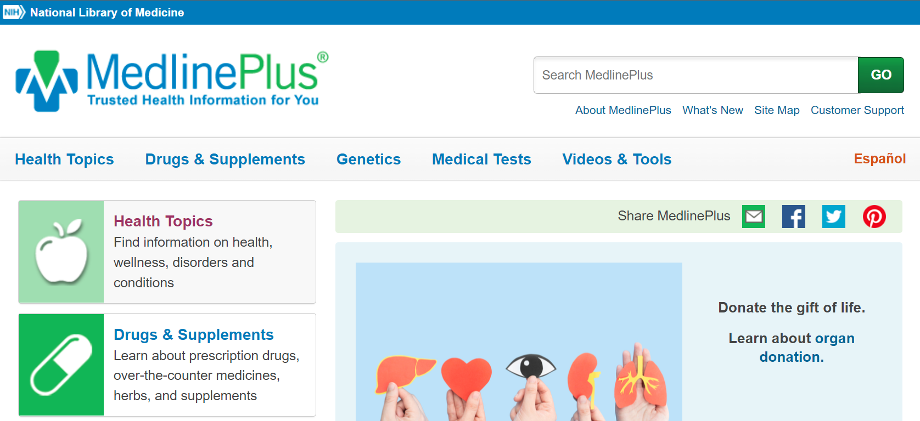
MedlinePlus.gov
Notes:
MedlinePlus is the National Institutes of Health's website for patients and the general public. Produced by the National Library of Medicine, it offers trusted and current health information, anytime, anywhere about diseases, conditions, and wellness issues in both English and Spanish for free. Medline Plus is accessible from a computer, tablet or phone, no matter the device, you will find the same information. Its content is developed to incorporate best practices for web accessibility and is compatible with assistive technology like screen readers. MedlinePlus articles avoid using complex medical jargon so users are less likely to be overwhelmed by what they’re reading. Consumers can access MedlinePlus for brief or in-depth explanations of a health topic, and health care providers can confidently refer their patients to it.
The MedlinePlus website has four main sections: Health Topics, Drugs & Supplements, Genetics, and Medical Tests. Within each of these collections, you can search or browse for topics. Topic pages follow a standardized template with clear structure and navigation so users can quickly get to the information they need.

Slide 7
About MedlinePlus.gov
1,600+ Selected Topics
Links to authoritative health information in English or Spanish
National Library of Medicine
National Institutes of Health
Trusted health-related organizations
Center for Disease Control and Prevention
Food and Drug Administration
National Center for Complementary and Integrative Health
Notes:
Currently, MedlinePlus is sourced from more than 1,600 selected organizations and provides 40,000 links to authoritative health information in English and 18,000 links to information in Spanish.
MedlinePlus links to information produced by the National Library of Medicine (NLM), the National Institutes of Health (NIH) and other trusted health-related organizations within the U.S. Federal Government, such as:
Centers for Disease Control and Prevention (CDC);
Food and Drug Administration (FDA); and the
National Center for Complementary and Integrative Health (NCCIH).

Slide 8
Trusted and Verified
Qualitative, Authoritative and Accurate
Educational, not promotional
Updated and maintained
Notes:
Information included in MedlinePlus is quality information, from authoritative sources and accurate. Information on MedlinePlus is educational, it is not selling or promoting a product or service and it completely free. The information is updated regularly, any broken links are removed daily. MedlinePlus is accurate, science based, unbiased. Information is presented at a sixth grade reading level, making it easier to read.

Slide 9
What’s In It For You?
Notes:
We previously covered that MedlinePlus has quality, educational up to date information. But what can you find on MedlinePlus and why should you consider using it? There is a lot of health information on the internet, you can become overwhelmed and not sure what is reliable when looking for information. With MedlinePlus, we already know that the information is trustworthy, but you may wonder will it fit my needs? Whether you are looking for information for yourself, a family member or a friend. MedlinePlus was designed to meet your health information needs, from well known diseases such as diabetes, rare diseases and new and emerging diseases such as COVID-19.
MedlinePlus website has four main sections: Health Topics, Drugs & Supplements, Genetics, and Medical Tests. Within each of these collections, you can search or browse for topics. Topic pages follow a standardized template with clear structure and navigation so users can quickly get to the information they need

Slide 10
Health Topics
Example Question
How much exercise do I need?
Search
Refine by Type
Health Topics
Health Topic Page
Browsing
Health Topics
Notes:
The first section of Medline Plus we’ll review is Health Topics. There are more than 1000 health topics available. There are two ways to cover Health Topics within MedlinePlus. First is to use the Search Box to look up a particular health topic, and the other option is to browse. Let’s look at one particular example to try both out.
***
Click: “Health Topics”
Scroll to “Health and Wellness”
Select “Fitness and Exercise”
Scroll to Exercise: How Much? see How Much Exercise Do I Need?
Search Box: Exercise Need
Point Out: Refine by Type and Format filters
Click How Much Exercise Do I Need?

Slide 11
Exercise 1
My mom was recently diagnosed with Breast Cancer.
Can you help me find some information I can share with my family?
Notes:
https://medlineplus.gov/breastcancer.html

Slide 12
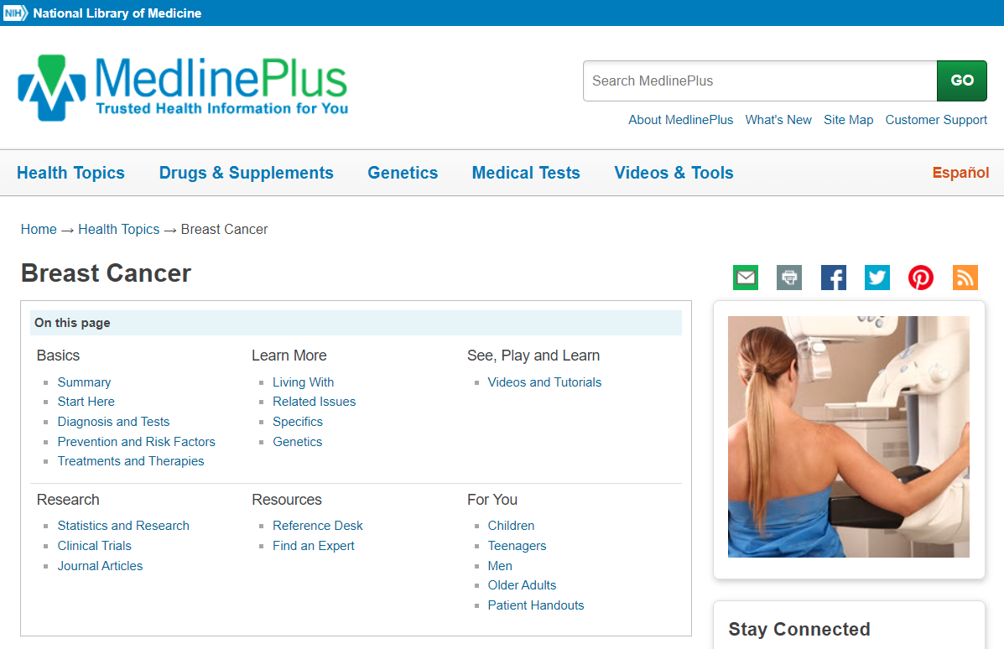
Topic Page
Notes:
https://medlineplus.gov/breastcancer.html
Let’s look at a topic page in a little more detail. As seen on the page, health topics include six focus areas:
Basics;
Learn More;
See, Play and Learn;
Research;
Resources; and
For You.
Each focus area is further broken down into sub-categories. Content in the sub-category varies by health topic. Clicking on these links will jump you to that section of the health topic page.

Slide 13
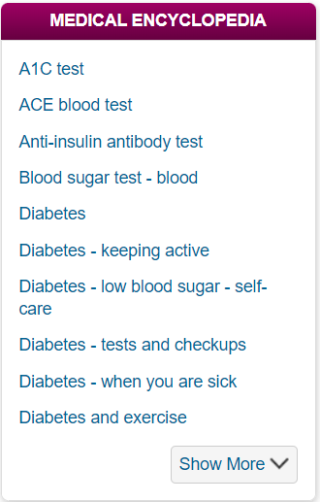
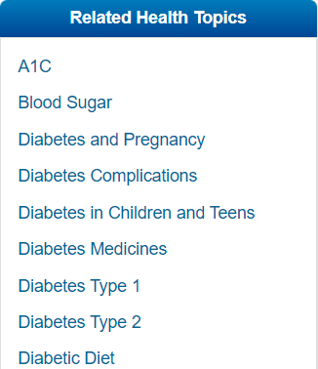
Other Features
Notes:
In the Medical Encyclopedia box, you will see related terms that link to the Medical Encyclopedia section of MedlinePlus. We will explore the Medical Encyclopedia in more detail later in this tutorial.
In the Related Health Topics box, you will see links to additional health topics that are relevant to the page you are viewing.

Slide 14
Health Topic Categories
Example Question
Where do I go to find a Calorie Counter to help me with Weight Control?
Basics
Learn More
See, Play, and Learn
Research
Resources
For You
Notes:
Basics include a written “Summary” that provides a narrative overview of the topic. “Start Here” includes the best links to external content, selected using the quality guidelines and regularly verified for currency, relevancy, and authority by MedlinePlus librarians. The sub areas “Diagnosis and Tests,” “Prevention and Risk Factors” and “Treatments and Therapies” include links to authoritative sources.
Learn More provides information about “Living With” a disease or condition, “Related Issues,” “Specific” and “Genetics” aspects related to a disease or condition.
See, Play, and Learn lists videos and tutorials, health check tools such as interactive calculators and games, and links to images.
Research provides numerical data and the latest research from the National Institutes of Health databases such as ClinicalTrials.gov and PubMed.gov.
Resources includes a “Reference Desk” of dictionaries or specific encyclopedia or glossaries. “Find an Expert” provides links to organizations and/or specialty healthcare professionals.
And finally, For You provides content for specific populations and patient handouts.
Example
Search Weight Control
Go to: Health Check Tools

Slide 15
On Your Own
Look up: Depression
What category would you find information depression and anxiety in Migraine patients?
Notes:
Related Issue

Slide 16
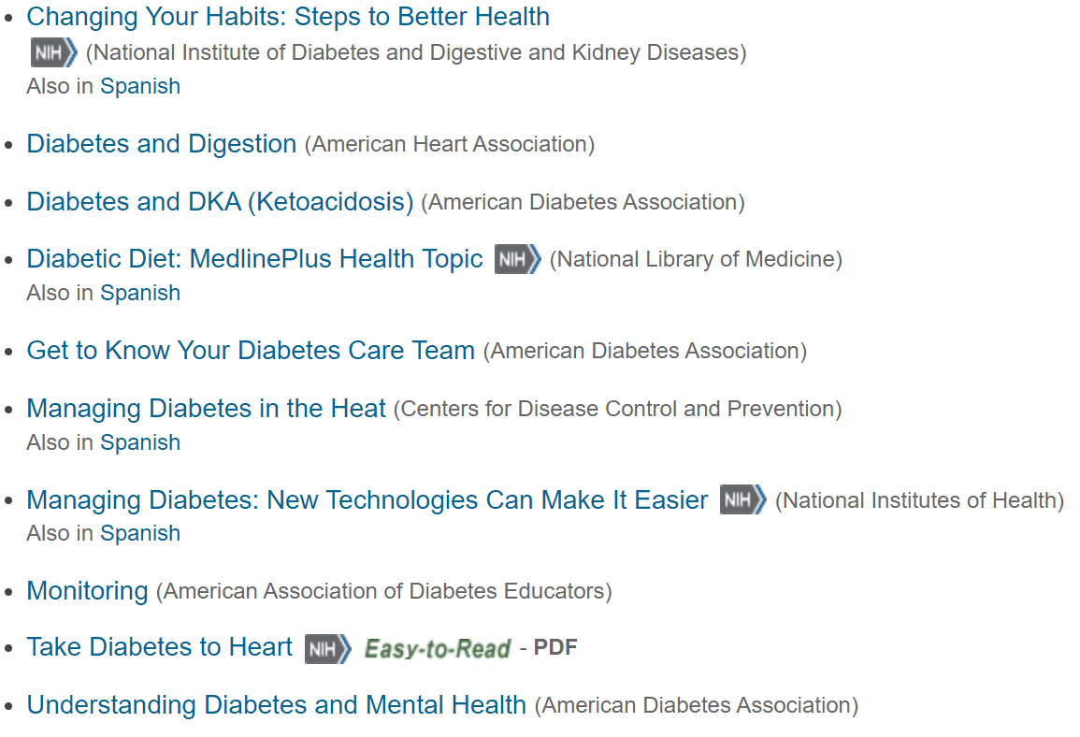
Health Topic: Link Descriptions
Notes:
Each record in a MedlinePlus health topic lists the source of the information on the link, so you will know where you are going before you click on it.
MedlinePlus also has certain specially-tagged records next to the link names, including:
Specific NIH content;
Easy-to-read;
Also in Spanish, and
Video.

Slide 17
Health Topics: Key Points
Regularly updated content;
Attributed authors;
Authoritative links; and
Easy-to-read summaries.
Notes:
Health Topics provide the backbone of MedlinePlus health information.

Slide 18
Exercises 2
Go to the Hepatitis C health topic page. Click on the “liver biopsy” link under the Medical Encyclopedia and answer the following question: Who is the author of the information about liver biopsy in the Medical Encyclopedia?
Go to the Obesity health topic page and answer the following question: Which is a Related Health Topic to Obesity featured on the page?
Diet and Exercise
Weight Control
Nutrition
Notes:
Answers
A.D.A.M.
Weight Control

Slide 19
Drugs and Supplements
Example Question
My doctor recently diagnosed Ritalin for my child. Can you help me find some information on it so I can share with my child care provider?
Search
Refine by Type
Health Topics
Health Topic Page
Browsing
Drugs & Supplements
Notes:
The information on drug pages is licensed from the AHFS Patient Medication Information

Slide 20
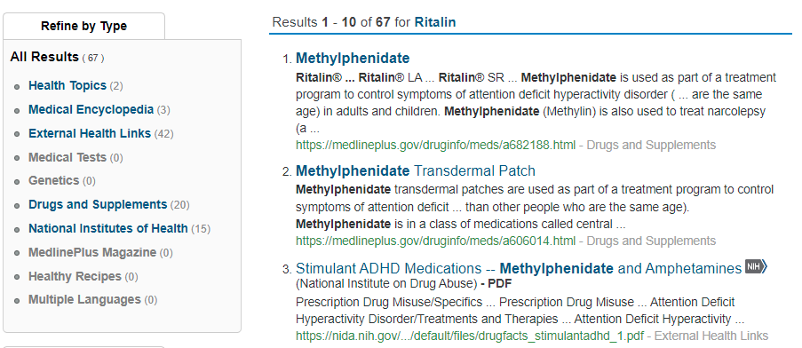
Ritalin Results
Notes:
Notice that the top result is for Methylphenidate. The drug database uses both brand and generic names for drugs. Methylphenidate is another term for Ritalin, which you can confirm in the “Brand Names” section of the drug page
Click on “Methylphenidate.”

Slide 21
Browsing
Example Question
My 80 year old mom is nauseous every morning. She doesn’t want to take any drugs for nausea. Could she drink ginger to help with that?
Drugs & Supplements
Herbs and Supplements
Notes:
As mentioned, another way to search for drugs and supplements is by browsing. This involves going to the Drugs & Supplements section of the website.
Click on Drugs & Supplements in the navigation menu or sidebar.
Notice all herbs and supplements are listed alphabetically and some include an NIH icon. An icon indicates that the link leads to an external website, like the National Center for Complementary and Integrative Health (NCCIH) or National Cancer Institute. If you don’t see an icon, the information is from the National Medicines Comprehensive Database consumer version
Go to “Drugs and Supplements” Topic Page
Click: All herbs and supplements
Click “G”
Click “Ginger”
Click on “What Have We Learned”

Slide 22
Exercises 3
I heard that Reishi Mushrooms are unsafe. Is there a particular form that is possibly unsafe?
extract or powder?
How effective is Green Tea at contributing to weight loss?
Very effective or Not effective
Notes:
Reishi mushroom powder (Correct)
Not effective (Correct)

Slide 23
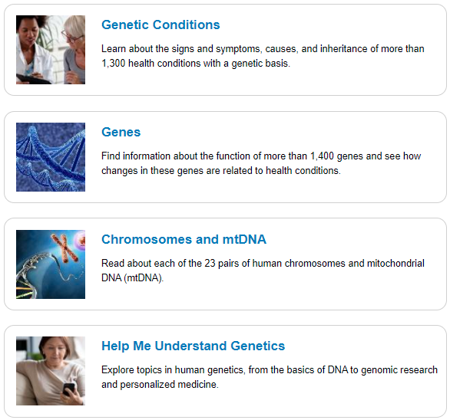
Genetics
Genetics
Genes
Chromosomes & mtDNA
Help Me Understand Genetics
Example Question
Can you tell me how many children are born with Down Syndrome each year in the United States?
Notes:
MedlinePlus Genetics contains four major sections.
The Genetic Conditions section allows you to browse alphabetically for signs, symptoms, cause, and more.
In the Genes section you can also browse gene information alphabetically.
Under Chromosomes and Mitochondrial DNA (mtDNA), you can browse for information by one of the 23 pairs of chromosomes or by Mitochondrial DNA.
The Help Me Understand Genetics area offers a basic explanation of how genes work and how mutations cause disorders, as well as current information about genetic testing, gene therapy, genetics research, and precision medicine.
Let’s look for more information about a genetic condition: Down syndrome.
Click on “Genetic Conditions.”
Browsing – Genetic Conditions
In the alphabetical list, click on the letter “D.”
Now, click on “Down syndrome.”
Genetic Conditions Page
On a genetic conditions page, you will see a detailed description of the condition. Further down the page is more detail about the frequency, causes, inheritance likelihood and other names of the genetic condition.
There are links to additional information and references.

Slide 24
Exercises 4
Which form of Color Vision Deficiency is the most common?
Blue-yellow
Red-green
Blue cone monochromacy
Which is NOT a health condition related to changes on Chromosome 1? (Hint: Chromosomes and mtDNA)
1p36 deletion syndrome
Neuroblastoma
Marfan syndrome
Notes:
Using either the MedlinePlus search box or the A–Z list on the Genetics Conditions page, go to the Color vision deficiency page
Red-green (correct)
Using the Chromosomes and mtDNA section, go to the Chromosome 1 page
Marfan syndrome (Correct)

Slide 25
Genetics: Key Points
2,800+ Topics
Genetics
Genetic Conditions
Genes & Chromosomes related to conditions
Help Me Understand Genetics
Notes:
MedlinePlus Genetics features more than 2,800 pages about genetics, genetic conditions, and the genes or chromosomes related to those conditions.
It also includes a Help Me Understand Genetics area that provides more fundamental information about the basics of genes, human genetics, genetic testing and therapy.
As genetic research continues, the MedlinePlus Genetics section will be regularly updated to reflect new discoveries and understanding.

Slide 26
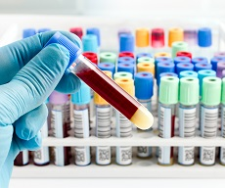
Medical Tests
150+ articles about medical tests
Example Question
Can you tell me what happens during an allergy skin test?

Slide 27
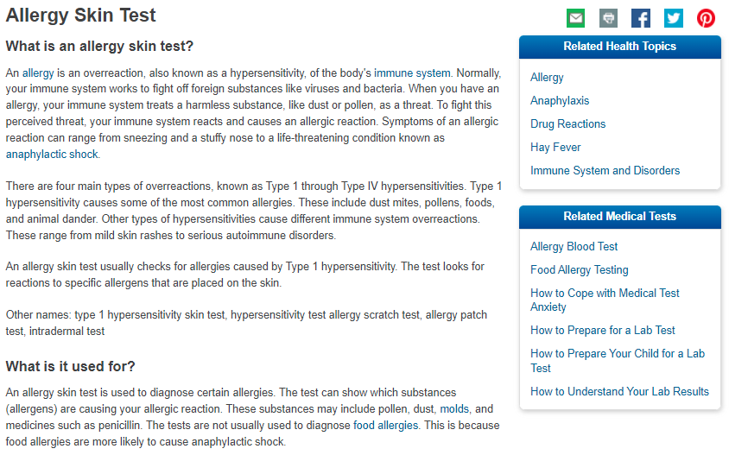
Medical Test Topic Page
Notes:
This is a Medical Test record page. Notice that it provides:
A summary of what the medical test is;
What it’s used for;
Why someone would need it;
What to expect during the test;
How to prepare for the test; and
Possible risks and results.
The record also includes links to related MedlinePlus health topics and other medical tests.

Slide 28
Exercise 5
Which of the following is not a result of a Stress Test?
Your current heart treatment is not working well.
Coronary artery disease is detected.
The electrocardiogram (EKG) machine records inaccurate results.
Notes:
The electrocardiogram (EKG) machine records inaccurate results. (Correct)
Demo Steps
Go to Medical Tests
Select “S”
Select “Stress Tests”
Go to “What do the results mean?”

Slide 29
Medical Test: Key Points
150+ Common Medical Tests
Information on the test
Why a doctor ordered it
What the results could mean
Notes:
MedlinePlus Genetics features more than 2,800 pages about genetics, genetic conditions, and the genes or chromosomes related to those conditions.
It also includes a Help Me Understand Genetics area that provides more fundamental information about the basics of genes, human genetics, genetic testing and therapy.
As genetic research continues, the MedlinePlus Genetics section will be regularly updated to reflect new discoveries and understanding.

Slide 30
Other Features
Medlineplus en Español
Medical Encyclopedia
Videos and Tools
Healthy Recipes
Notes:
Much of MedlinePlus is available in Spanish including the Medical Encyclopedia, Drugs database, Herbs and Supplements, Medical Tests, Videos and Multimedia and Healthy Recipes. You can toggle between the English and Spanish pages. On the
MedlinePlus licenses a Medical Encyclopedia from A.D.A.M.
More than 4,000 articles, videos and graphics are available in English and Spanish.
Watch health videos; check your health with interactive calculators and quizzes, and play health related games
Tutorials to understand medical words
Evaluate health information

Slide 31
Other Features 2
Notes:
If available, you can view a page in Spanish, by clicking the Español link at the top of the page on the right hand side.

Slide 32
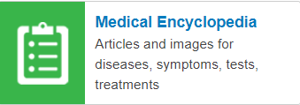
Medical Encyclopedia
4000 articles, videos and graphics
Example Question
I want to find out how to calculate BMI
Notes:
Type BMI in the search box and click go

Slide 33
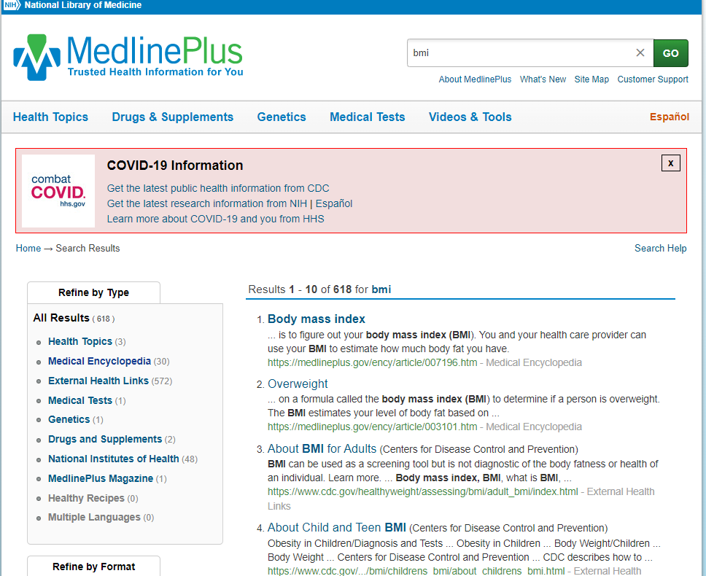
MedlinePlus Medical Encyclopedia
Notes:
Body Mass Index is at the top of the results. Look to the left in the refine by type box and click Medical Encyclopedia.
Click on Body Mass Index
You could have also clicked Medical Encyclopedia, go to the letter B and look for body mass index

Slide 34
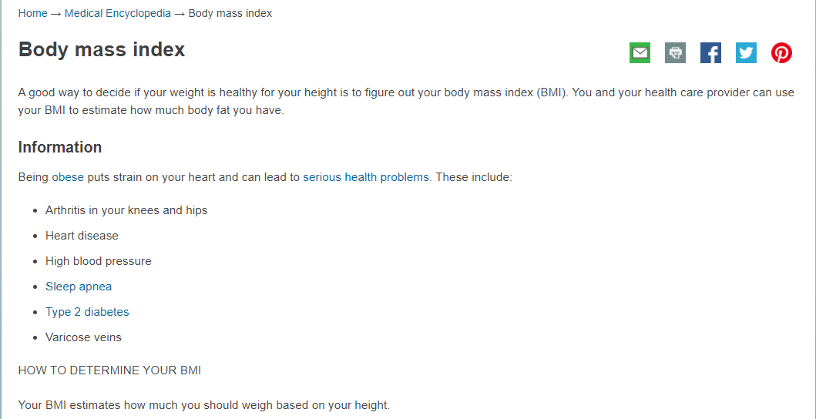
Body Mass Index
Notes:
This the medical encyclopedia page. It provides:
A brief overview or definition of the term
Additional information about the term
Click to keep reading section, expands and gives additional information and related to the term

Slide 35
Exercise 6
What is a healthy BMI?
Below 18.5
Between 18.5 and 24.9
Over 40
If you keep reading, what image is related to BMI?
Body frame size
Gastric bypass surgery
Notes:
Between 18.5 and 24.9(Correct)
Demo Steps
Search BMI in the search box or from medical encyclopedia listing (go to B and scroll down to body mass index)

Slide 36
Videos and Tools
Explore health information through video and play
Example Question
Do I have a pet allergy?
Notes:
Type pet allergy in the search box or go the health check tools and look for allergy
Find the pet allergy quiz to take

Slide 37
Healthy Recipes
Find recipes by type of meal or diet
Example Question
I am looking for recipes that support a dairy free lifestyle
Notes:
Click on the healthy recipes section on the left hand side of the main MedlinePlus
Scroll below to the dairy free section to review recipes under that category
Alternatively you can type dairy free into the search box and refine by type: healthy recipes

Slide 38
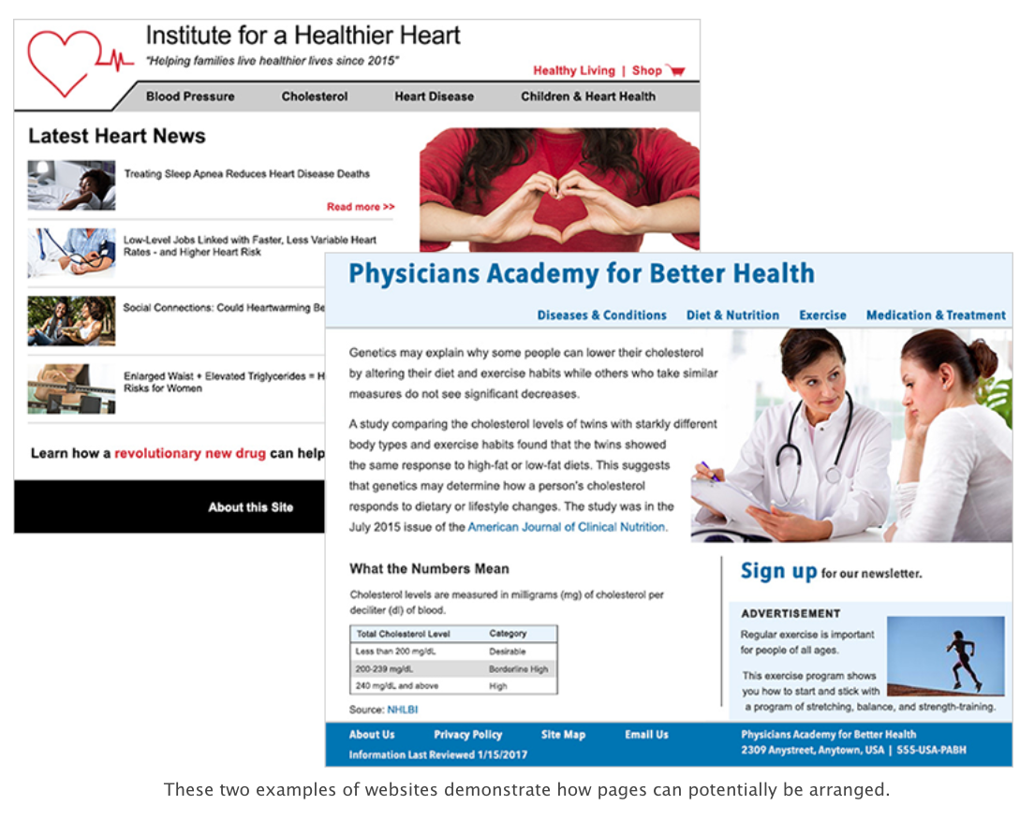
Evaluating Internet Health Information Checklist
www.nlm.nih.gov/medlineplus/webeval/webeval_start.htm
Notes:
For information found on the web, you may want to look at a tutorial developed by the National Library of Medicine on MedlinePlus. It can also be easily shared with users at your library. This tutorial teaches you how to evaluate the health information you find on the Internet and is divided into five sections. If you don’t want to have them do the tutorial on a computer, you also can download the tutorial and print it for them. There’s even a checklist available to evaluate online health information that users can use.
Checklist for Evaluation Internet Health Information

Slide 39
More Resources
Easy-to-Read Materials
Organizations and Directors
Health Information in Multiple Languages
Social Media
Weekly Newsletters
MedlinePlus Magazine
Notes:
Easy-to-read materials – which shows an alphabetical list of consumer health materials on a variety of topics, that is easier for people to read, understand, and use;
Organizations and directories of major health organizations – to help you find libraries, health professionals, services and facilities;
Health information in multiple languages – providing links to high-quality health information in languages in addition to English and Spanish;
Social media – linking to MedlinePlus’ Twitter and Facebook pages;
Weekly My MedlinePlus Newsletter – subscribing to My MedlinePlus newsletter features information on health and wellness, diseases and conditions, medical test information, drugs and supplements, and healthy recipes; and the
Quarterly NIH MedlinePlus Magazine – which provides updates on the latest breakthroughs from NIH-supported research, as well as health tips and wellness overviews vetted by NIH experts.

Slide 40
Connect with Region 1
nnlm@hshsl.umaryland.edu
@nnlmregion1
@nnlmregion1
https://news.nnlm.gov/region-one-insights/

Slide 41
Thank you
NNLM Region 1 Team
nnlm@hshsl.umaryland.edu
Notes:
We hope you enjoyed this presentation!

