Slide 1
How can I narrow down my search results?
Appraise

Slide 2
Discussion question
Besides study type, what are some other indicators that the evidence you’re looking at is up-to-date, relevant, and high quality?
Notes:
[NOTE TO FACILITATOR: If you are completing these modules in an order other than suggested in the facilitation guide, you may need to adjust these discussion points.]

Slide 3
Objectives
By the end of the program, participants will:
Discuss the use of filters and field tags in PubMed

Slide 4
What Do You Think?
If you were looking for the most up-to-date and high-quality information about smoking cessation in older adults, what are some categories in which you might want to limit your search results?
Notes:
Discussion question: If you were looking for the most up-to-date and high-quality information about smoking cessation in older adults, what are some categories in which you might want to limit your search results?
--------
Up-to-date: limit to last 5 years or 3 years (etc.)
High-quality: limit to systematic reviews or meta-analyses, maybe also RCTs
Older adults: age category 65+

Slide 5
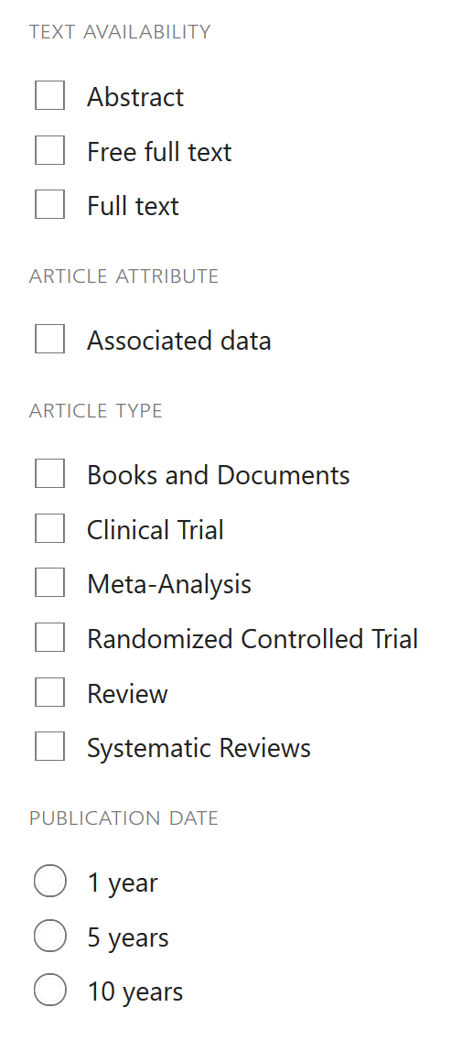
PubMed Filters
Easily narrow your search results
Located on the left side of search results page
Customizable
Notes:
PubMed offers a number of filter options to make narrowing your results quick and easy.
You can find these filtering options on the left side of your search results page. Here’s what they look like by default.
You can also customize these filters in a few ways.

Slide 6
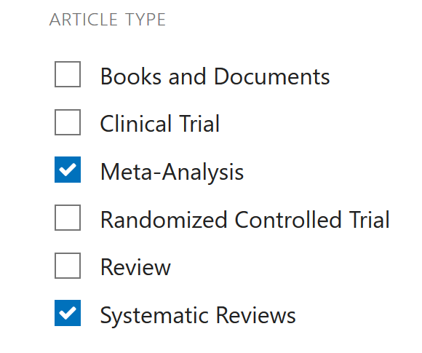
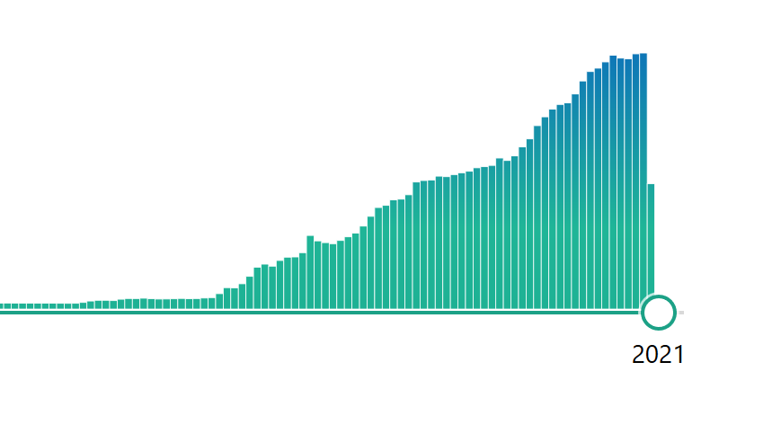
Date Range & Article Type
Results Indicator Timeline.
Notes:
If you don’t like the preset options of 5 and 10 years, you can adjust the results for the date range you’re interested in by using the results indicator timeline that you’ll see above the filters.
Another really useful customization you can make is to select what article types will show up on the Article Types filter menu. Just select your filters by clicking on them. This is a nice way to save time in searching for specific article types – for example, you can just search for systematic reviews and meta-analyses by using the respective filters.

Slide 7
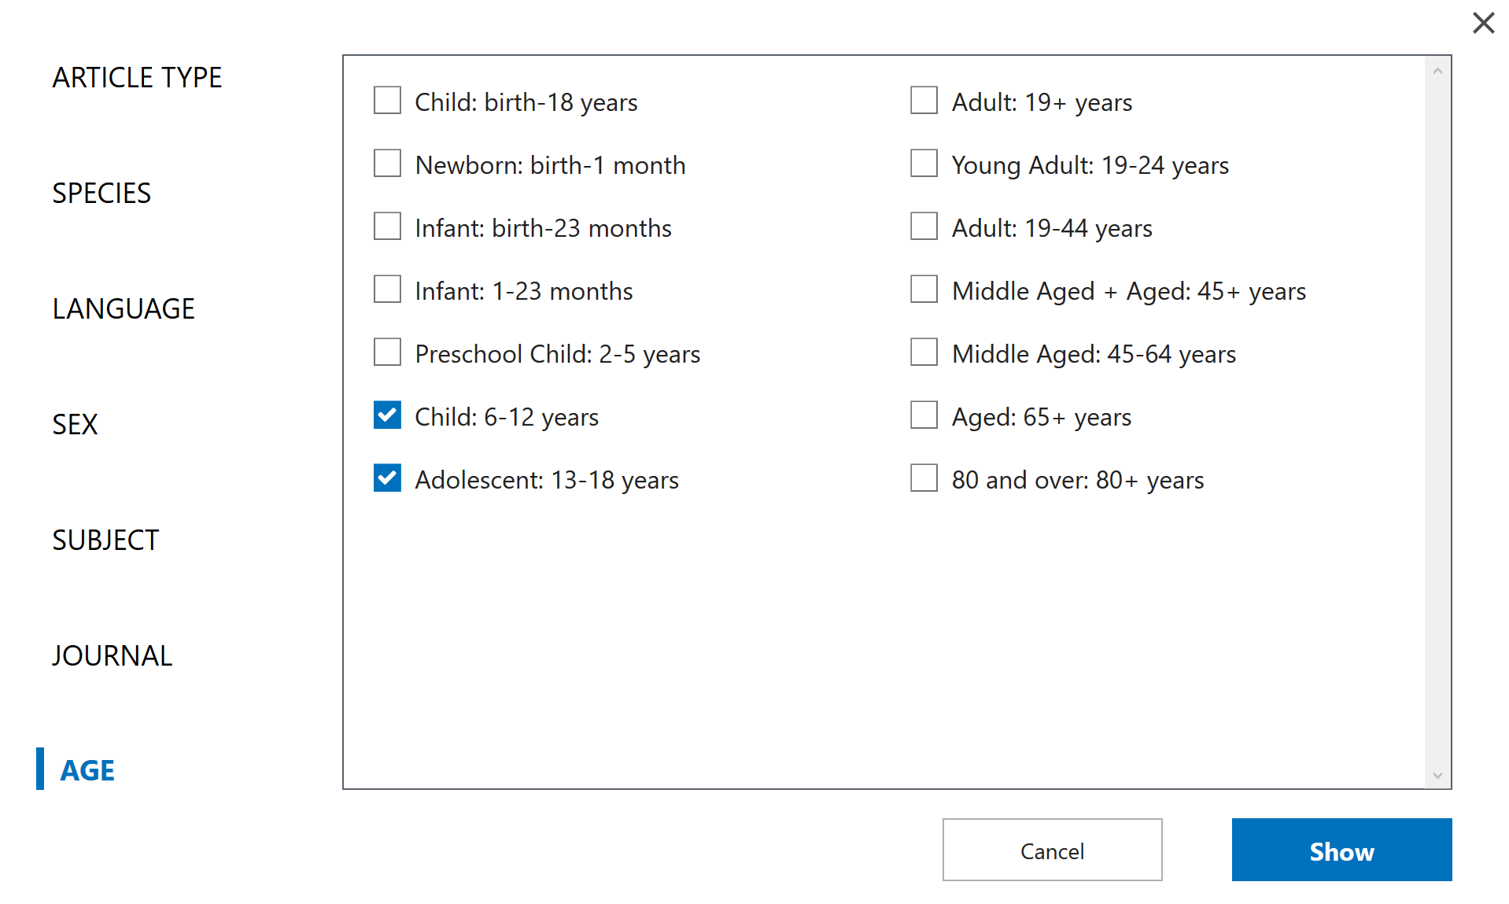
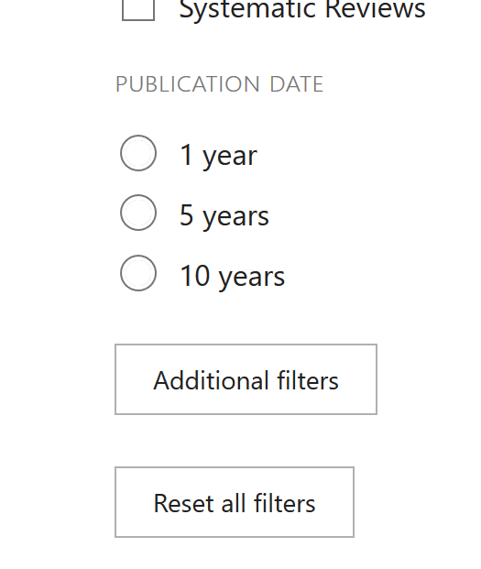
Other Filters
Notes:
Finally, you can also customize your entire filters list by clicking ‘show additional filters’ at the bottom. This allows you to select which filters you want to show up on your filter menu.
Here’s a look at the Ages filter, which you can find in the additional filters list. If you add it, you’ll see that you can customize this list just like you could customize the Article Types list.

Slide 8
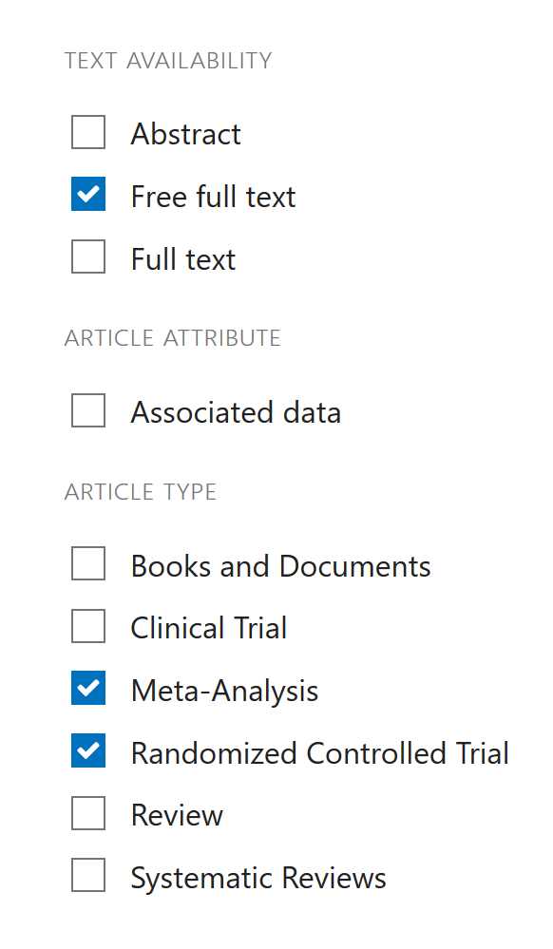
Important Note…
Any filters you apply will stay on when you do new searches unless you clear them!
Notes:
One important warning! If you find what you’re looking for and move on to another search, your active filters will remain active unless you clear them. You can click on individual active filters to deactivate only specific filters, click on ‘clear’ next to a filter category to clear all active filters in that category, or click on ‘clear all’ at the bottom of the filters list to deactivate all active filters.
If you don’t do this, you may end up narrowing the results of your next search more than you intended!

Slide 9
Field Tags
Filters limit your results after you search.
You can also use field tags to limit your results before you search.
Notes:
Whereas the filters we just learned about are used to narrow or refine your results after you’ve run a search, there’s also a way to make your search query more specific. If you know ahead of time that you only want certain types of articles or information, you can use what are called field tags.

Slide 10
What is a field?
Article records contain various descriptive fields – like filling out a form with “name,” “address,” “birth date” fields. The database searches in fields, not in the text of articles.
Searching the “author” field for a name will give you articles that have that name in the author field.
What is a field tag?
A word or abbreviation in square brackets directly after a search term: Smith[au] searches for “Smith” in the author field.
Notes:
When articles are indexed in PubMed, they are described using a variety of descriptive fields. When you’re filling out a form about yourself, you might fill in fields with your name, address, birth date, etc. If this information was entered into a database, the database could then be searched using these fields. That’s exactly how PubMed searches – it doesn’t search the text of an article, but rather the descriptive fields in article records. If you were to search the author field for an author’s name, your search results would contain articles that have that name in the author field.
To search specifically in the author field, you can use some simple syntax: a field tag, which is just a word or abbreviation referring to a certain field, in square brackets directly after the term you wish to search that field for. So, to search for articles authored by someone named Smith, type Smith[au].

Slide 11
Common Field Tags
[au] : author
[ti] : title
[ab] : abstract
[ot] : other term (author-supplied keywords)
[la] : language
URL to Full list
Notes:
Here are some common field tags:
[au] searches the author field
[ti] searches the title field, so the titles of articles
[ab] searches the text of the abstract
[ot] searches the “other term” field, which is usually populated by author-supplied keywords
[la] is for language, for instance if you only want to find English-language articles you can use this tag. You can also filter for English language after searching.
You can view the full list of field codes at this link.

Slide 12
Take home message
Consider:
In what types of situations do you think you would prefer to write a very specific search query that returns few results as opposed to writing a broader query that will return numerous results that you can then filter?
Remember:
Filters help you narrow your search after you’ve run it
Field tags help you make your search query more specific
Developed resources reported in this presentation are supported by the National Library of Medicine (NLM), National Institutes of Health (NIH) under cooperative agreement number UG4LM012342 with the University of Pittsburgh, Health Sciences Library System. The content is solely the responsibility of the authors and does not necessarily represent the official views of the National Institutes of Health.
Notes:
Today you learned how to use search filters to narrow your search results and how to use field tags to make your search query more specific.
In the time until our next session, think about what types of situations you might prefer to use each of these strategies to narrow your results. When would you prefer to write a very specific search query, perhaps using some field tags, that will return fewer results; as opposed to writing a less specific query that will return many results that you can then choose to filter?
[NOTE TO FACILITATOR: If you want to complete group discussion immediately following this module content, change the title of this slide to ‘Group Discussion’ and delete the slide with corresponding questions in the next module. If you would like to have discussion take place using your internal LMS system, you can include instructions here for how participants can participate. Then, adjust the slide with the corresponding questions in the next module as needed.]

